Slide 1

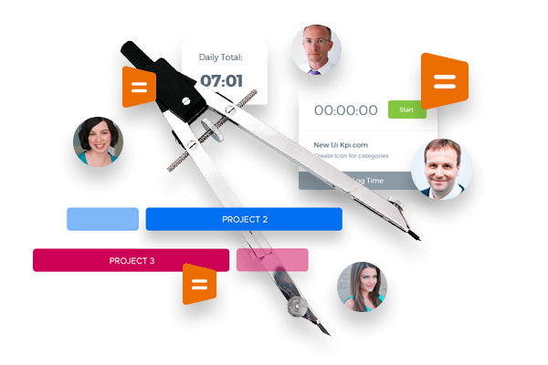
Kpi.com Project Management

Slide 2
kpi.com – Kpi.com Software Inc is a privately held London-based company found up by Muz Karabaev. Currently has an offshore operating base in Tashkent (Uzbekistan) Dubai, UAE – total headcount is 130+ people.
The company provides Software, Application, Design, Consultancy&Data and Digital Media products and services to its customer base since 2005. Major customers include Mindshare Mena, DMGT (Daily Mail Group), Asset International Inc, AIP Corp, etc.
In 2008, Kpi.com Software Inc started building its first product - SaaS app, and Launched in 2010 WorkforceTrack ERP beta product, which was later rebranded as kpi.com ERP, with the strap line – “Simply Manage Your Business” (Registered Trademark).
So far the company has over 500 active customers (about 400+ companies using kpi.com, total user base exceeds over 15,000 to date) and has core service only clients in Publishing and Digital, and web and mobile software sectors – mainly as offshoring and subcontracting services.

Slide 3
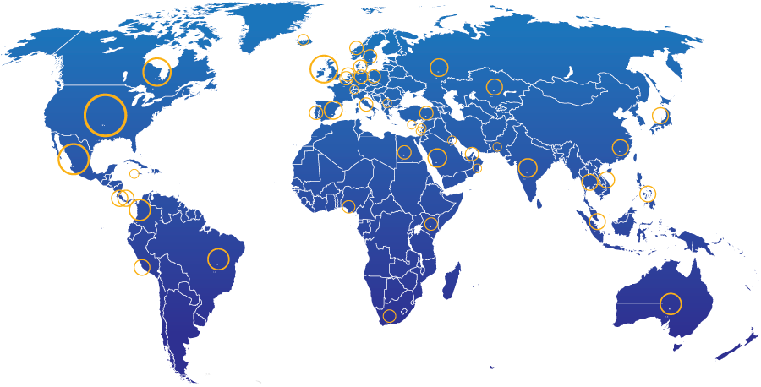
Introduction
Geographic spread of kpi.com end users
28%
North America
13% UK
20% Other parts of Europe
20% Middle East
4%
South America
2%
Africa
5% Australia
7% Rest of the World
400+ Companies, 15000+ User Base and Growing

Slide 4

















Kpi.com selected clients from UAE
4

Slide 5


Kpi.com Global Customers

Slide 6
Why kpi.com?
Cost Efficient: Eliminate on-premise IT-related costs (hardware, software, workforce, etc.)
All in One Accounting, HRM, Payroll, Project Management modules are seamlessly integrated to cut cycle times and reduce process errors
Integrations: Google and MicroSoft
Cloud: Access and process business transactions from anywhere through the internet and mobile applications
Global: Multi-subsidiary and multi-currency for growing businesses
Mobile: Mobile Apps availability
Support: Provides live, email, phone support
Scalable: pay as you grow, while
Updated: continuous upgrades to deliver new features and latest technological innovations
Adaptable: can be customized to meet customer-specific needs

Slide 7
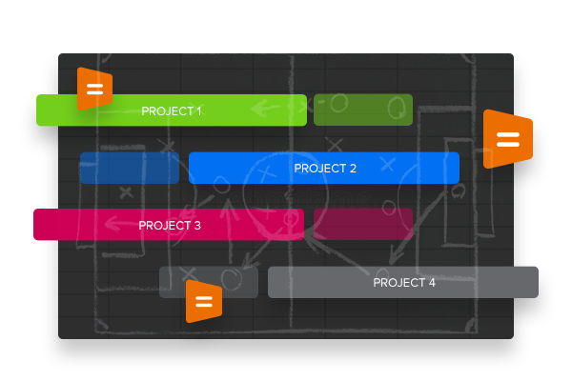
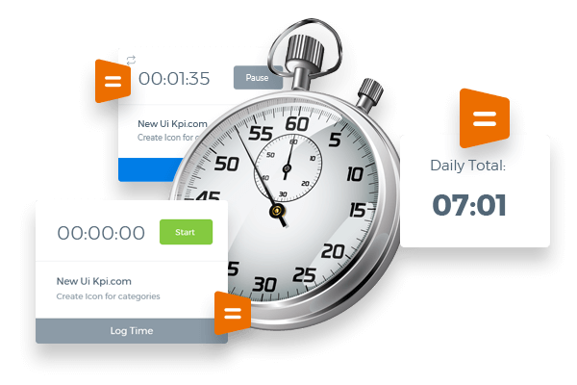
The Projects Module includes the following sections:
Tasks
Issues
Timesheet
Timesheet Approval
Customers
Employees
Departments
Resource Utilization

Slide 8
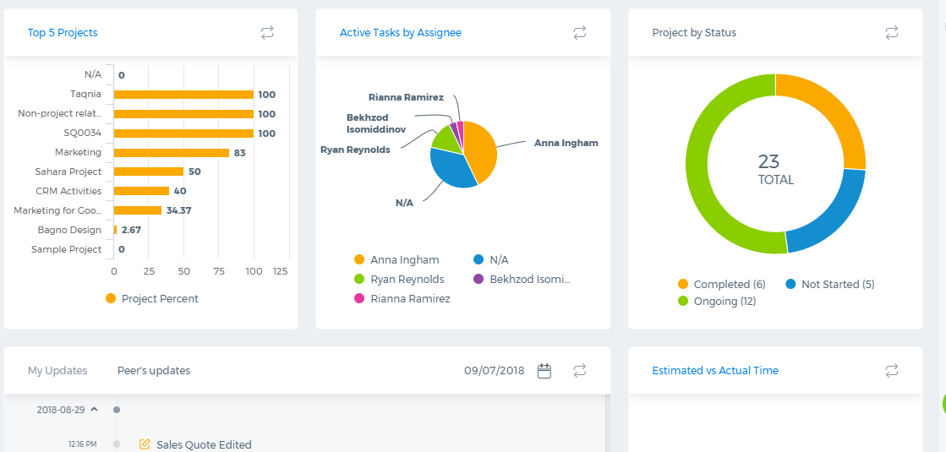
Projects Dashboard
Customizable Dashboards help to get the graphic representation of your custom reports for easy visualization and analysis of main patterns.

Slide 9
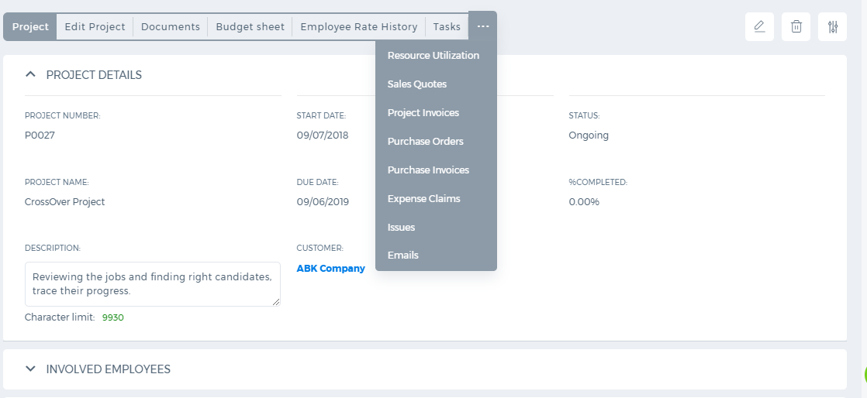
Projects
Project Budget
Project Documents
Employee Rate History
Resource Utilization
Project Templates
Employee Involvement

Slide 10
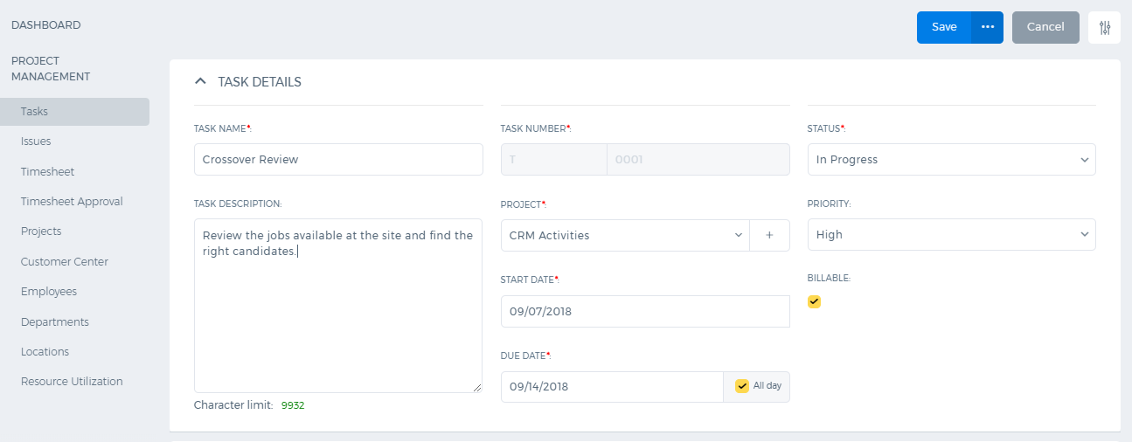
Task Management
Billable Tasks
Predecessor/Successor Tasks
Workstreams
Task Reminders
Task Assignment
Links/Attachments/Notes

Slide 11
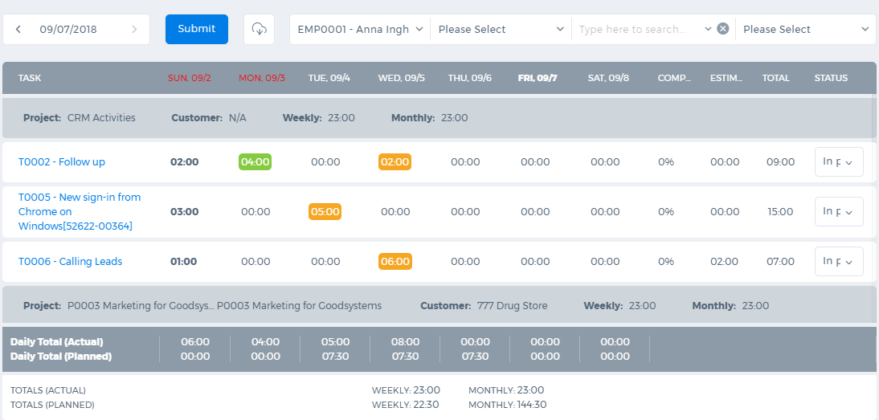
Timesheet
Timer
Time Entries
Submit for Approval
Custom Timesheet Report
Import/Expor Time
Filter

Slide 12
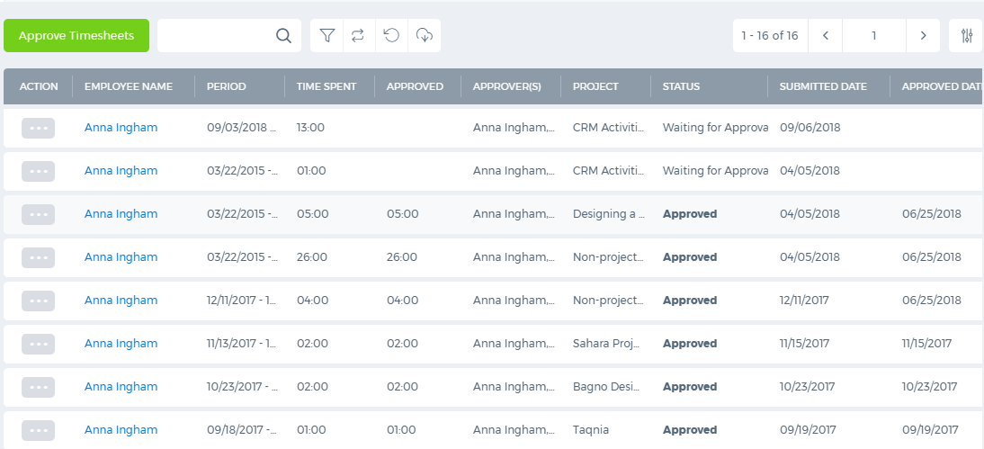
Timesheet Approval
Bulk Approval
Filter Options
Show Completed Projects
Review Approved Hours
Export Options
Comments

Slide 13
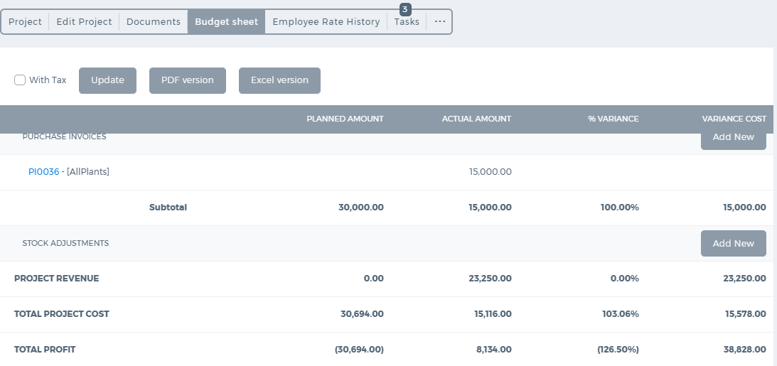
Project Budget
Planned vs Actual
Employee Expenses
Project Revenue
Project Costs
Total Profit
Difference in Percentages
Export options

Slide 14
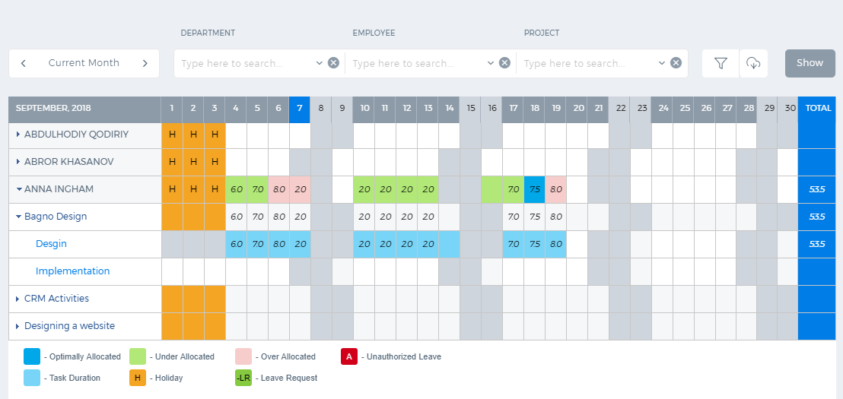
Resource Utilization
Easy Review of Resource Allocation
Colored Highlights for Allocation
Filter Options
Export Options
Comparison with Timeslot and Timesheet
Enter/Edit Estimated Time

Slide 15


