Slide 1

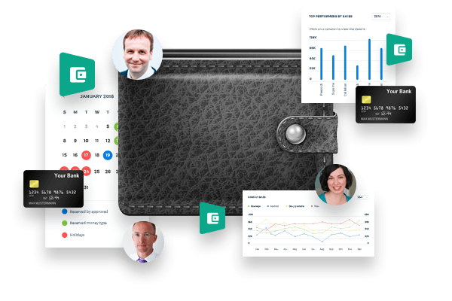
Kpi.com Payroll

Slide 2
kpi.com – Kpi.com Software Inc is a privately held London-based company found up by Muz Karabaev. Currently has an offshore operating base in Tashkent (Uzbekistan) Dubai, UAE – total headcount is 130+ people.
The company provides Software, Application, Design, Consultancy&Data and Digital Media products and services to its customer base since 2005. Major customers include Mindshare Mena, DMGT (Daily Mail Group), Asset International Inc, AIP Corp, etc.
In 2008, Kpi.com Software Inc started building its first product - SaaS app, and Launched in 2010 WorkforceTrack ERP beta product, which was later rebranded as kpi.com ERP, with the strap line – “Simply Manage Your Business” (Registered Trademark).
So far the company has over 500 active customers (about 400+ companies using kpi.com, total user base exceeds over 15,000 to date) and has core service only clients in Publishing and Digital, and web and mobile software sectors – mainly as offshoring and subcontracting services.

Slide 3
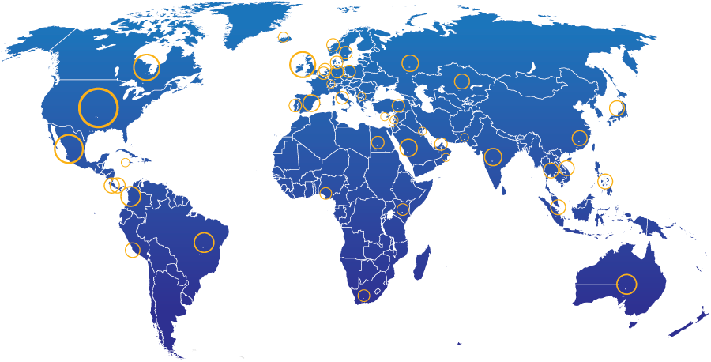
Introduction
Geographic spread of kpi.com end users
28%
North America
13% UK
20% Other parts of Europe
20% Middle East
4%
South America
2%
Africa
5% Australia
7% Rest of the World
400+ Companies, 15000+ User Base and Growing

Slide 4

















Kpi.com selected clients from UAE
4

Slide 5


Kpi.com Global Customers

Slide 6
Why kpi.com?
Cost Efficient: Eliminate on-premise IT-related costs (hardware, software, workforce, etc.)
All in One Accounting, HRM, Payroll, Project Management modules are seamlessly integrated to cut cycle times and reduce process errors
Integrations: Google and MicroSoft
Cloud: Access and process business transactions from anywhere through the internet and mobile applications
Global: Multi-subsidiary and multi-currency for growing businesses
Mobile: Mobile Apps availability
Support: Provides live, email, phone support
Scalable: pay as you grow, while
Updated: continuous upgrades to deliver new features and latest technological innovations
Adaptable: can be customized to meet customer-specific needs

Slide 7
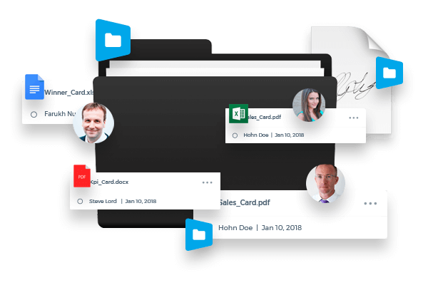

The Payroll Module includes the following sections:
Employees
Single Payruns
Group Payruns
Cash Advance
End of Service Gratuity
Reports
Additional Payments
Single Payment

Slide 8
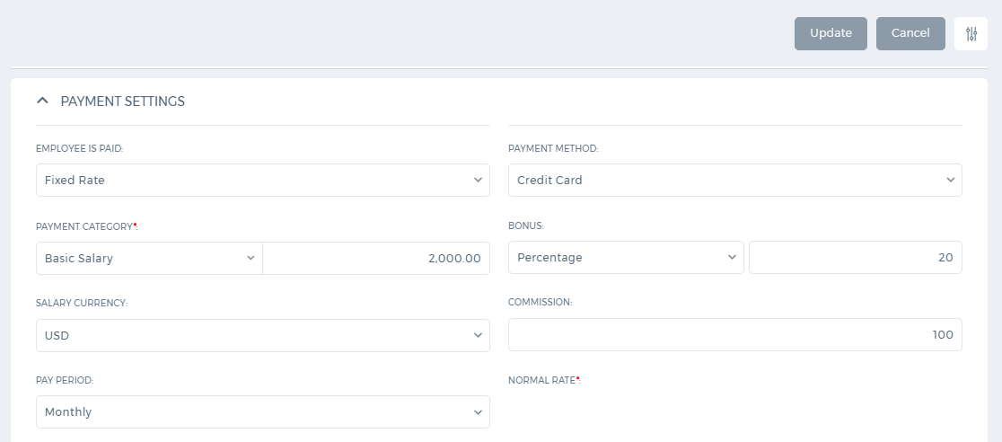
Employees
Employee Details
Payment Settings
Payroll Settings
Payments and Deductions
Overtime Settings

Slide 9
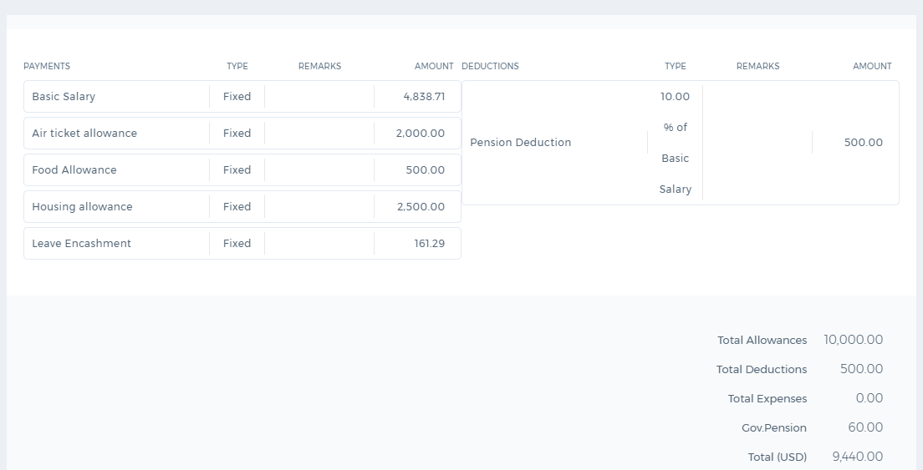
Single Payrun
Custom PDF Templates
Multiple Currencies
Custom Fields
Approval Process
Employee Expenses
Payments/Deductions

Slide 10
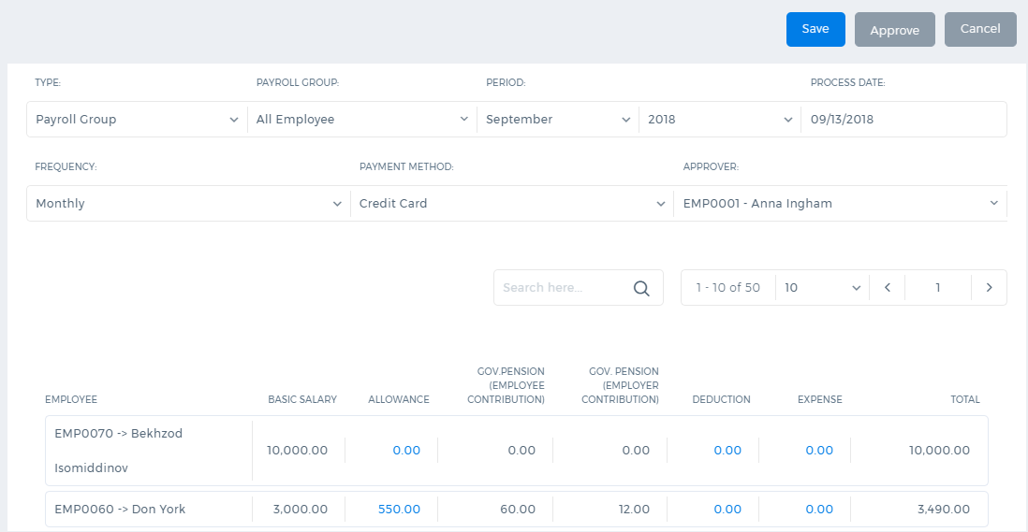
Group Payrun
Approval Process
Employee Groups
Project Payroll
Custom Templates
Pension Contribution
Pension Contribution
Basic Salary/Allowances

Slide 11
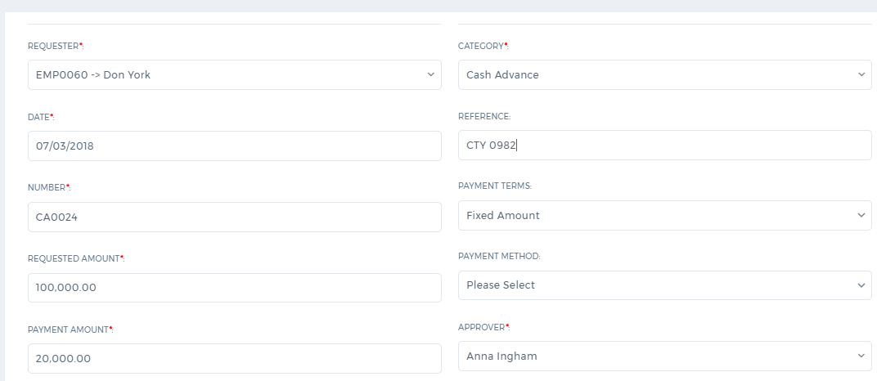
Cash Advances
Pay back period
Payment amount
Approval Process
Multiple Currency
Loans
Terms

Slide 12
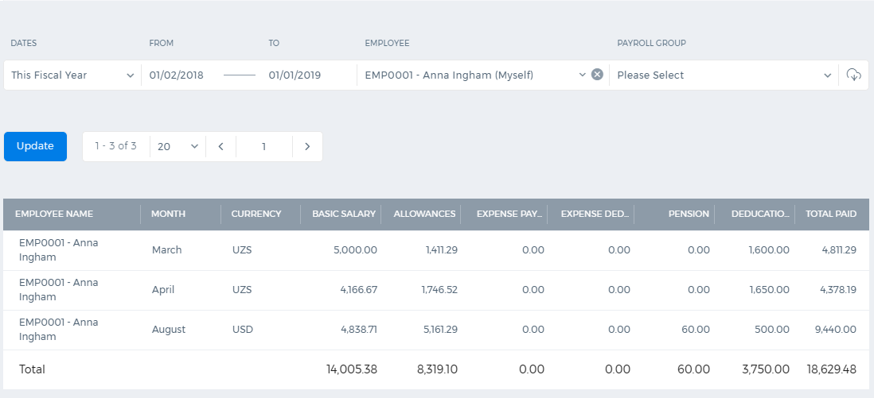
Payroll Reports
WPS Report
End of Service
Pension Contribution
Cash Advance/Loan
Salary Report

Slide 13


