Slide 1

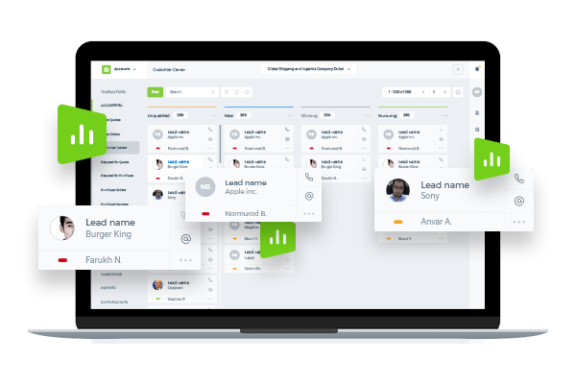
Cloud HR Solution

Slide 2
kpi.com - KPI Software Inc - is a privately held London-based company found up by Muz Karabaev. Currently has an offshore operating base in Tashkent (Uzbekistan) Dubai, UAE – total headcount is 130+ people.
The company provides Software, Application, Design, Consultancy&Data and Digital Media products and services to its customer base since 2005. Major customers include Mindshare Mena, DMGT (Daily Mail Group), Asset International Inc, AIP Corp, etc.
In 2008, Kpi.com Software Inc started building its first product - SaaS app, and Launched in 2010 WorkforceTrack ERP beta product, which was later rebranded as kpi.com ERP, with the strap line – “Simply Manage Your Business” (Registered Trademark).
So far the company has over 500 active customers (about 400+ companies using kpi.com, total user base exceeds over 15,000 to date) and has core service only clients in Publishing and Digital, and web and mobile software sectors – mainly as offshoring and subcontracting services.

Slide 3
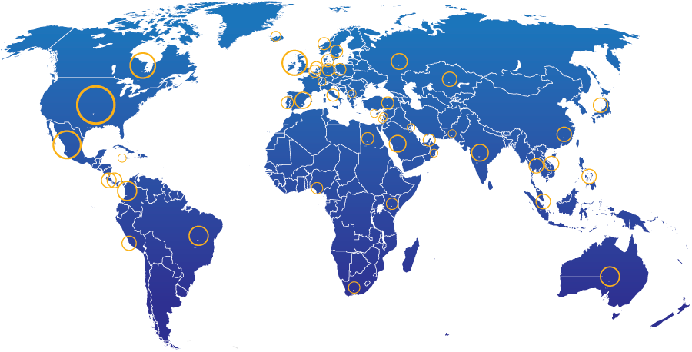
Geographic spread of kpi.com end users
28%
North America
13%
UK
21% Other parts of Europe
20%
Middle East
4%
South America
2%
Africa
5%
Australia
7% Rest of the world
400+ Companies, 15000+ User Base and Growing

Slide 4

















KPI.com: UAE Selected Clients
4

Slide 5


KPI.com: Global Clients

Slide 6
Why kpi.com?
Cost Efficient: Eliminate on-premise IT-related costs (hardware, software, workforce, etc.)
All in One Accounting, HRM, Payroll, Project Management & E-commerce modules are seamlessly integrated to cut cycle times and reduce process errors
Integrations: Google and MicroSoft
Cloud: Access and process business transactions from anywhere through the internet and mobile applications
Global: Multi-subsidiary and multi-currency for growing businesses
Mobile: Mobile Apps availability
Support: Provides live, email, phone support
Scalable: pay as you grow, while
Updated: continuous upgrades to deliver new features and latest technological innovations
Adaptable: can be customized to meet customer-specific needs

Slide 7
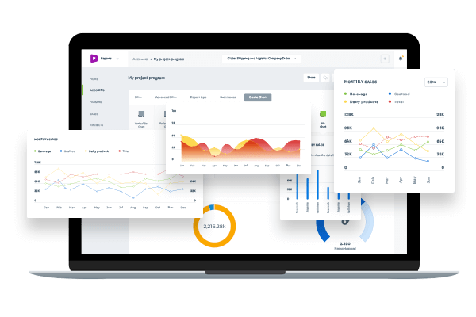
HR Management module

Slide 8
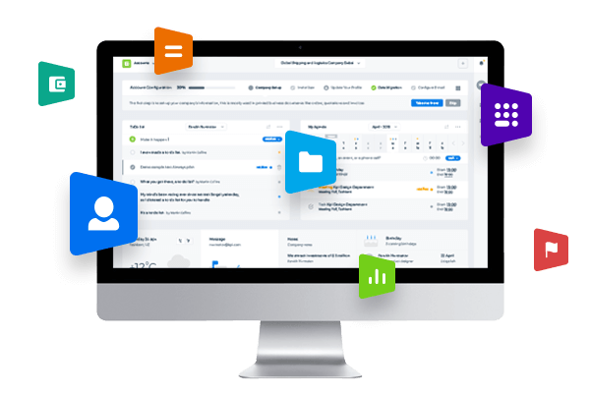
HR module includes such features as:
HR Dashboards
Manage employees and their profiles
ESS – Employee Self Service feature
Manage goals
Employee attendance tracking
Recruitment process
Manage documents
Generate Reports

Slide 9
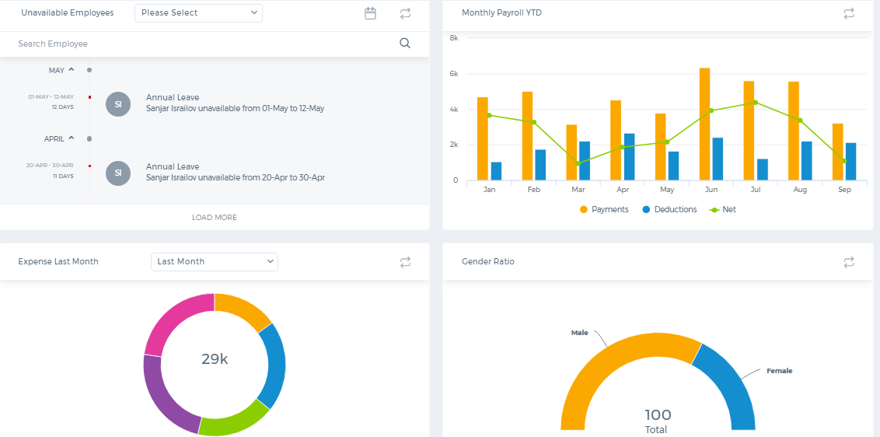
HR Dashboards
Customizable HR dashboards can help you to see the HR performance related figures and keep track of the overall progress within the HR process

Slide 10
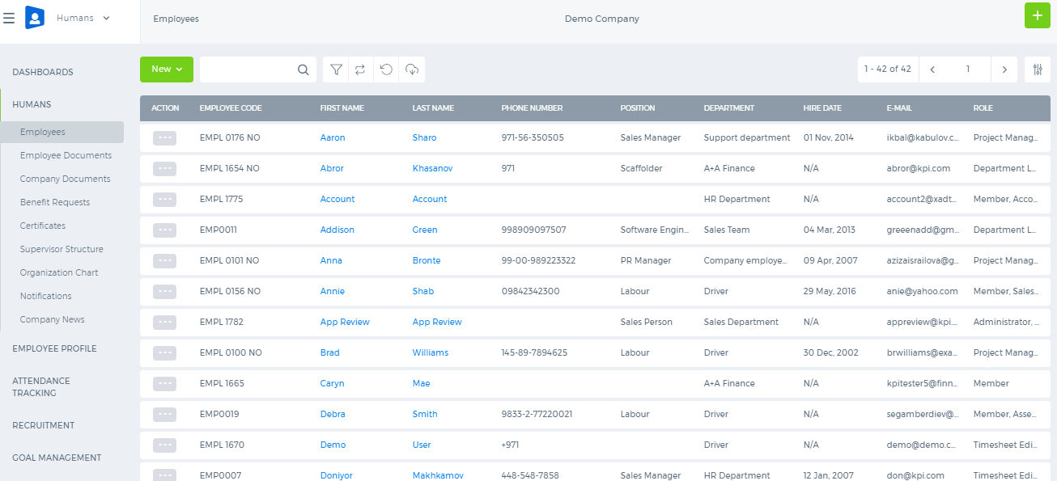
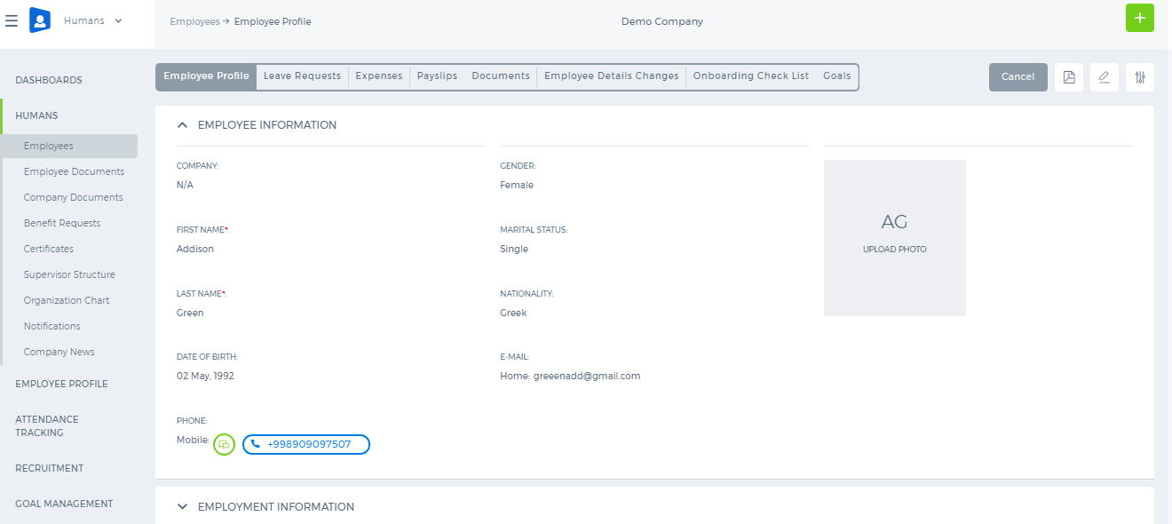
HR Employee Management
In the main employees section, you can manage the list of all your employees with their data and view each employees information from their profile page

Slide 11
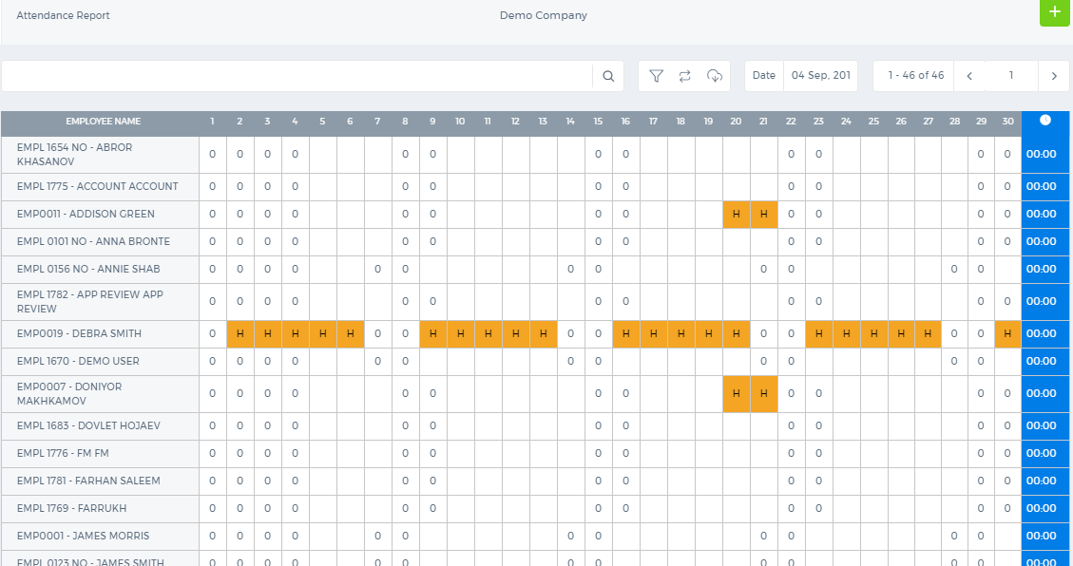
HR Attendance Tracking
Manage your employees attendance, keep track of what time they come and leave the work, see the holidays or leave requests within a month.

Slide 12
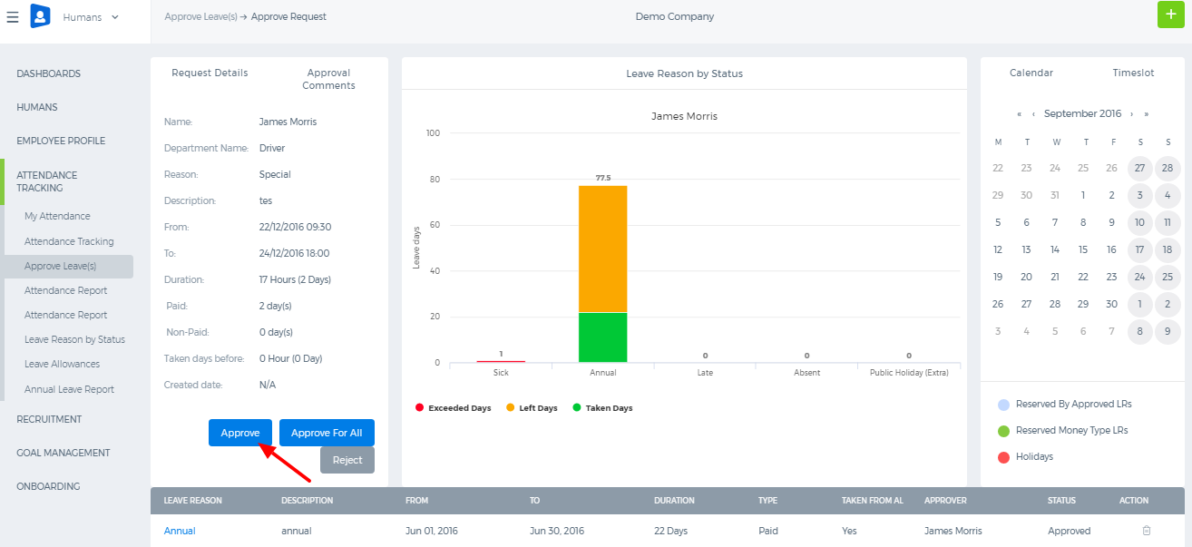
HR Leave Management
You can also manage your employees leave requests by reviewing their submitted leave requests on various reasons

Slide 13
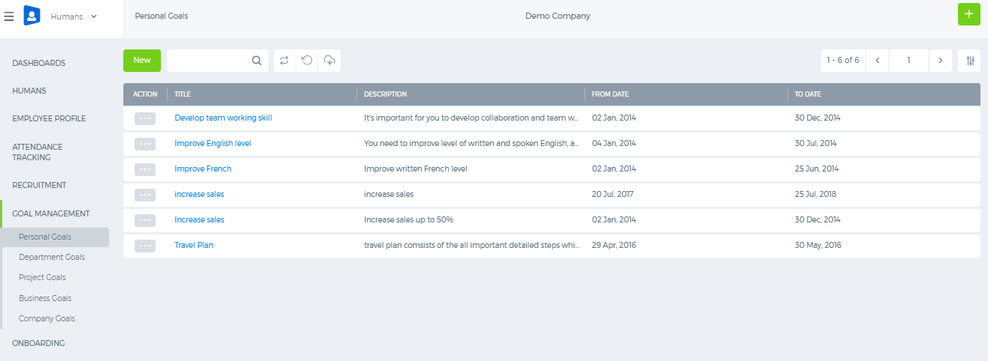
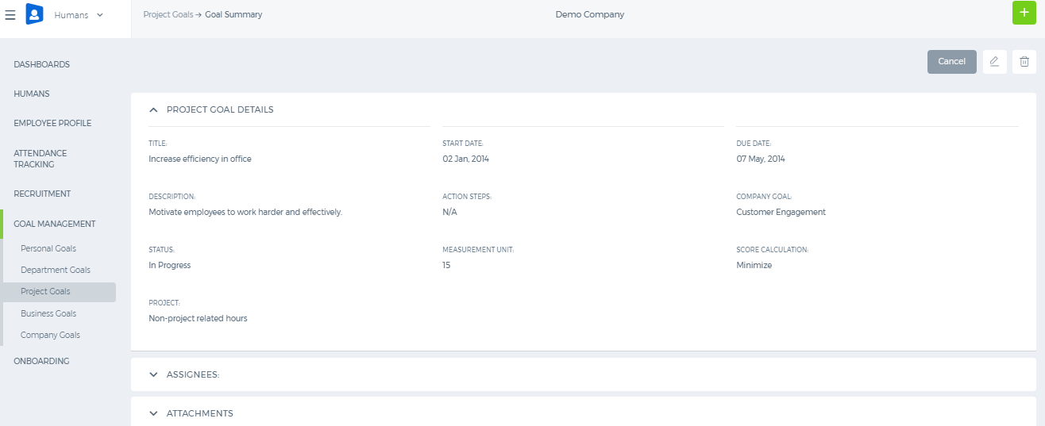
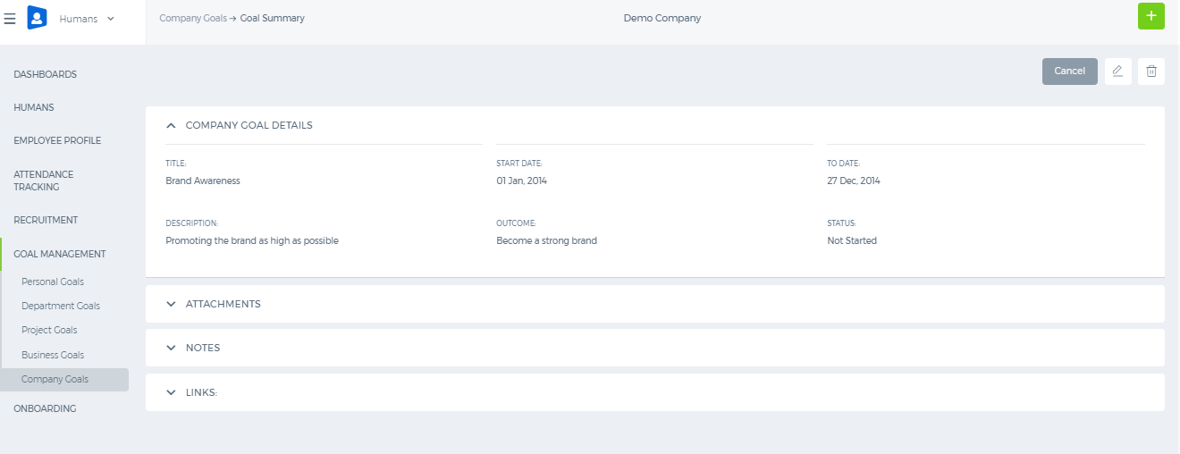
HR Goal Management
Set up personal, department, project, business and company goals that need to be reached at the end of specific period and review the performance of the team based on these results

Slide 14

HR Recruitment
Easily manage the hiring process through Recruitment section
You can post your vacancies through your website
Manage candidates, upload via site or manually
The system allows users to add activities related to candidates, for example, register interviews, make calls, send emails
Track all documents related to the candidate
Match the vacancies for the respective candidates
Shortlist the candidates upon the interview results
Manage the placements when candidate is offered a job

Slide 15
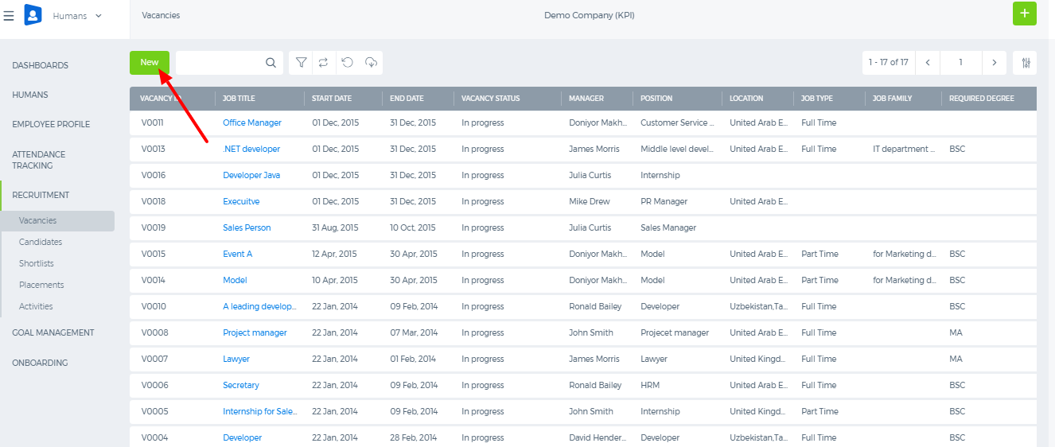
HR Recruitment: Vacancies
Add your vacancies and manage all your vacancy positions in the listing page

Slide 16
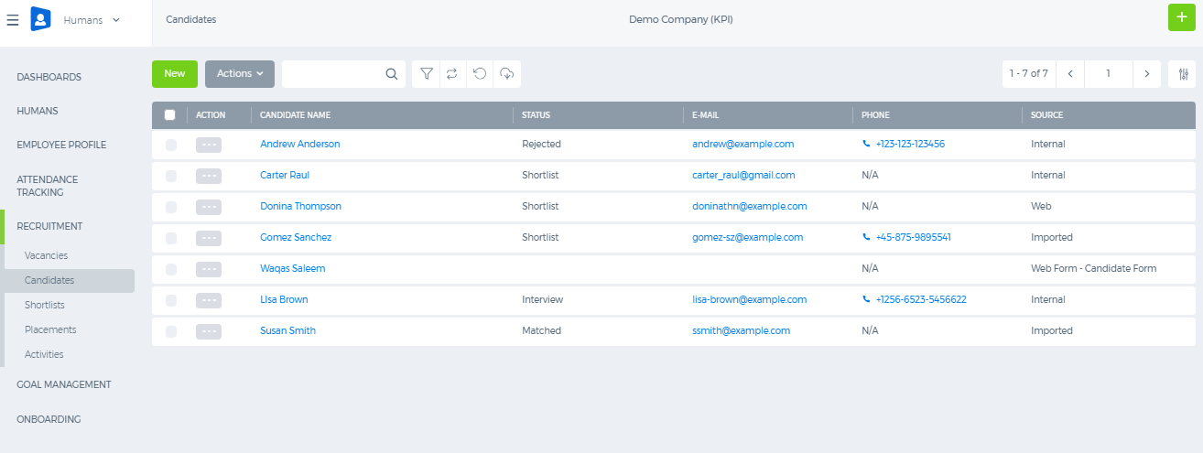
HR Recruitment : Candidates
Add your candidates and keep track of their status within the candidates page

Slide 17
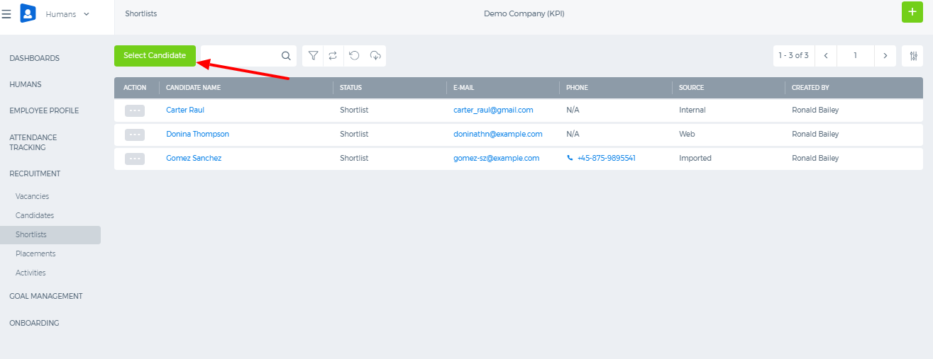
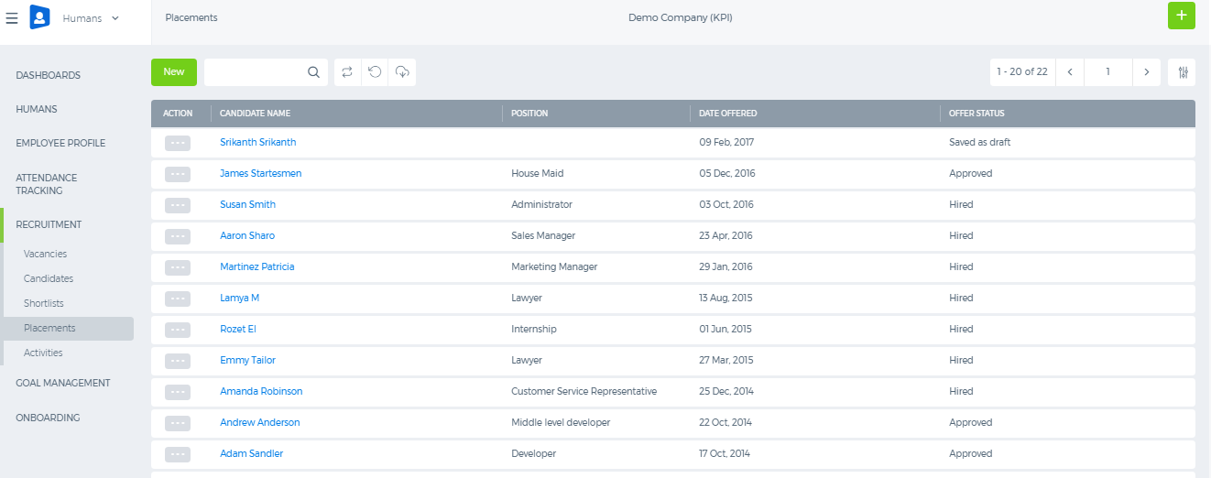
HR Recruitment : Candidates
Select and shortlist the candidates based on interview results and manage placements of candidates

Slide 18


