Slide 1

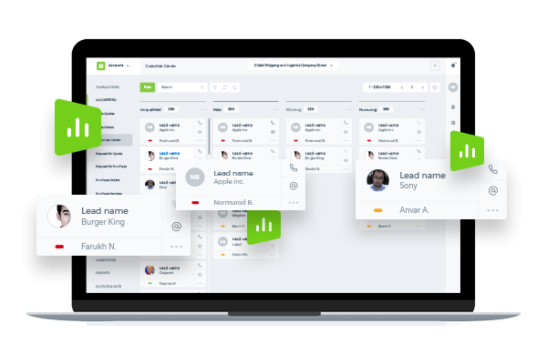
Cloud CRM Solution

Slide 2
kpi.com - KPI Software Inc - is a privately held London-based company found up by Muz Karabaev. Currently has an offshore operating base in Tashkent (Uzbekistan) Dubai, UAE – total headcount is 130+ people.
The company provides Software, Application, Design, Consultancy&Data and Digital Media products and services to its customer base since 2005. Major customers include Mindshare Mena, DMGT (Daily Mail Group), Asset International Inc, AIP Corp, etc.
In 2008, Kpi.com Software Inc started building its first product - SaaS app, and Launched in 2010 WorkforceTrack ERP beta product, which was later rebranded as kpi.com ERP, with the strap line – “Simply Manage Your Business” (Registered Trademark).
So far the company has over 500 active customers (about 400+ companies using kpi.com, total user base exceeds over 15,000 to date) and has core service only clients in Publishing and Digital, and web and mobile software sectors – mainly as offshoring and subcontracting services.

Slide 3
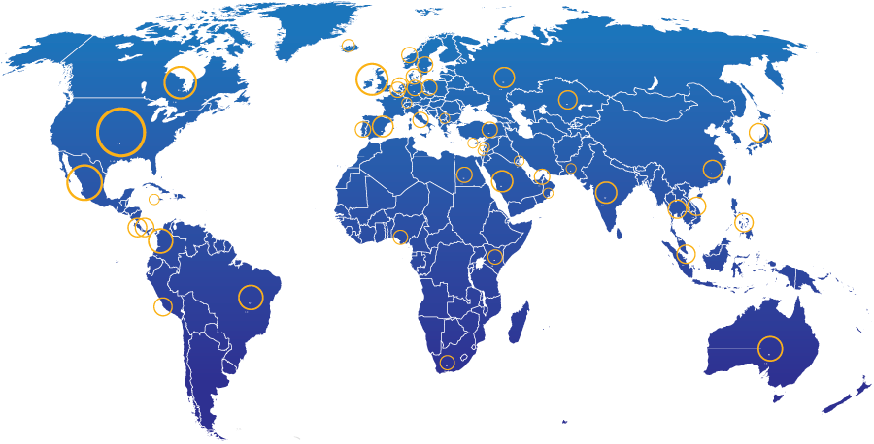
Geographic spread of kpi.com end users
28%
North America
13%
UK
21% Other parts of Europe
20%
Middle East
4%
South America
2%
Africa
5%
Australia
7% Rest of the world
400+ Companies, 15000+ User Base and Growing

Slide 4

















KPI.com: UAE Selected Clients
4

Slide 5


KPI.com: Global Clients

Slide 6
Why kpi.com?
Cost Efficient: Eliminate on-premise IT-related costs (hardware, software, workforce, etc.)
All in One Accounting, HRM, Payroll, Project Management & E-commerce modules are seamlessly integrated to cut cycle times and reduce process errors
Integrations: Google and MicroSoft
Cloud: Access and process business transactions from anywhere through the internet and mobile applications
Global: Multi-subsidiary and multi-currency for growing businesses
Mobile: Mobile Apps availability
Support: Provides live, email, phone support
Scalable: pay as you grow, while
Updated: continuous upgrades to deliver new features and latest technological innovations
Adaptable: can be customized to meet customer-specific needs

Slide 7
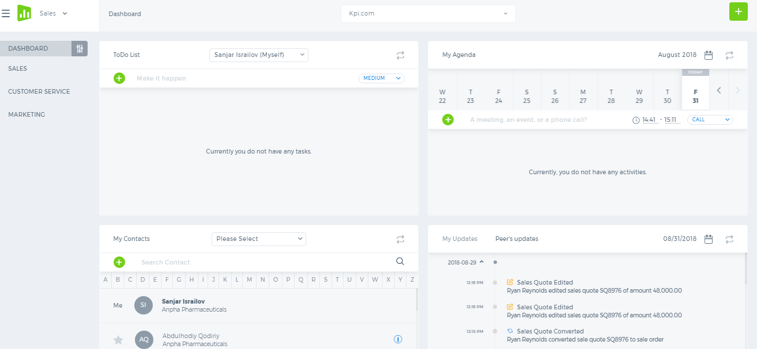
CRM
kpi.com CRM provides a complex solution for managing sales, marketing and customer service processes. Convert your leads into prospects, close deals, promote brand awareness using mass mailing tool and resolve your client issues using case management.

Slide 8
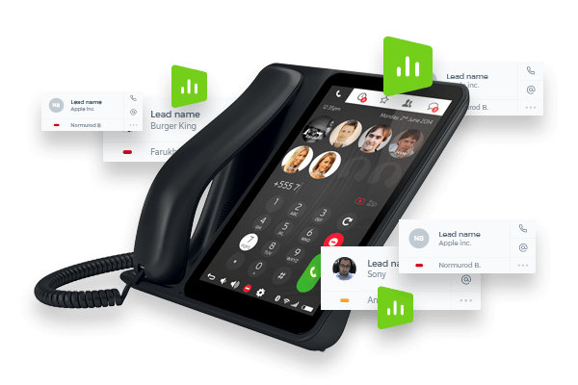
Kpi.com CRM solution includes the features:
Lead, Opportunity , Clients Management
Customizable CRM Dashboards
Case Management
Message Center – Integration with your email accounts
Google Calendar
Web Forms
Email Marketing

Slide 9
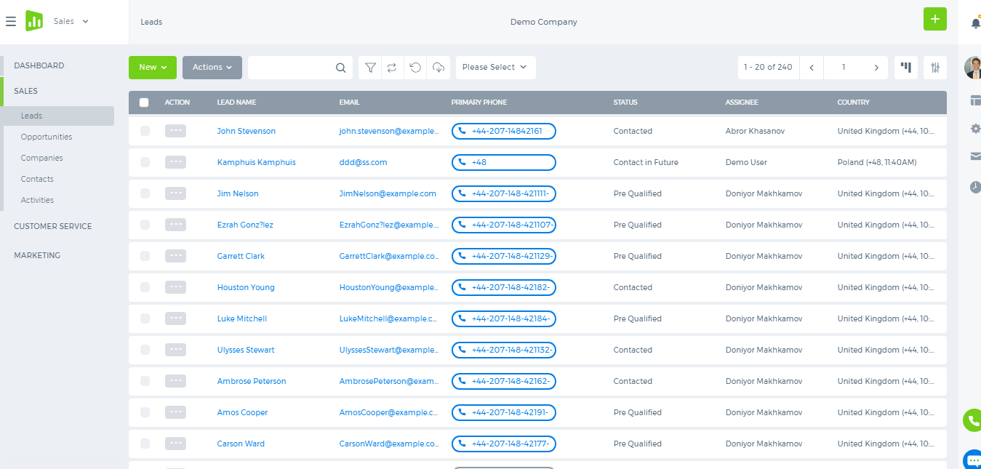
Lead Management
Manage your leads from the main lead listing, keep track of their statuses, add assignees and use actions to delete, edit or view specific leads.

Slide 10
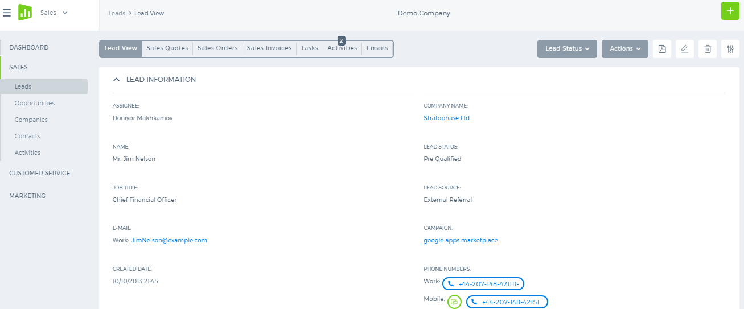
Lead View
View the lead information, change the lead status, generate sales quote proposal, add tasks and activities from the lead view form.

Slide 11
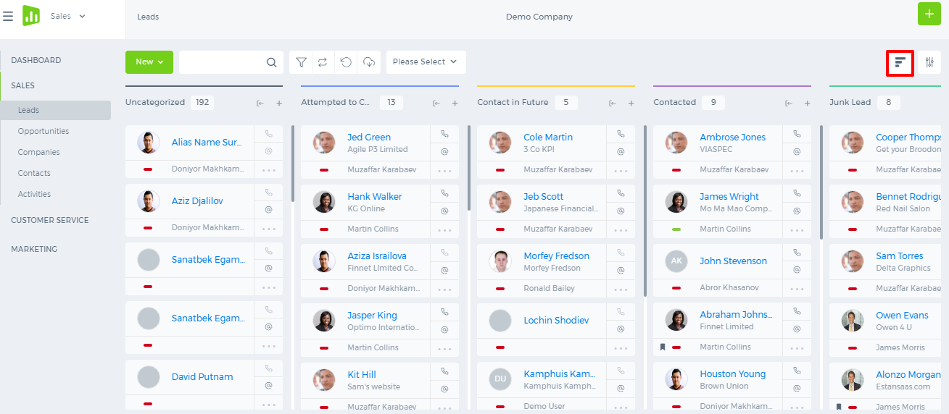
Kanban View
See your leads in a Kanban View with categorized columns, move the lead from one category into another by dragging and dropping, change the lead orders, email or call the leads directly from this view.

Slide 12
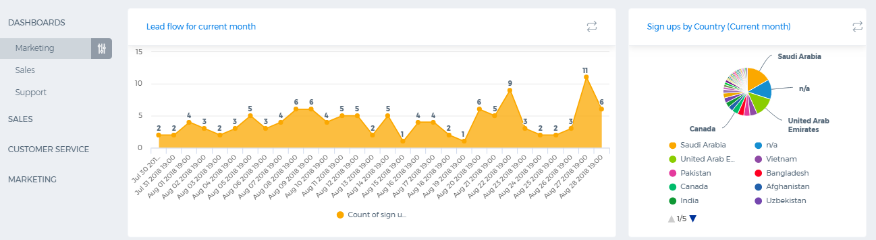
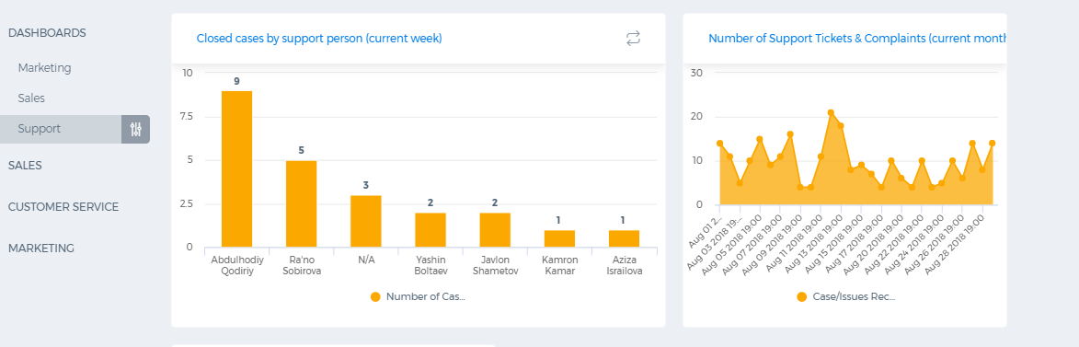
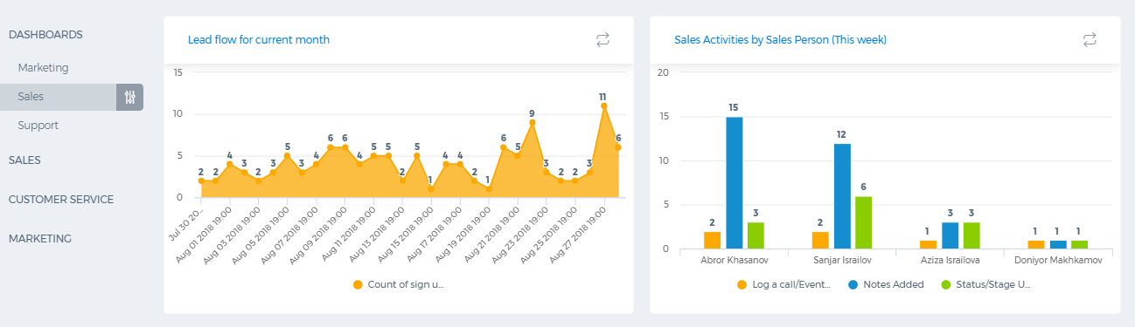
Sales, Marketing and Support Dashboards

Slide 13

Case Management
Manage your client cases
Assign employees to work on customers cases
Keep track of case progress
Resolve the client issues
Notify your customers once their issue is fixed

Slide 14
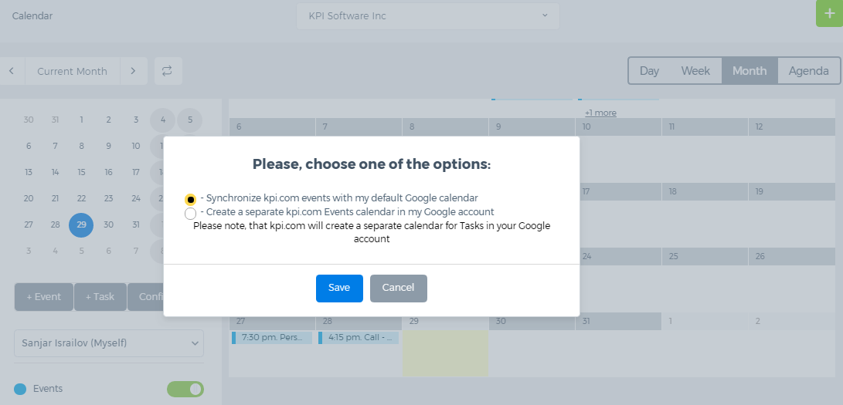
Google Calendar
Integrate your kpi.com calendar with Google Calendar
Synchronize your kpi.com events and tasks with Google Calendar

Slide 15
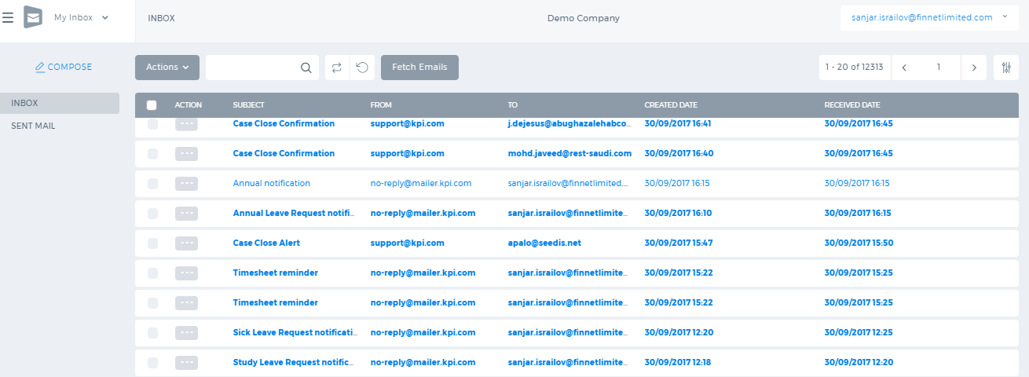
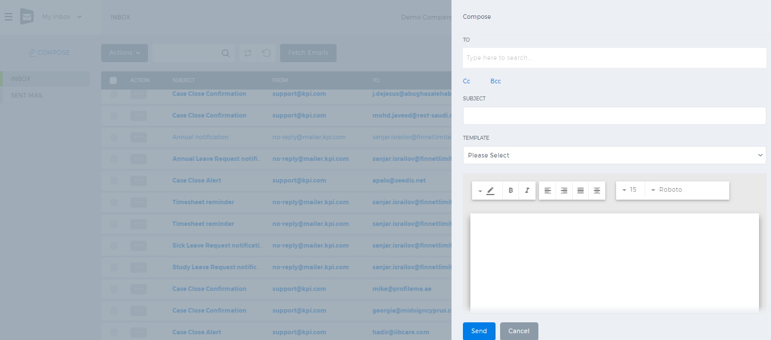
Message Center
Integrate your Gmail, Yahoo or other email accounts with kpi.com
Configure your email account and manage all your emails in the system
Fetch your emails from your email service
Send any kind of emails or notifications directly from the system

Slide 16
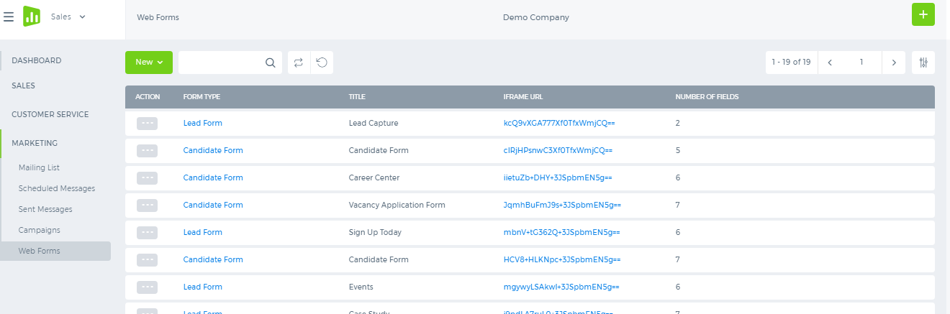
Web Forms
Create your customized web forms in the system and embed them into your website

Slide 17
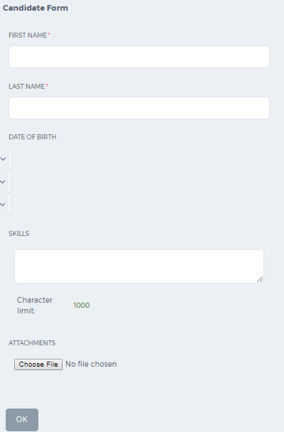
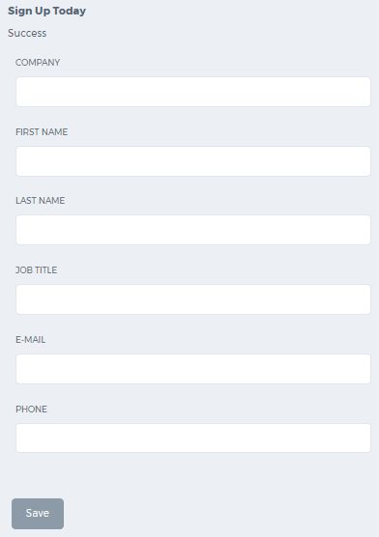
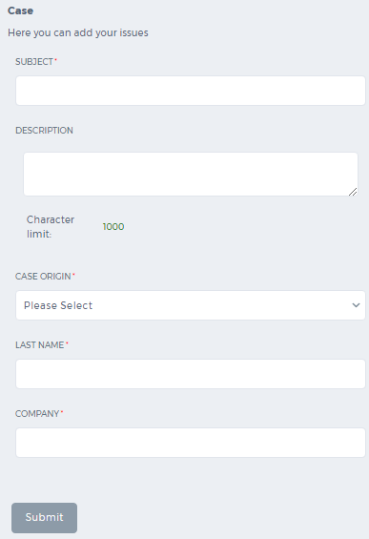
Candidate , Case and Lead Forms
Whenever the customers fill out the form and submit them, the submitted details will be created in the system under respective sections such as lead, case or candidate

Slide 18
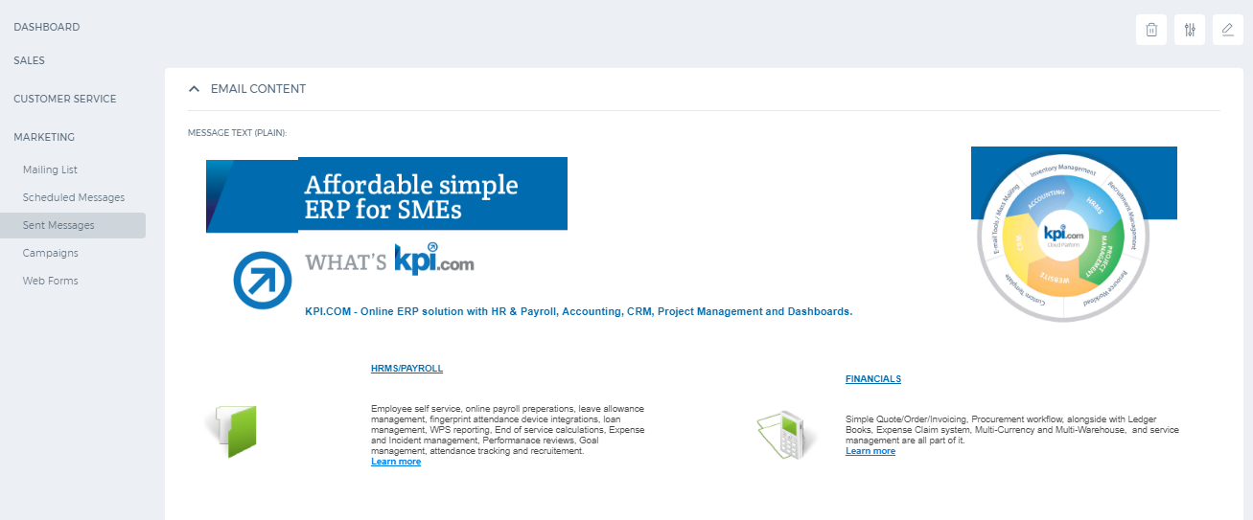
Email Marketing
Promote your companies brand awareness using your mass mailing tool. Send out various campaign based newsletters to your target customers. Analyze the mass mailing campaign using the statistics for the sent email.

Slide 19
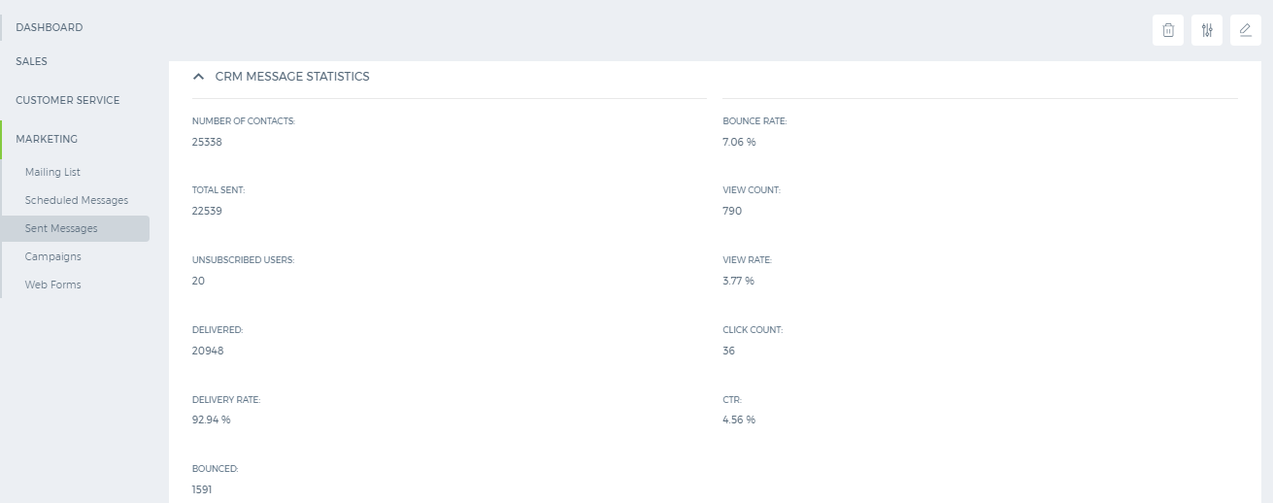
Sent Campaign Statistics
Analyze the statistics of your mass mail campaign by viewing the delivery rate, the number of bounced emails and total clicks. Track those who unsubscribe from your email campaign and check how many people have opened your mail.

Slide 20


