Slide 1

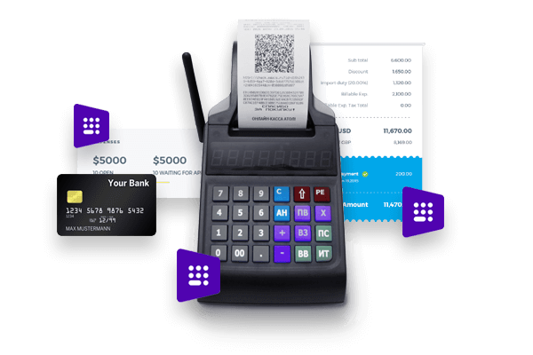
Kpi.com Accounting

Slide 2
kpi.com – Kpi.com Software Inc is a privately held London-based company found up by Muz Karabaev. Currently has an offshore operating base in Tashkent (Uzbekistan) Dubai, UAE – total headcount is 130+ people.
The company provides Software, Application, Design, Consultancy&Data and Digital Media products and services to its customer base since 2005. Major customers include Mindshare Mena, DMGT (Daily Mail Group), Asset International Inc, AIP Corp, etc.
In 2008, Kpi.com Software Inc started building its first product - SaaS app, and Launched in 2010 WorkforceTrack ERP beta product, which was later rebranded as kpi.com ERP, with the strap line – “Simply Manage Your Business” (Registered Trademark).
So far the company has over 500 active customers (about 400+ companies using kpi.com, total user base exceeds over 15,000 to date) and has core service only clients in Publishing and Digital, and web and mobile software sectors – mainly as offshoring and subcontracting services.

Slide 3

Introduction
Geographic spread of kpi.com end users
28%
North America
13% UK
20% Other parts of Europe
20% Middle East
4%
South America
2%
Africa
5% Australia
7% Rest of the World
400+ Companies, 15000+ User Base and Growing

Slide 4

















Kpi.com selected clients from UAE
4

Slide 5


Kpi.com Global Customers

Slide 6
Why kpi.com?
Cost Efficient: Eliminate on-premise IT-related costs (hardware, software, workforce, etc.)
All in One Accounting, HRM, Payroll, Project Management modules are seamlessly integrated to cut cycle times and reduce process errors
Integrations: Google and MicroSoft
Cloud: Access and process business transactions from anywhere through the internet and mobile applications
Global: Multi-subsidiary and multi-currency for growing businesses
Mobile: Mobile Apps availability
Support: Provides live, email, phone support
Scalable: pay as you grow, while
Updated: continuous upgrades to deliver new features and latest technological innovations
Adaptable: can be customized to meet customer-specific needs

Slide 7
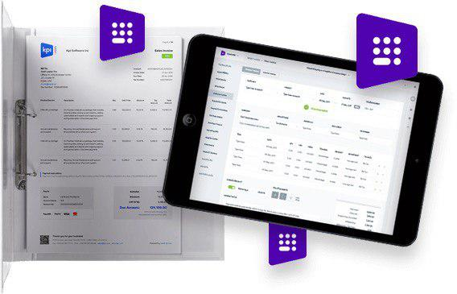
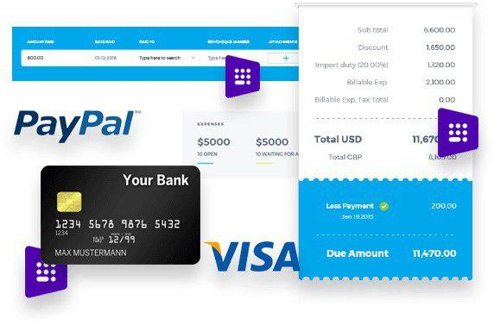
The Accounts Module includes the following sections:
Accounting: Sales and Purchasing, Inventory, Assets and Expenses.
Transactions: Payments, Prepayments, Manual Entry, Checks
Warehouse: Stock Adjustment, Stock Transfer
Statements: Profit and Loss, Balance Sheet, Cash Flow, Stock Valuation, Trial Balance, VAT Return, Budget Manager
Settings: Invoicing and Financial Settings

Slide 8
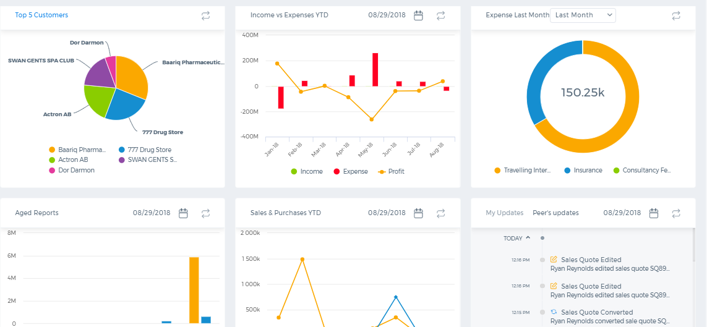
Accounts Dashboard
Customizable Dashboards help to get the graphic representation of your custom reports for easy visualization and analysis of main patterns.

Slide 9
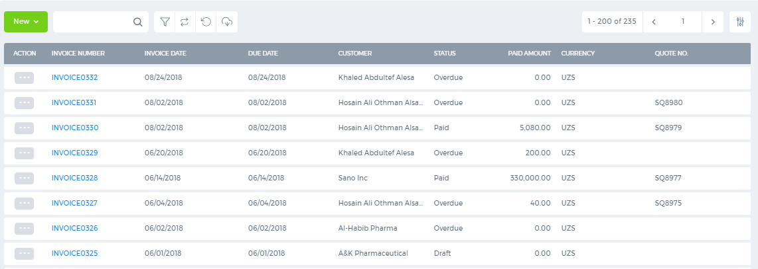
Invoicing
Multiple Currency
Custom Templates
Billable Expenses
Recurring Invoice
Credit Notes
Custom Fields

Slide 10
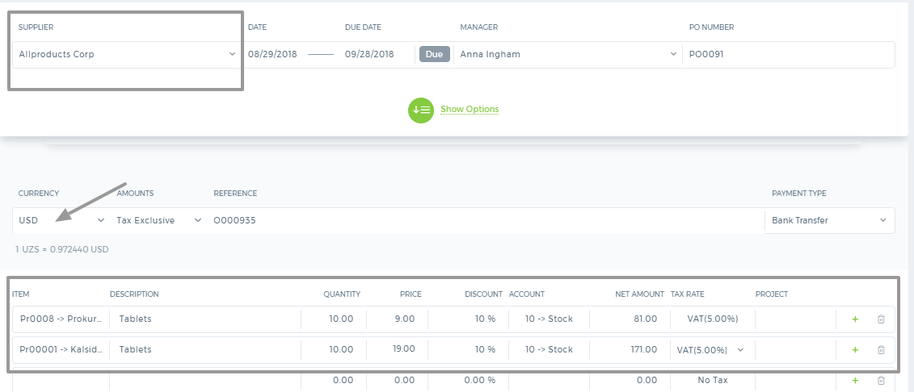
Purchasing
Receive Stock
Goods Received Notes
Landing Costs
Approval Process
Custom Templates
Multiple Currency

Slide 11
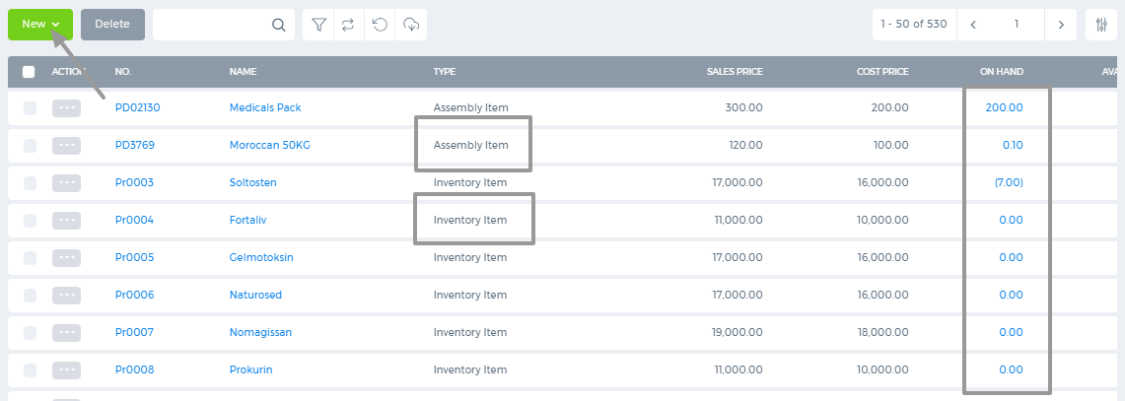
Products/Services
Inventory Items
Service Items
Average Cost
Warehouse
Stock Adjustments
Stock Transfer
Available Stock
Product Categories

Slide 12
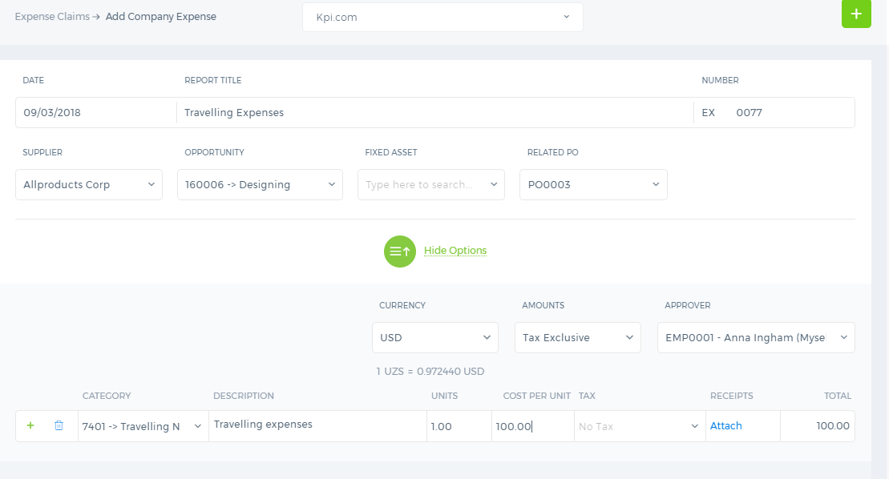
Expenses
Multiple Currencies
Custom Templates
Bill To Customer
Approval Process
Company Expense/Employee Expense
Landing Costs

Slide 13
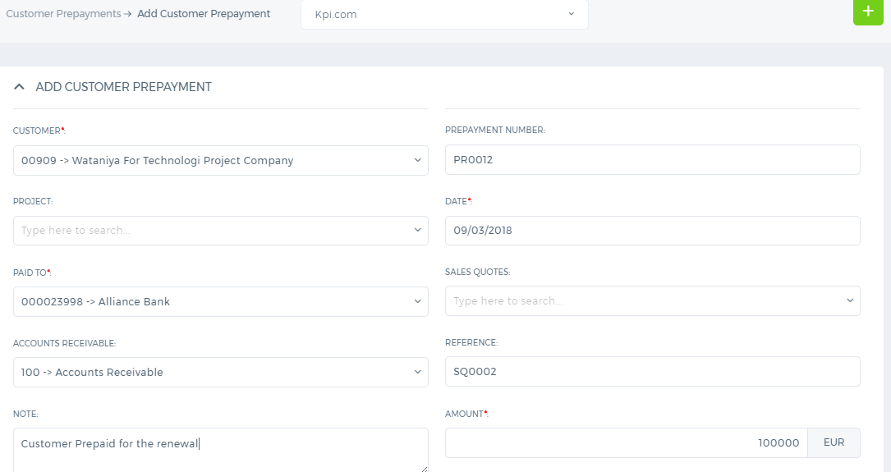
Transactions
Cash Receipts/Payments
Bank Receipts/Bank Payments
Prepayments
Manual Entries
Receive Payments
Pay Invoices

Slide 14
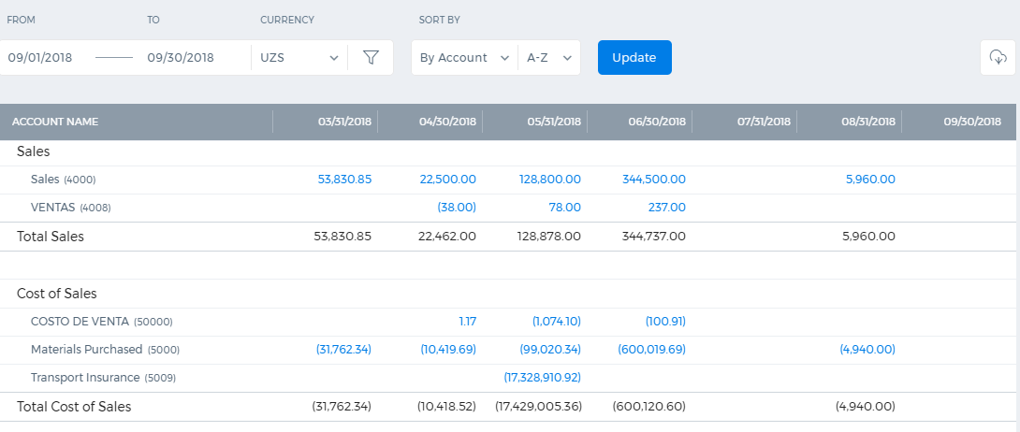
Statements
Profit and Loss
Balance Sheet
Trial Balance
Cash Flow Statement
Aged Receivables
Aged Payables
Journal Report
Account Transactions

Slide 15


