Slide 1

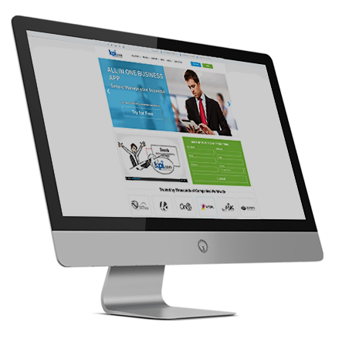
Online Project and Resource Management Software
By: Muz Karabaev, Founder of kpi.com | muz@kpi.com

Slide 2

Introduction

Slide 3

Introduction – who we are
kpi.com – part of Finnet Limited, Software Company Started/Founded in 2005 by Muzaffar Karabaev in London, United Kingdom.
MobileCloud DMCC is a sister company in Dubai, and became GCC Sales and Support Headquarters for kpi.com-Finnet Limited from 2014.
120+ employees spread over three Regions:
Central Asia, GCC (UAE) & UK, Plus our Partner Network (KSA and Oman).
30+ partners/resellers working and providing support for kpi.com in more than 10 Countries. GCC is a major focus NOW

Slide 4
What is kpi.com/Business Management Software?
SME’s Business Processes
Cloud SaaS Software
Ease of Processes
Keep it simple
5 Modules
Single Platform
Built in Workflows
Affordable
With kpi.com you get:
Ease of adoptability
Five core modules in one application
Cloud and Central System
Focus on quality and working method
Multiple layers of support, including trainings and migration

Slide 5
Principles of kpi.com
The kpi.com is built around the following principles:
Cloud Business Management Software
Integrated
Customizable
Kpi.com Reporting Principles
The software should be able to provide the
Financial information quickly
Kpi.com Customer Service Principles
Customers should get full assistance from
support team until they are fully on-boarded.
Easy to Use
Affordable
Kpi.com Upgrading Principles
The cloud business software should provide
automatic regular upgrades for free. For all
customers.
Available on mobile

Slide 6
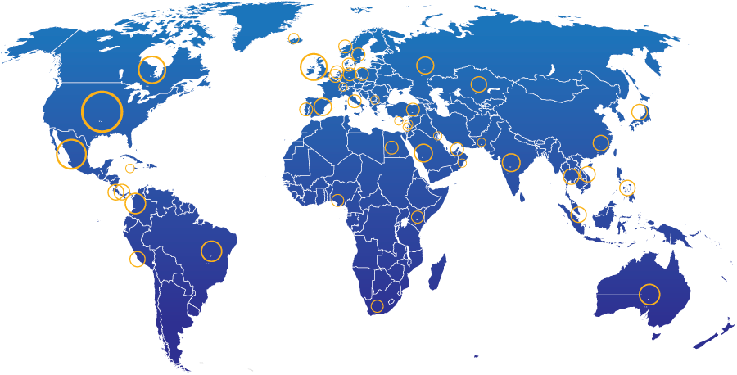
KPI.com: End Users Geographic Spread
28%
North America
21% Other parts of Europe
13%
UK
20%
Middle East
4%
South America
2%
Africa
5%
Australia
Rest of the world – 7%
3000+ Companies, 15000+ User Base and Growing

Slide 7
Kpi.com modules and processes

Slide 8






What is kpi.com software?
It incorporates all key business functions of your business
Payroll
Keep Track of Employees
HRMS
Manage cash/money
Accounting and Finance
Bookkeeping
CRM
Case management
Manage Customers
Inventory Management
Warehouse Management
Keep track of products
Project Management
Produce or Implement
Manufacturing
Sell
Storefront
Sales Force Automation

Slide 9
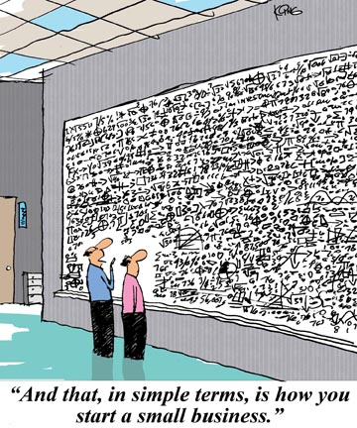

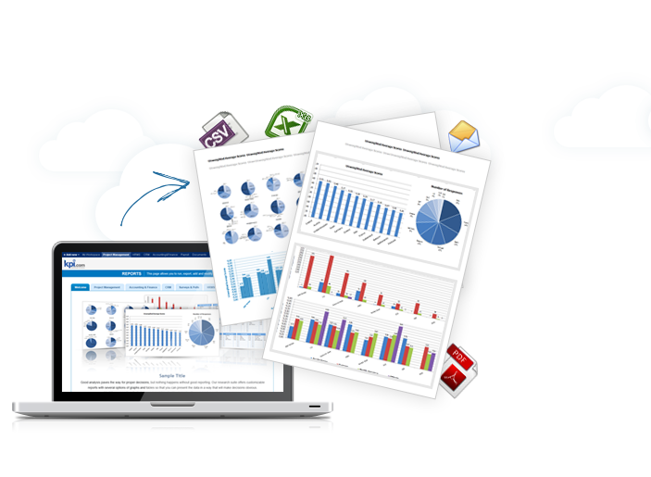
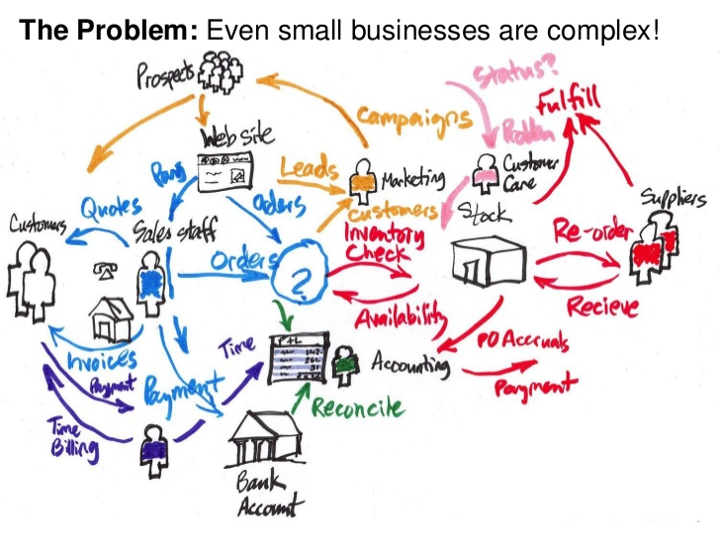
Even a small business is complicated
Kpi.com makes it easy to manage

Slide 10
Project and Resource Management

Slide 11







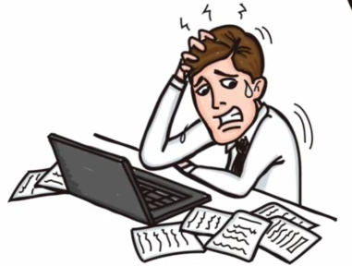
Project Management Workflow
Simple Project Management Workflow:
Add Project
Add Task
Timesheet
Timesheet Approval
Convert from
CRM Opportunity
Task Timer
Monthly
By Project
By Employee
Add task
Add multi-task
Add from template
Import
View the allocation
Setup Reminders
Resource Utilization
Dashboard
Project
Management
Settings
Close the project
View who is too busy, and who is sitting without tasks
Archive the project

Slide 12

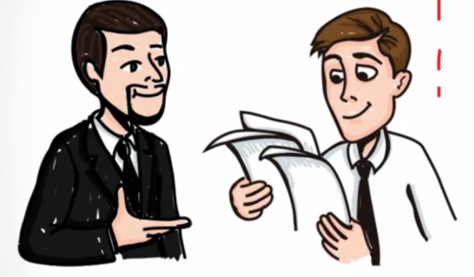






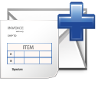

Project Management Workflow
Construction Project Management Workflow:
Add Project
Prepare a budget
Approve budget
Purchase Order
Workflows can be customized easily
Start the project
Receive goods
Payroll
Analyze requirements
Create Estimates
Approve the timeline
Add Workstreams
Add Tasks
Timesheet
Timesheet
Approval
Bill the client

Slide 13

PM Workflow
Or you can utilize the following workflow if you operate in Professional Services Industry:
Add Project
Add Task
Timesheet
Timesheet Approval
Convert from
CRM Opportunity
Task Timer
Monthly
By Project
By Employee
Add task
Add multi-task
Add from template
Payroll
Bill the client
Group Pay-run
Partial Billing
Recurring Invoice
Close the project
Archive the project
Most of our customers are professional service companies

Slide 14
Project Management - Planning

Slide 15
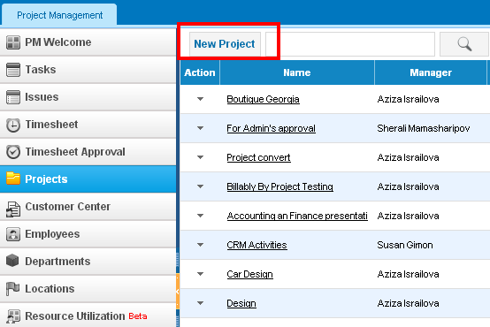

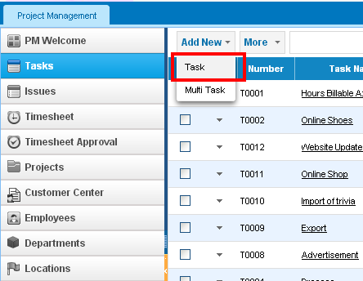
Getting Started
Add Project
Or simply Project, Task:
Add Project
Add Task
Add Task
https://www.youtube.com/watch?v=_hLNlEVsqho

Slide 16
PM Default Access Levels
Roles | What they can see in PM?
Administrators | All projects, all tasks, all issues, all timesheets
Project Managers | All projects which they own. Full project view. All tasks and all issues which they manage
Department Leaders | Limited project view, their own timesheet, tasks of the department, timesheet approval
Accountants | Limited project view, all invoice, purchase orders, sales quotes, sales orders of all projects, their own tasks
Employees | Limited project view, their own timesheet, their own tasks

Slide 17
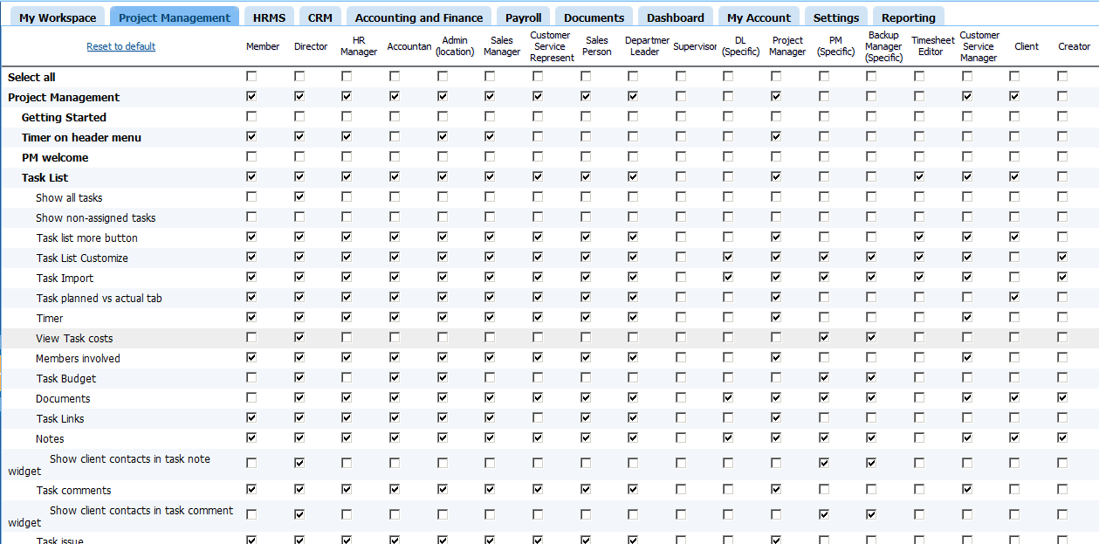
Setup your own permission settings
Settings -> Permission Management -> Project Management

Slide 18
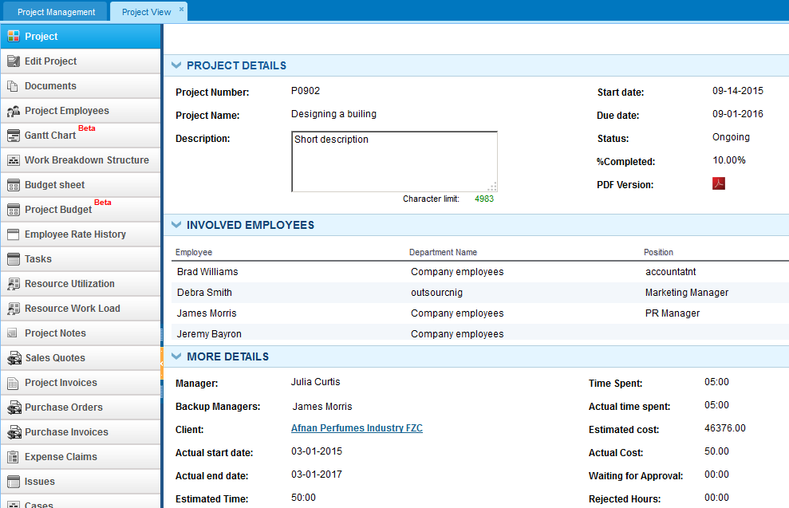
Project View
This is what you can do in PM section
Planning duration
Budgeting
The visibility of these sections is controlled by permission management
Analyze the workload
Accounting documents

Slide 19
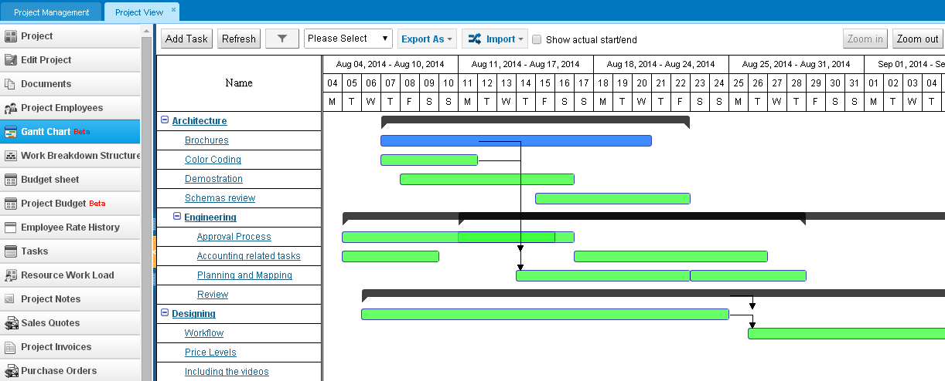
Project Gantt Chart

Slide 20
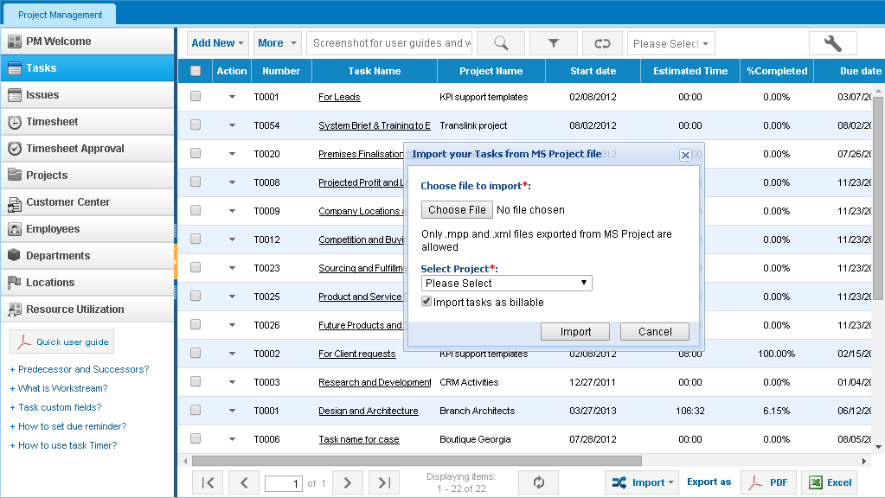

Import your own MS Project File
We want to import our own MS Project files

Slide 21
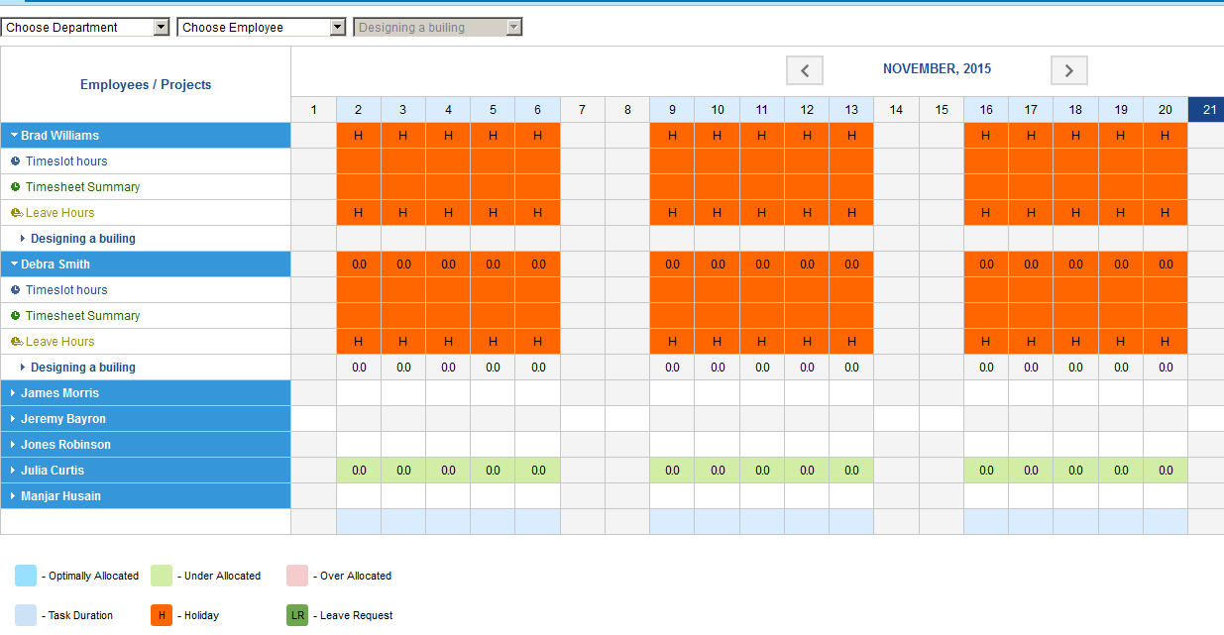
Resource Utilization
See if employees have enough tasks

Slide 22
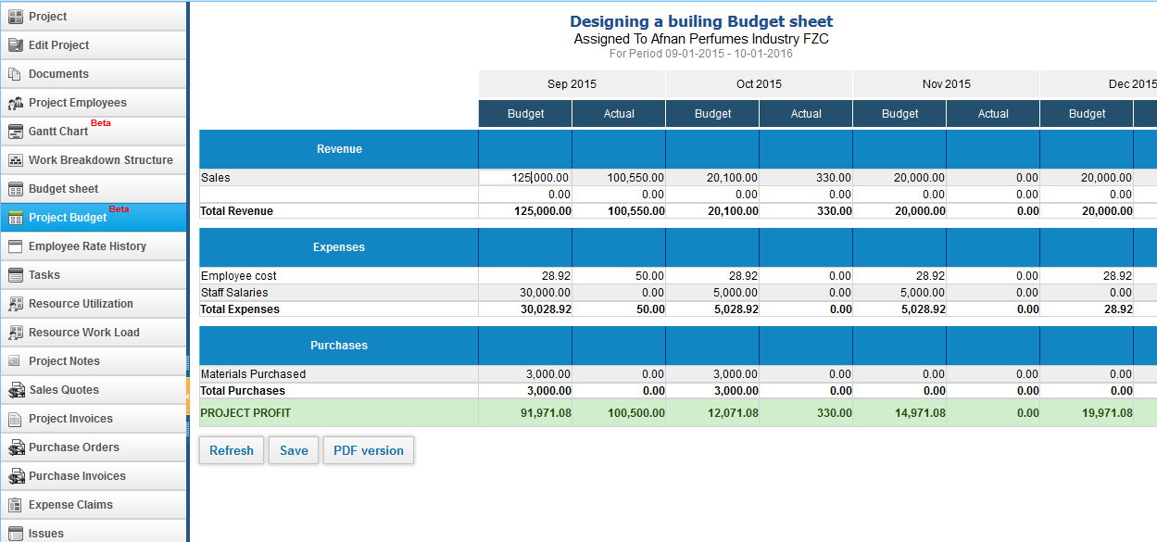
Project Budget/PNL
Write down budgeted figures just here

Slide 23
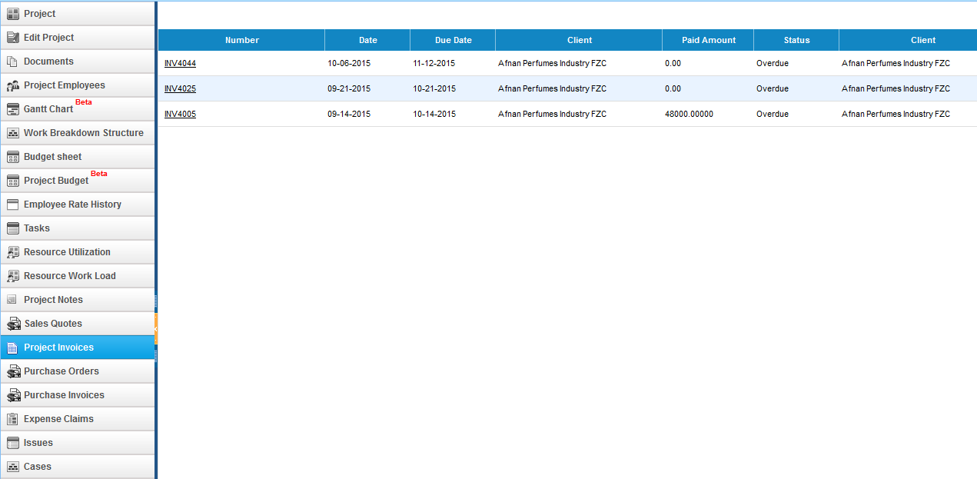
Project Invoicing
You can generate invoice in Accounting section

Slide 24
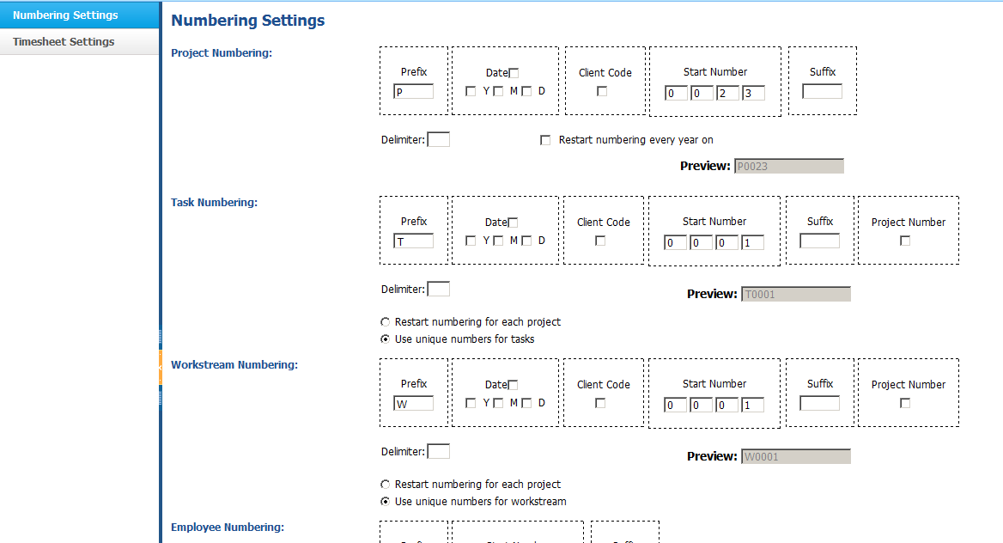
PM Settings
Create automatic numbering properties for new projects
We have so many projects, that we get confused

Slide 25
Timesheet

Slide 26
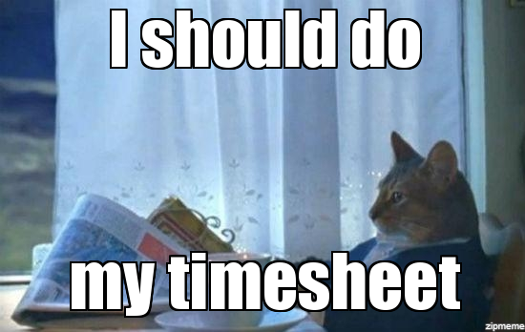
Introduction to Timesheet
Timesheets are great for 3 reasons:
They make costs visible
They help to automate billing/invoicing
They help to automate Payroll processes
They help in project planning and tracking
Time tracking can increase revenue through automating billing, which tends to make it easier for a company to get correct invoices out for all hours worked by consulting staff

Slide 27
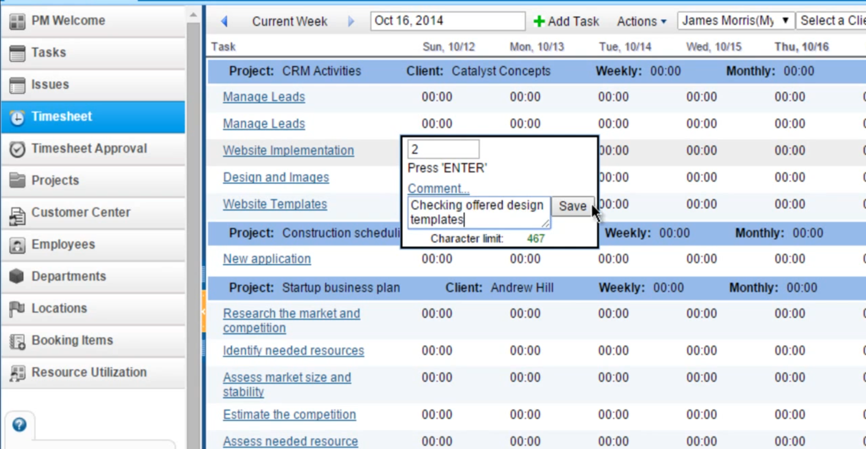
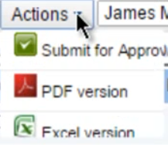
Timesheet
Employees fill out timesheet and submit for approval

Slide 28
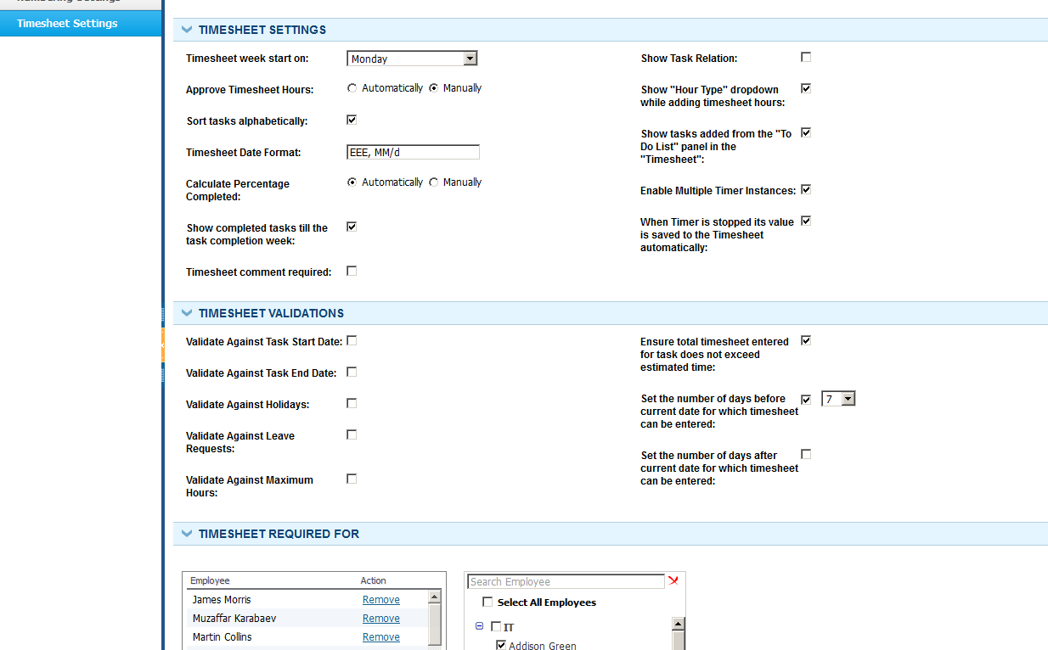
Timesheet Settings
We need to validate timesheet, and it’s not required for everyone
Setup timesheet validations
Setup employees who need to use timesheet

Slide 29
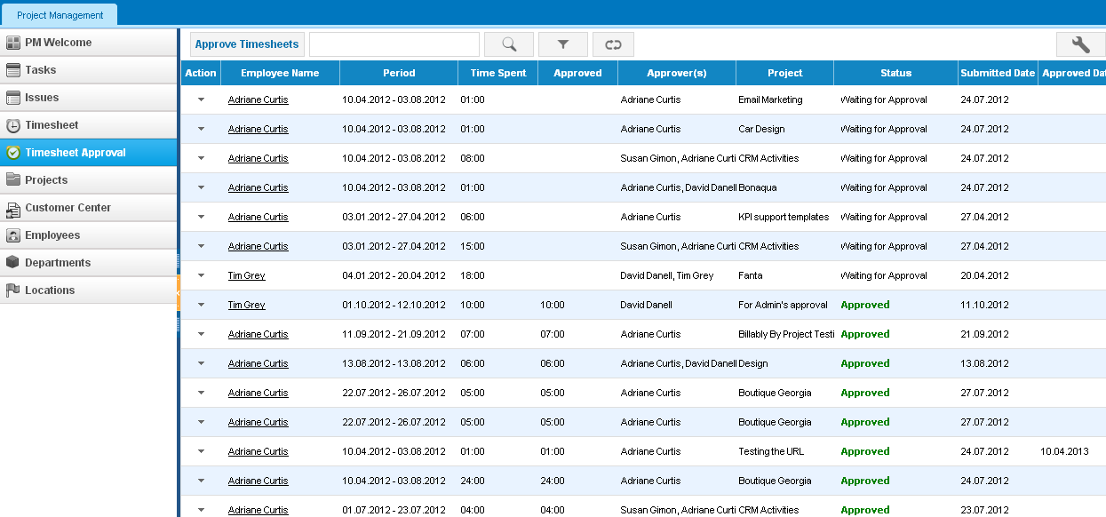
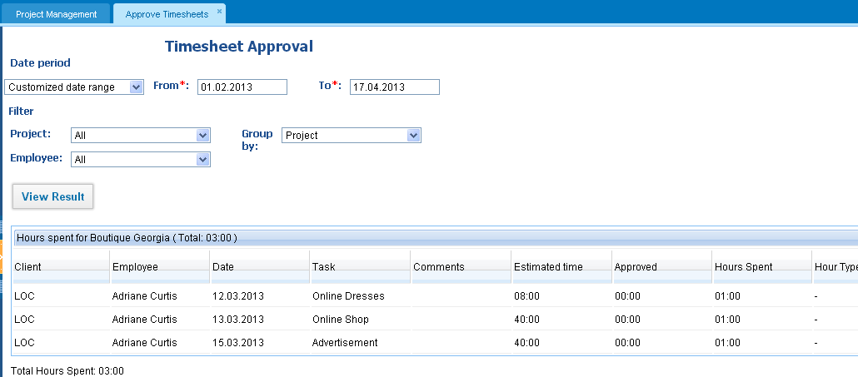
Timesheet Approval

Slide 30
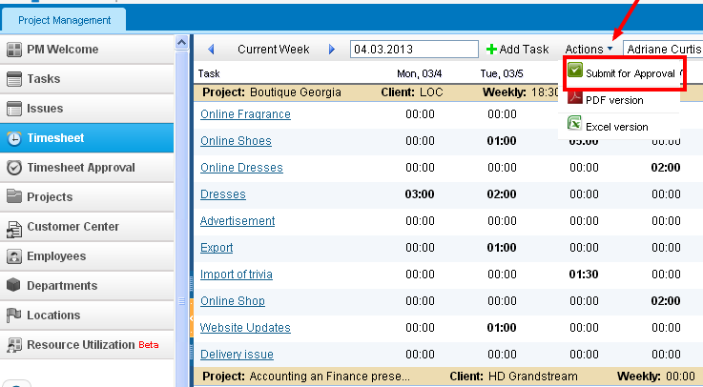
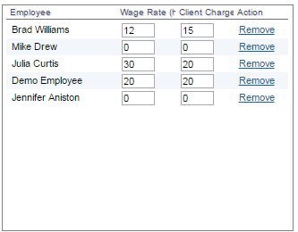
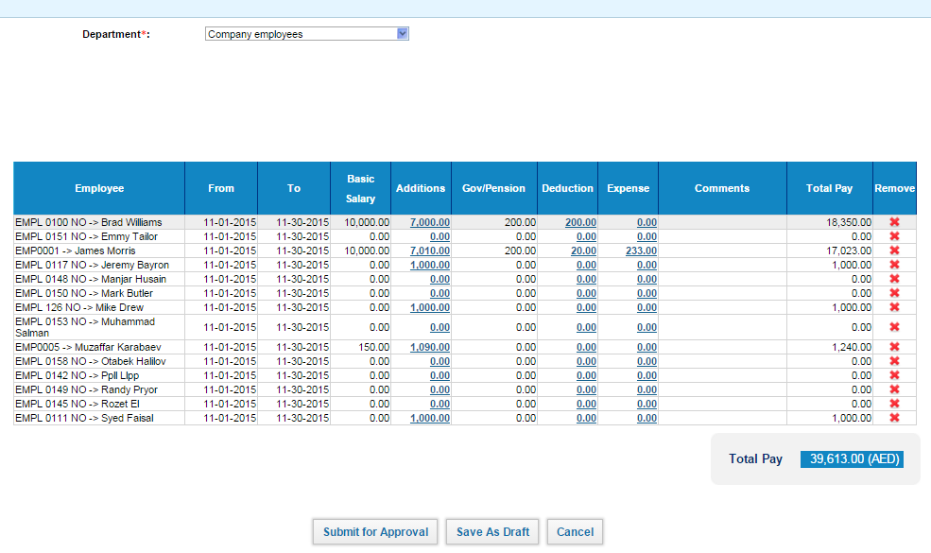
Timesheet/Payroll
1. Make sure employees fill out timesheet
We want to pay employees on an hourly rate
2. Specify rates per project
4. Run payroll as regular
3. PMs Approve Timesheets

Slide 31
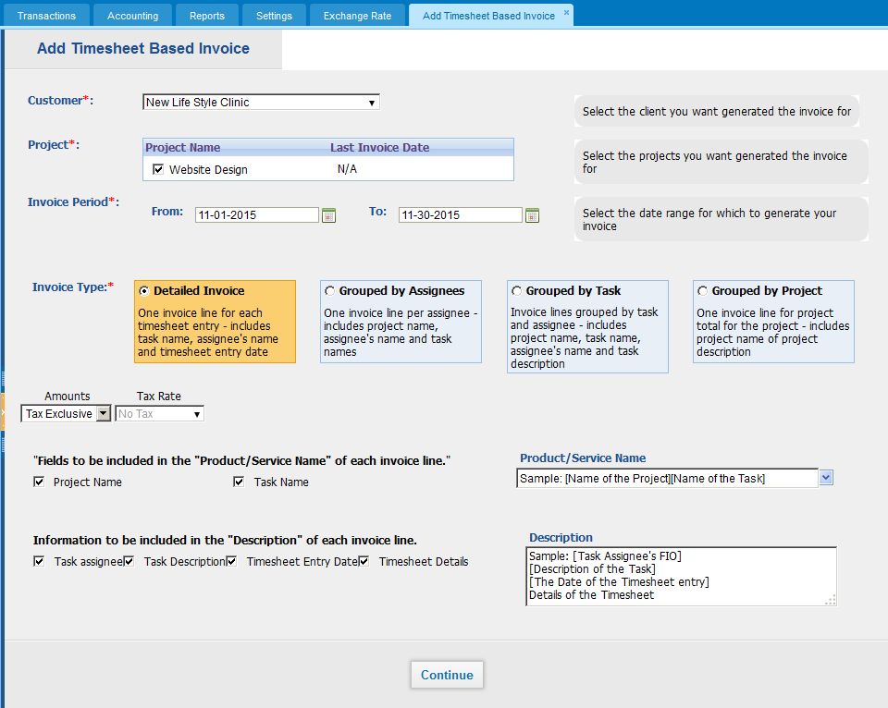
Timesheet Invoice
We want to bill all timesheet hours to the client
Change the template here

Slide 32
Booking Items

Slide 33
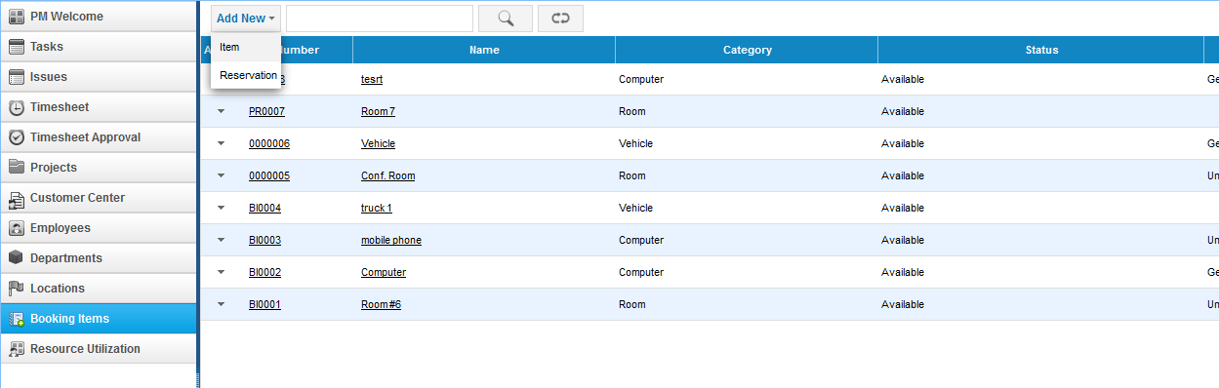
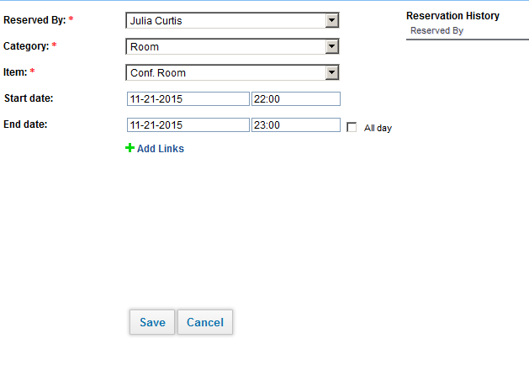
Booking Items
Reserve an item
See if the item is currently available

Slide 34
Contracts and Monthly Timesheet

Slide 35
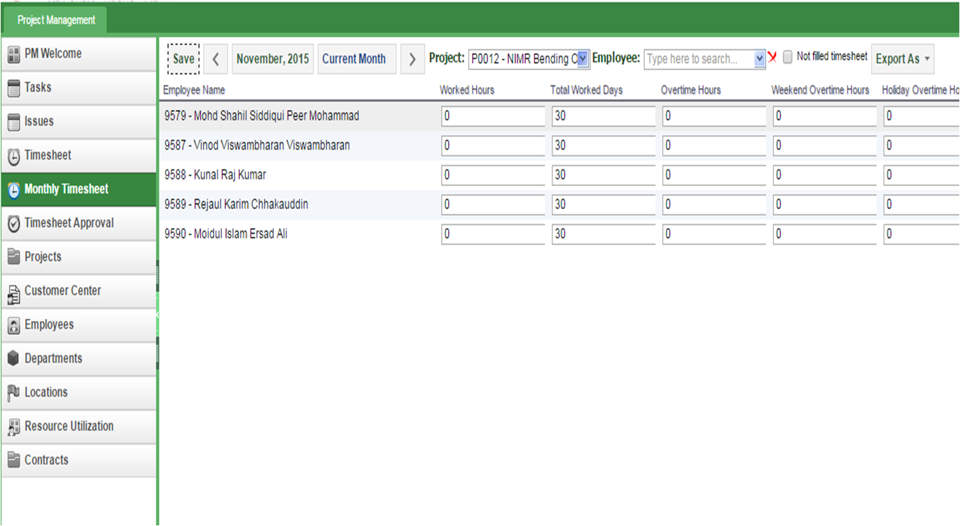
Monthly timesheet contracts
Our employees need to fill out monthly timesheet

Slide 36
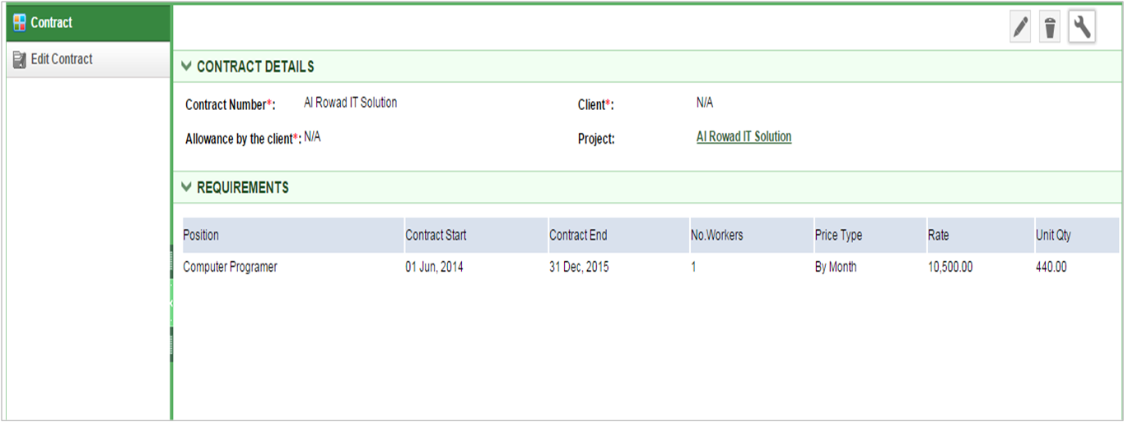
Monthly timesheet contracts
Monthly timesheet works with contracts
Setup contracts for each position employees

Slide 37
Reporting

Slide 38





Introduction to reporting tool
You can analyze the company performance with reporting tool.
Custom Reports
Excel Templates
Charts and Dashboards
Advanced Formulas
Watch on You-tube:
https://youtu.be/u7tx4rwkalM

Slide 39
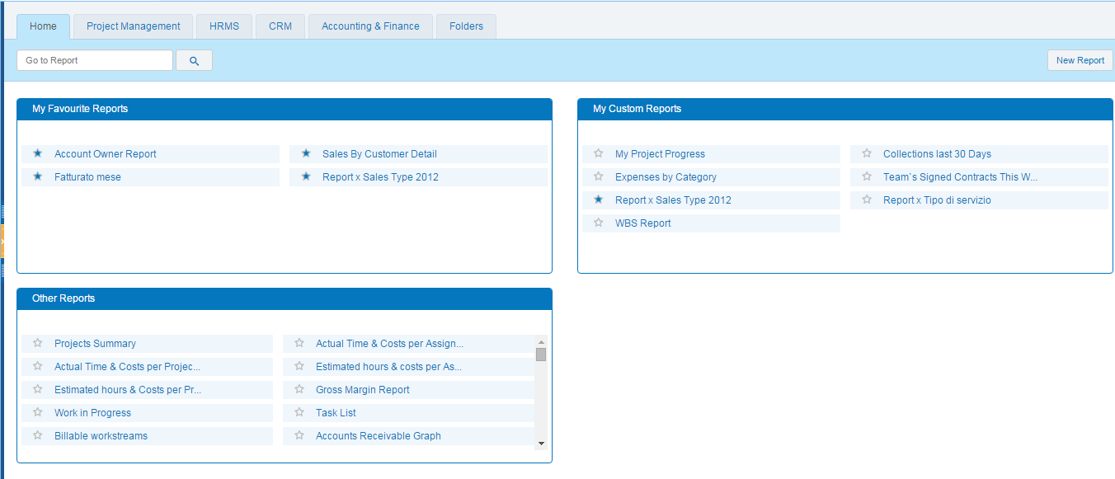
Reporting Home
Setup your favorite reports for easy access
Create your own report
Default reports

Slide 40
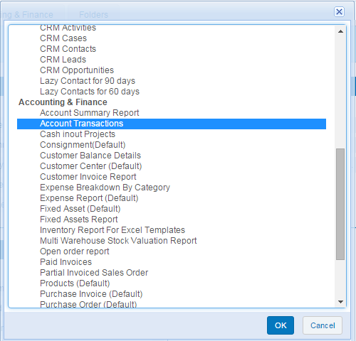
Create your own report
1. Choose Report Template
2. Customize Report

Slide 41
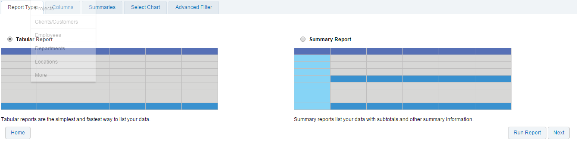
Create your own report
Choose report style: tabular/summary

Slide 42
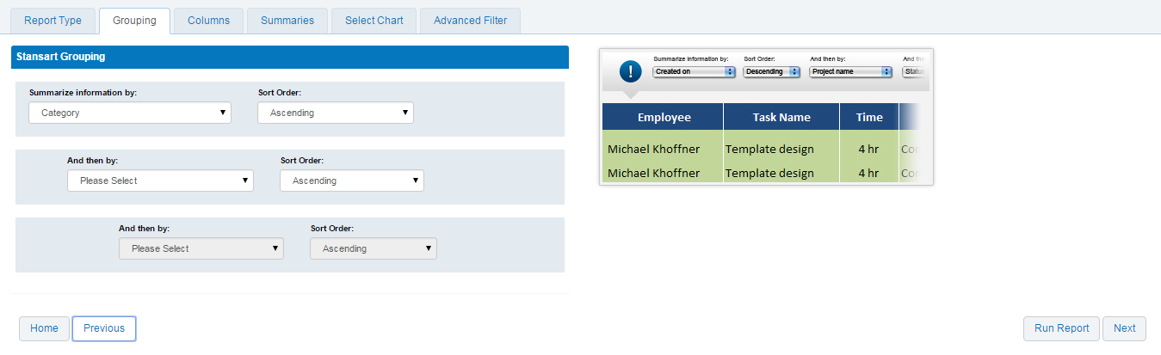
Create your own report
Choose grouping type:

Slide 43
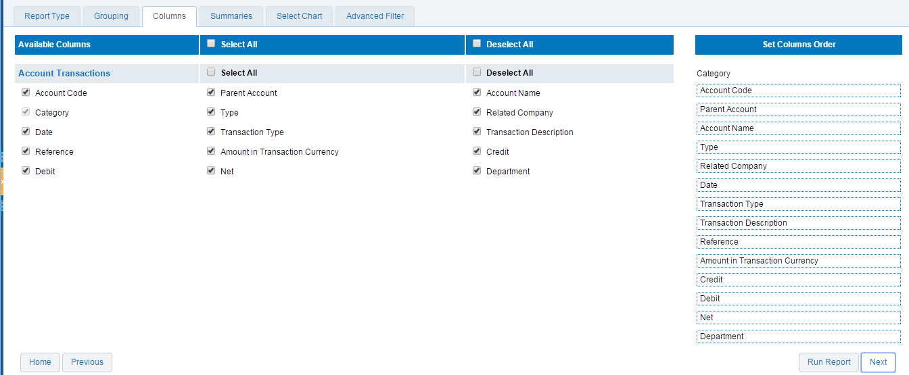
Create your own report
Choose columns:

Slide 44
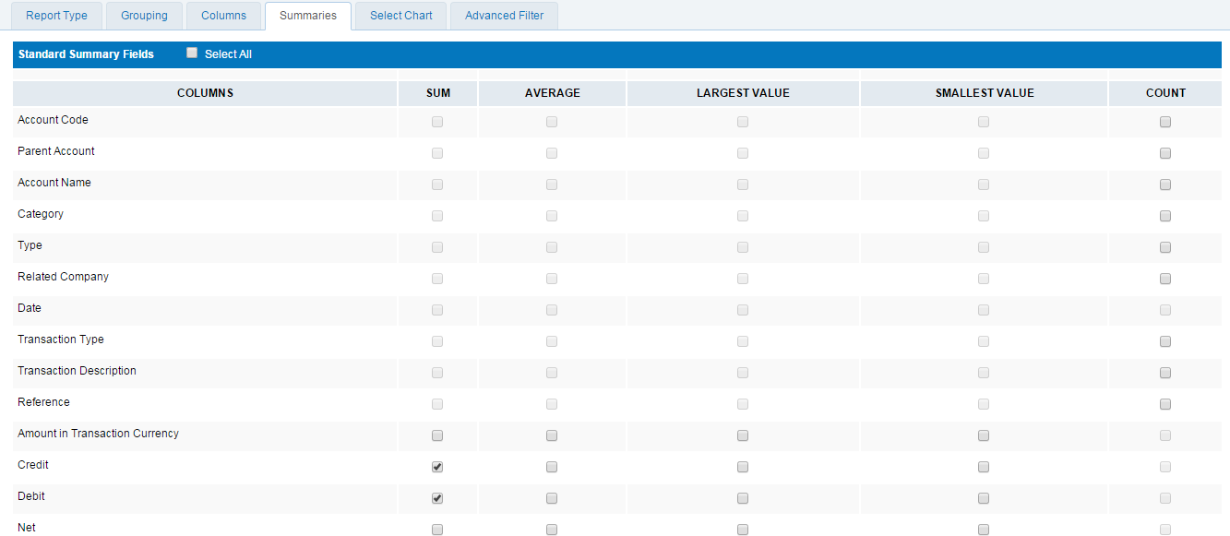
Create your own report
Select summaries:

Slide 45
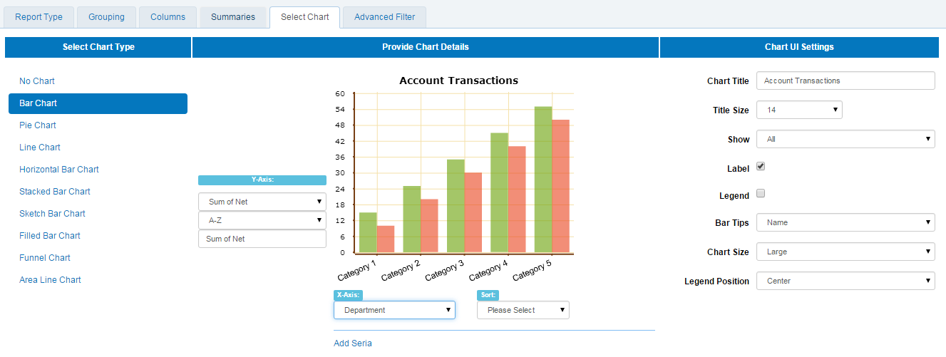
Create your own report
Select the chart type:

Slide 46
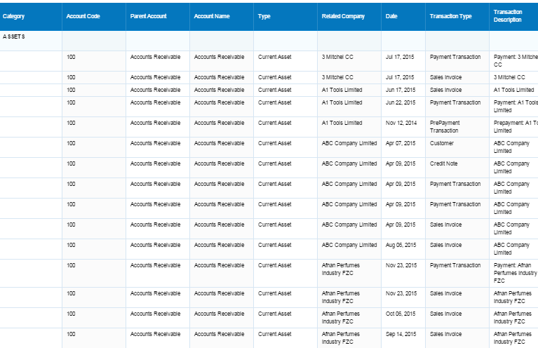
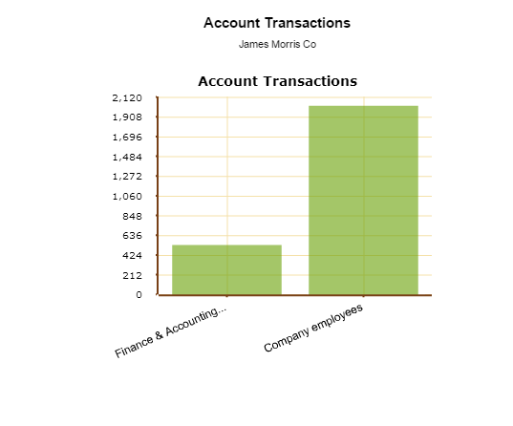
Create your own report
Report is created:

Slide 47
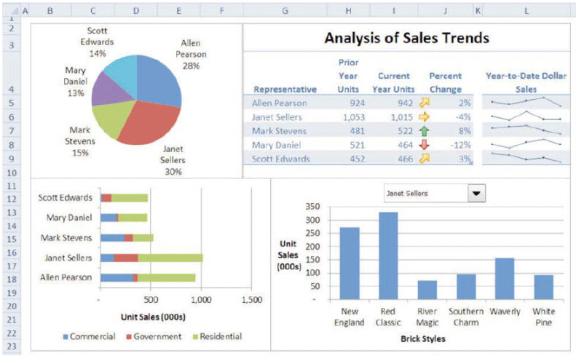
Excel Templates
After customizing Report, NCO were able to design complex reports in a simple way, by themselves. The ability to export in Excel format let them modify the pieces of information of their reports according to sales situations, as well as improve the visual appearance

Slide 48
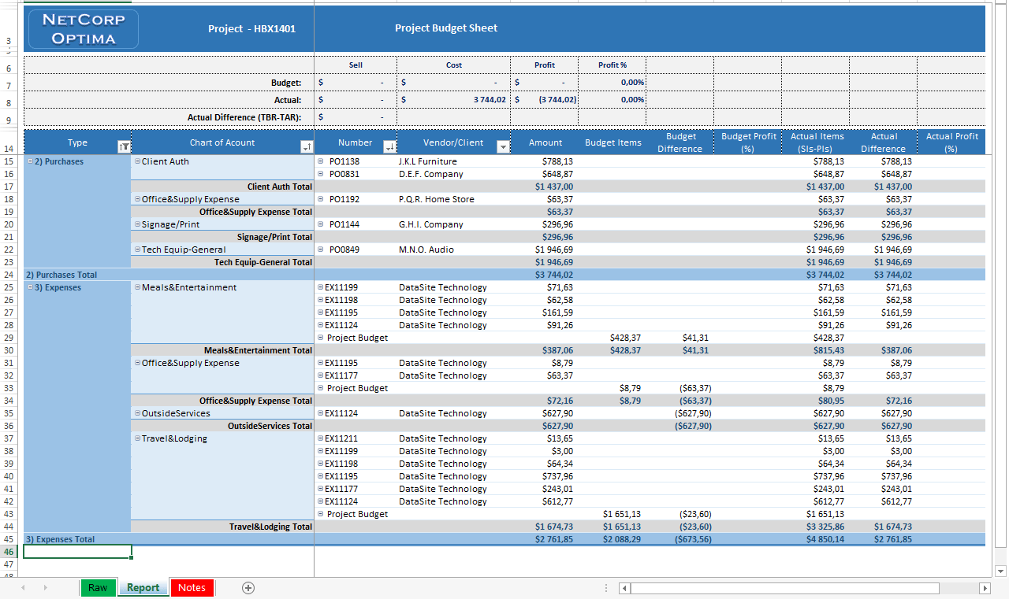
Excel Templates
One of our clients – NetCorp Optima (NCO) project managers of which wanted, while leading a project, to get answers to questions such as: What is the current status of the project?, How is the project going?, What are the important issues we should worry about?

Slide 49
Add-Ons

Slide 50
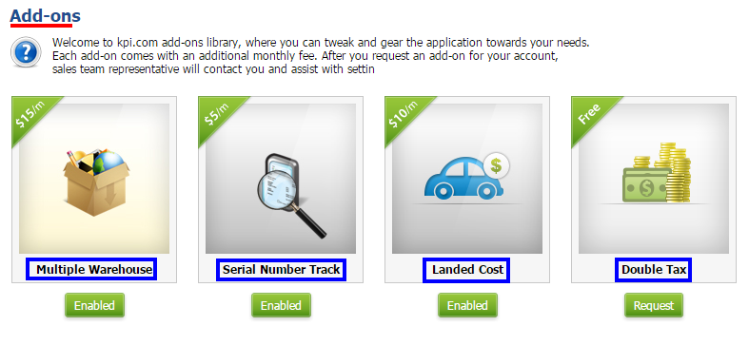
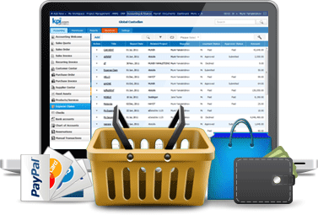
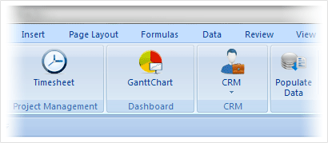
Kpi.com Plugins
There are a number of add-ons which you can enable:
Storefront
Excel Plugin

Slide 51
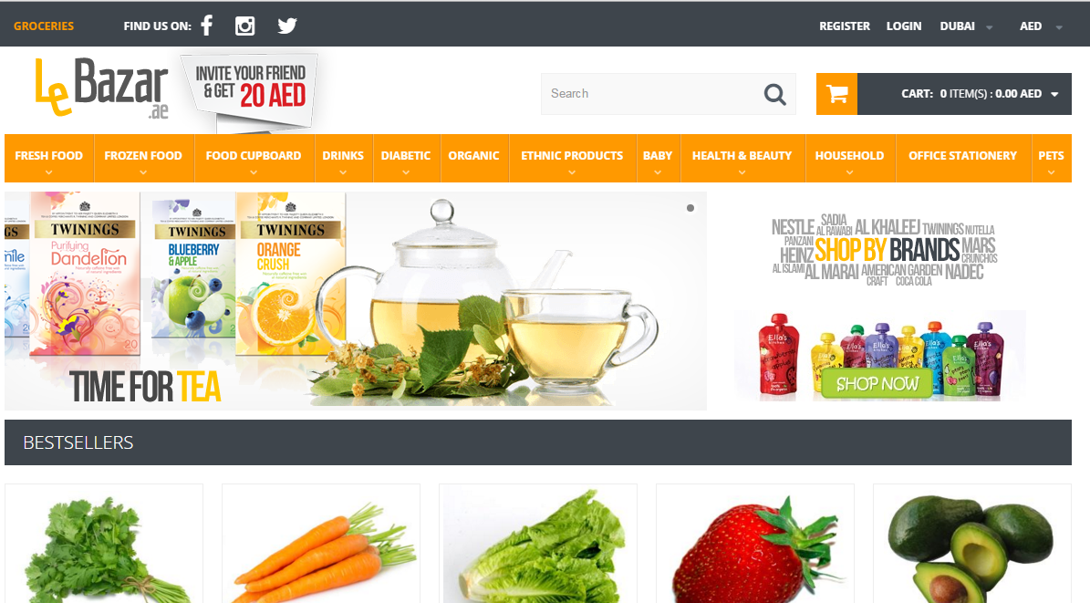
Storefront Management Plug-in
LeBazar.ae – Our customer who built storefront in kpi.com
Manage products inside
Kpi.com

Slide 52
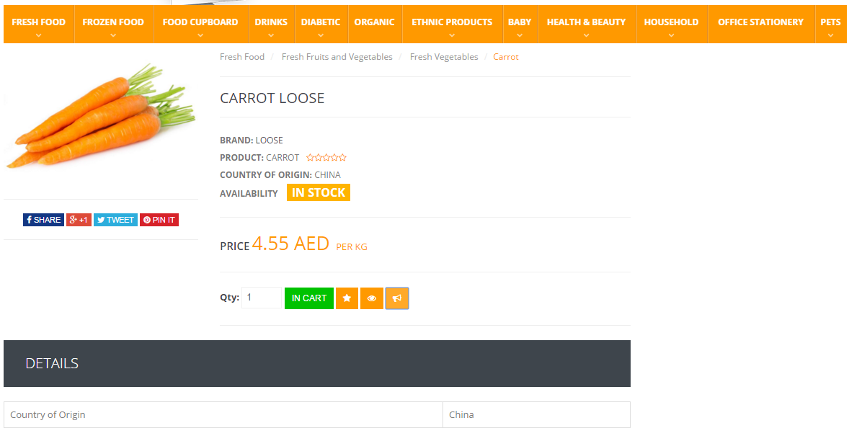
Storefront Management Plug-in
LeBazar.ae – Our customer who built storefront in kpi.com
Manage products inside
Kpi.com
All storefront purchases are
processed from accounting (sales orders)

Slide 53
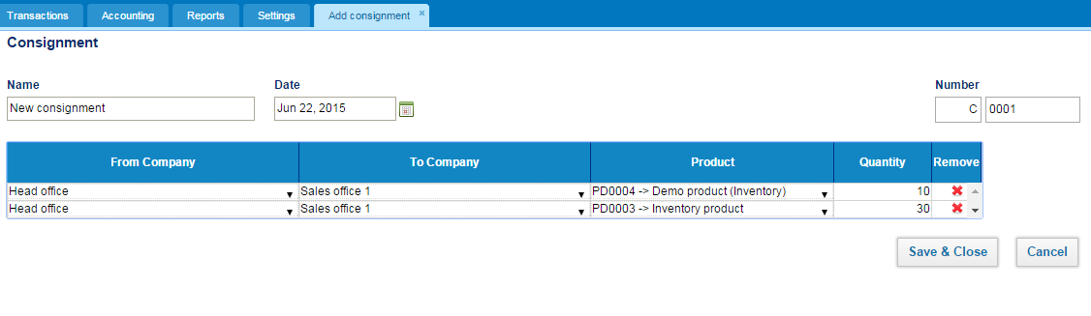
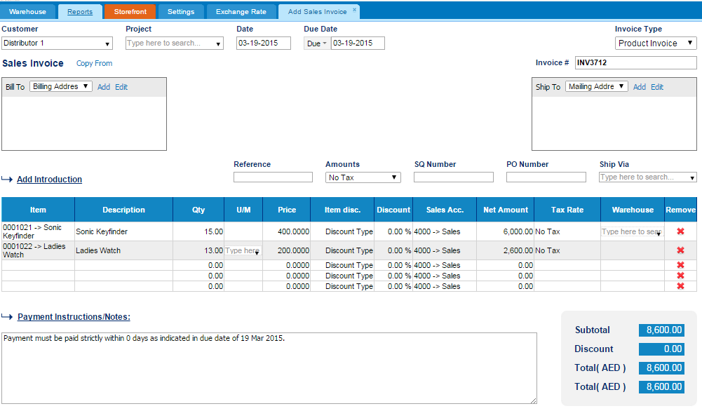
Consignment add-on
You can send items to your clients or subsidiaries for consignment
Your clients/customers will appear here
When your subsidiaries the sales of consignment items trigger bookkeeping transactions automatically

Slide 54
Need more?
You can customize kpi.com under your own requirements:
Invoice
Settings
Your own functionality/feature
Your own tabs/fields/entities
Your own rules
Colors
Logo
Level 3
Workflows, tabs, sharing
Hide/Add additional tabs
Workflow rules/reminders
Custom sharing/access controls
Level 2
Rules
Custom Fields,
2-level Workflows
Colors/Logo/Templates
Level 1
Workflow
Section 1
Feature 1
Feature 2
Core kpi.com

Slide 55

Settings
Set up each company and financial settings
Set up profile and how you should get an email
Custom Fields
Set up each module
Set up workflows
Set up permission levels

Slide 56

Workflow Automation Settings
Define workflows for certain rules in the system

Slide 57

Workflow Automation Settings
Following activities can be triggered when workflow rule is true
Example: send email customer every 2 weeks once the subscription is active

Slide 58


Reference Settings
You can change the default values in our lists

Slide 59
2-Level Workflows
Add Leave Request
Approve Leave Request
Approve Leave Request
2-Level approvals can be easily be enabled
Employee
Manager
Manager-2
Purchase Order Request
Approve Purchase Order
Approve Purchase Order
Employee
Manager
Manager-2
Contact us at support@kpi.com for enabling 2-level approvals for your company

Slide 60
Why kpi.com?

Slide 61






Benefits of kpi.com
By adopting kpi.com, you will be able to enjoy the following benefits:
Lower Operational Costs
Transparency of processes
Ease of Sharing
Improved Customer Service
Better Reporting
Increased Efficiency

Slide 62
Kpi.com is Safe and Secure
Physical security
It is hosted on Amazon cloud
Network security
HTTPS protocol is used to encrypt data
People and processes Employees have no access to customer data

Slide 63
Our backup policy
You can request one of these backups from the beginning of your subscription period
Daily Backups
Weekly Backups
DB Backups
All-time backups
Monthly Backups
You will get this when you decide to quit kpi.com

Slide 64
Our engagement model with clients
How will we work with you?
You will be assigned a relationship manager who will work with you from the beginning
Relationship manager will help you to setup the system and get running until the end of on-boarding period
On-boarding period is typically 3 months, but it can be extended
You will be able to call your own relationship manager any time in case of any issues
When you are fully on boarded, our generic support team will take care of you, but you will have an access to your own relationship manager too.

Slide 65


We Offer Lot’s of Training Materials for Free
Our guidebooks:
Our help center:
Our video trainings:
Project Management overview: http://www.youtube.com/watch?v=_hLNlEVsqho
CRM: http://www.youtube.com/watch?v=2qFEjSawfCU
HR: http://www.youtube.com/watch?v=swYk62gTCwA
Accounting Videos: http://www.youtube.com/playlist?list=PLa7P0Qa2jO2X9tYQ9aVPV4NJ3F4C9sScW

Slide 66


Our Support Team is There For You 24 Hours

Slide 67














We love our customers and they love us too!
These Companies Trust Kpi.com in Running Their Business:
526+ Active Companies, 3000+ users from partners
12,000,000+ Projects
1,550,452+ Timesheet entries
4,458,263+ Invoice Documents

Slide 68





Signup For a Free Trial
It’s takes less than 60 seconds

