Slide 1

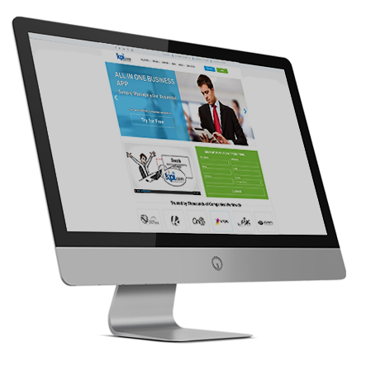
Kpi.com Cloud HR and Payroll Software
By: Muz Karabaev, Founder of kpi.com | muz@kpi.com

Slide 2

Introduction

Slide 3

Introduction – who we are
kpi.com – part of Finnet Limited, Software Company Started/Founded in 2005 by Muzaffar Karabaev in London, United Kingdom.
MobileCloud DMCC is a sister company in Dubai, and became GCC Sales and Support Headquarters for kpi.com-Finnet Limited from 2014.
120+ employees spread over three Regions:
Central Asia, GCC (UAE) & UK, Plus our Partner Network (KSA and Oman).
30+ partners/resellers working and providing support for kpi.com in more than 10 Countries. GCC is a major focus NOW

Slide 4
What is kpi.com/Business Management Software?
SME’s Business Processes
Cloud SaaS Software
Ease of Processes
Keep it simple
5 Modules
Single Platform
Built in Workflows
Affordable
With kpi.com you get:
Ease of adoptability
Five core modules in one application
Cloud and Central System
Focus on quality and working method
Multiple layers of support, including trainings and migration

Slide 5
Principles of kpi.com
The kpi.com is built around the following principles:
Cloud Business Management Software
Integrated
Customizable
Kpi.com Reporting Principles
The software should be able to provide the
Financial information quickly
Kpi.com Customer Service Principles
Customers should get full assistance from
support team until they are fully on-boarded.
Easy to Use
Affordable
Kpi.com Upgrading Principles
The cloud business software should provide
automatic regular upgrades for free. For all
customers.
Available on mobile

Slide 6
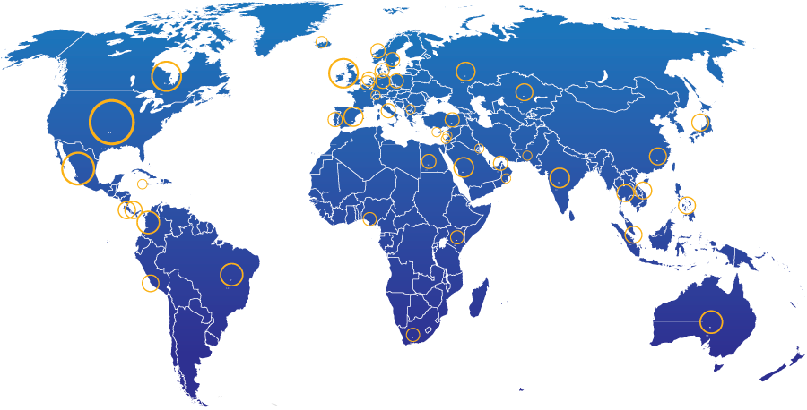
KPI.com: End Users Geographic Spread
28%
North America
21% Other parts of Europe
13%
UK
20%
Middle East
4%
South America
2%
Africa
5%
Australia
Rest of the world – 7%
3000+ Companies, 15000+ User Base and Growing

Slide 7
Kpi.com modules and processes

Slide 8






What is kpi.com software?
It incorporates all key business functions of your business
Payroll
Keep Track of Employees
HRMS
Manage cash/money
Accounting and Finance
Bookkeeping
CRM
Case management
Manage Customers
Inventory Management
Warehouse Management
Keep track of products
Project Management
Produce or Implement
Manufacturing
Sell
Storefront
Sales Force Automation

Slide 9
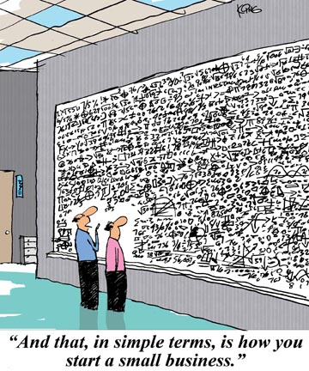

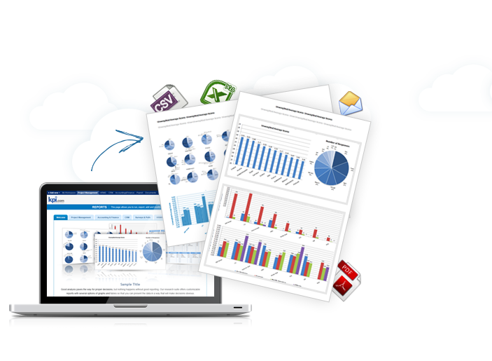
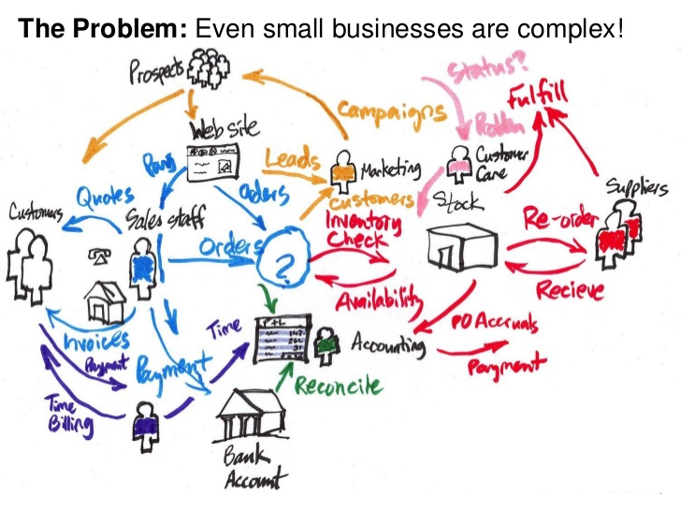
Even a small business is complicated
Kpi.com makes it easy to manage

Slide 10
HRMS

Slide 11

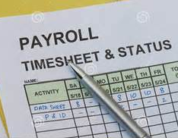
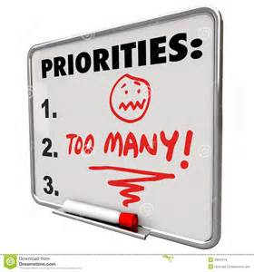

Why is there a need for HRMS?
 | Too much paperwork?
No payroll history?
 | Too much trivial tasks?
Complaints not addressed?

Slide 12


What is in HRMS?
ESS
Manage Employees
Recruitment
Group Pay-run
Taxes, Reports
Run Payroll
Leave Requests
In-out hours
Track Attendance
Simple Appraisals
Review Performance
Annual Reviews
https://www.youtube.com/watch?v=swYk62gTCwA

Slide 13
HRMS Default Access Levels
Roles | What they can see in HR?
Administrators | Everything
HR Managers | Everything
Department Leaders, Project Managers | Limited HR View (only data related to their own department/project)
Accountants | Limited HR View
Employees | Their own data only

Slide 14
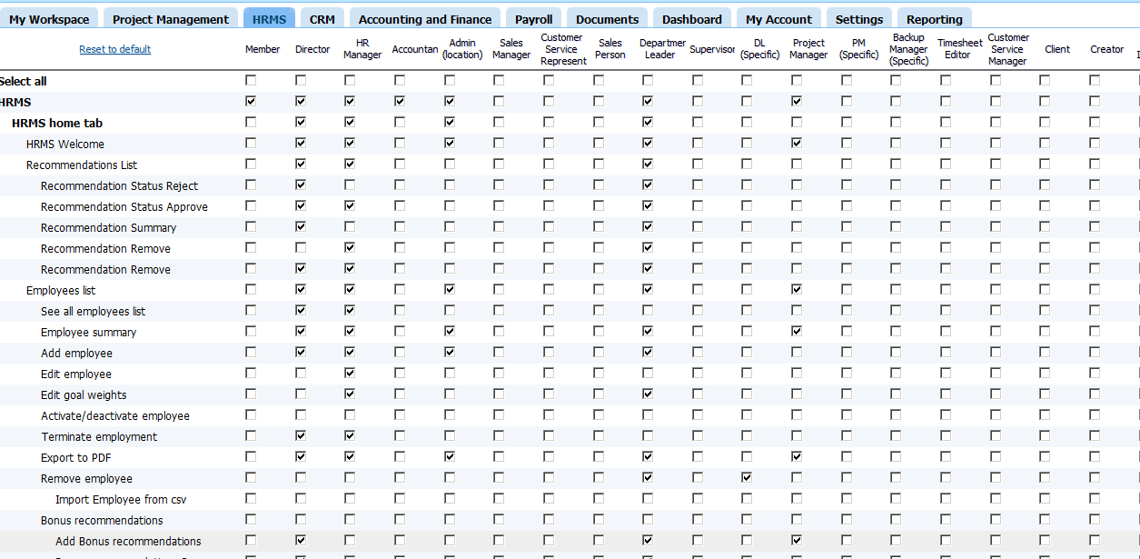
Setup your own permission settings
Settings -> Permission Management -> HRMS

Slide 15

Let’s start with a paperwork problem
01
Paperwork is a burden
HR has a lot of paperwork
02
Tracking document expirations
Tracking expiration date of documents and storing the documents is not easy
03
Employee Self Service
Having employees update their own documents is better

Slide 16
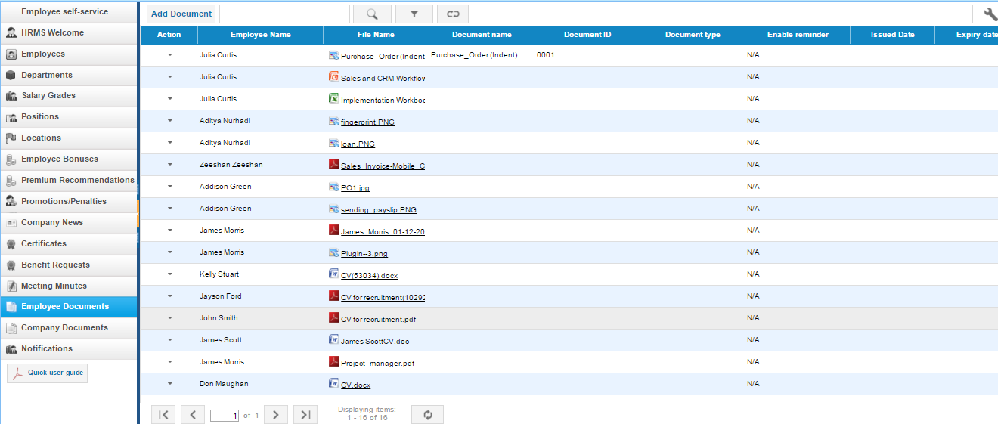
How kpi.com deals with paperwork
Upload 2 types of documents

Slide 17
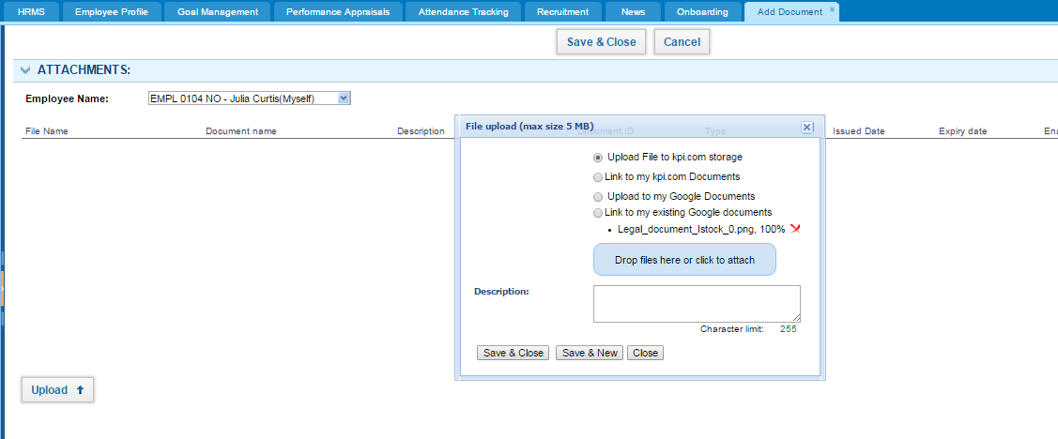
Kpi.com documents management

Slide 18
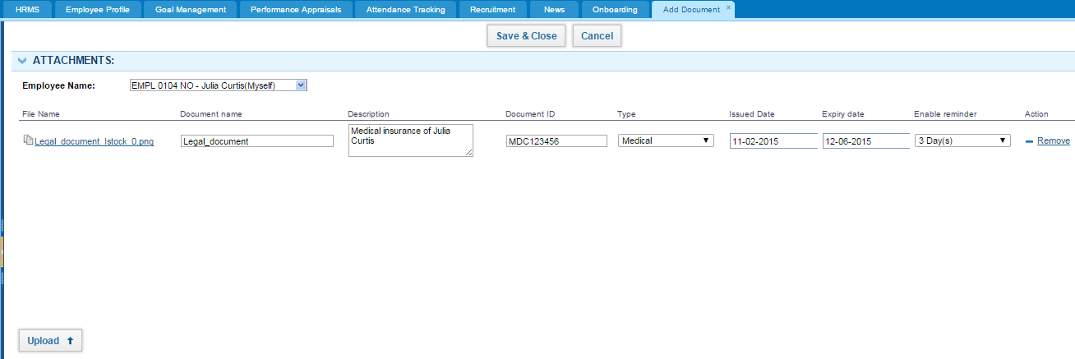
Kpi.com documents management
The system will remind you whenever the document expires
Enable calendar reminders

Slide 19
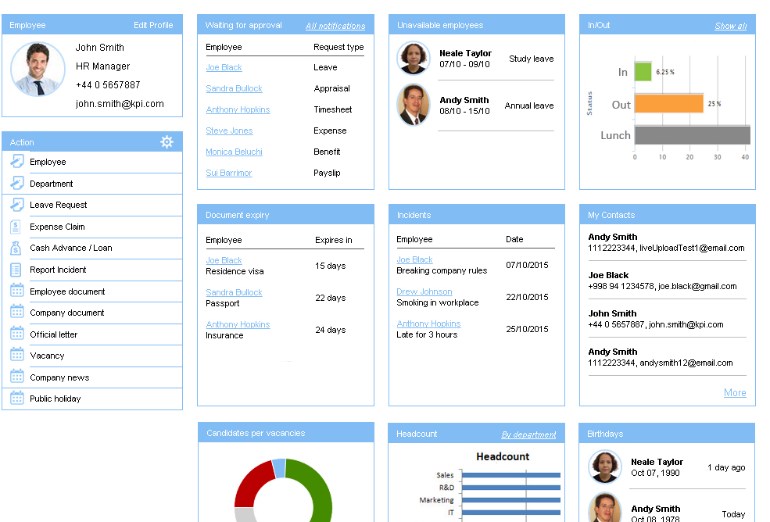
HR views all document expiries in one place
HR can take appropriate actions needed

Slide 20
Employee Self Service

Slide 21
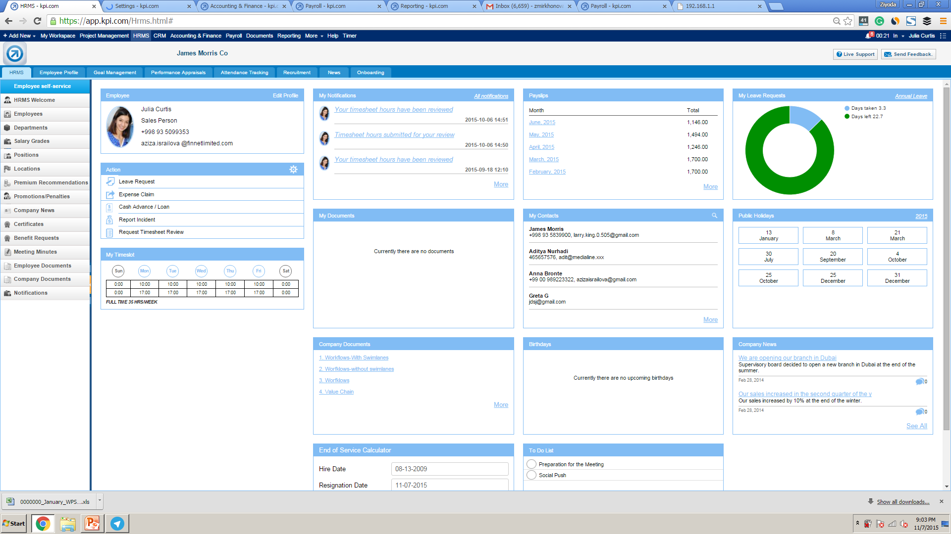

ESS concept allows HRs to ease their workload
Our employees can see and modify their own HR Data

Slide 22
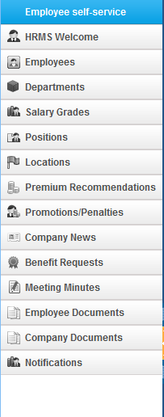
Employees can see a lot of their stuff
Employees can see their own HR related features

Slide 23
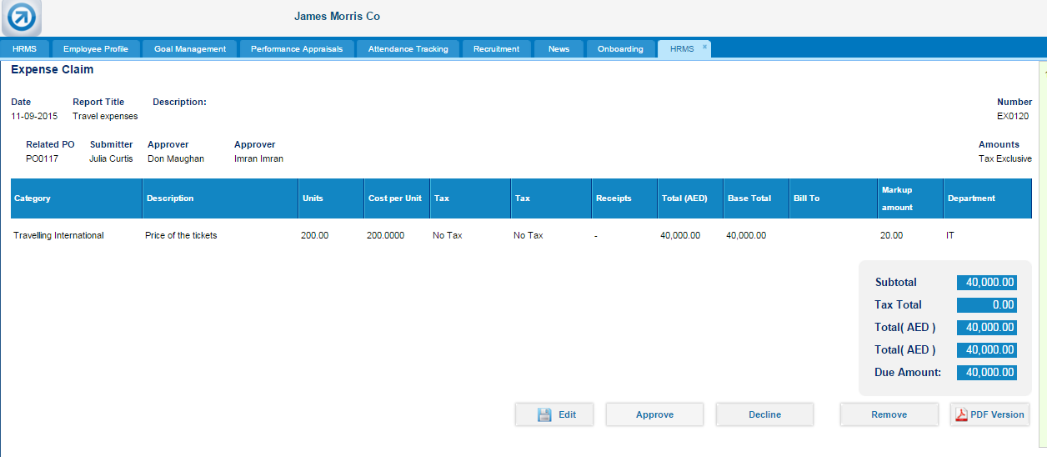
Employees can claim their company expenses
2 level of Approvals can be enabled for your company upon request

Slide 24
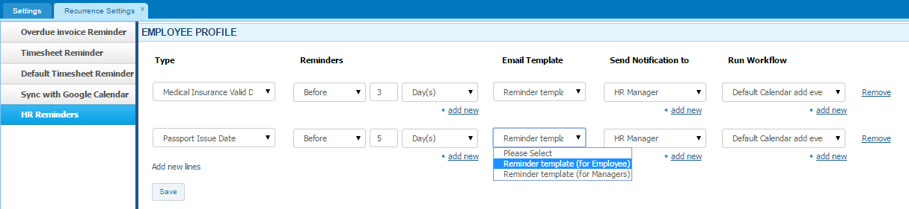
ESS: HR can setup reminders for employees
Settings -> Recurrence Settings -> HR reminders
You can trigger your own events
Reminders can be set to Employees or to managers

Slide 25
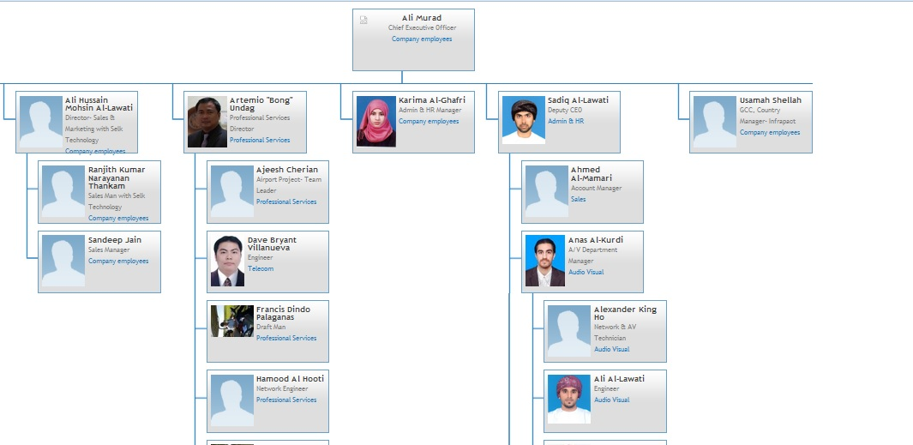
Organizational Structure
Setup positions and departments
and supervisors
Your new employees can see the organizational structure when they login firstly

Slide 26
Attendance Tracking –In/Outs

Slide 27
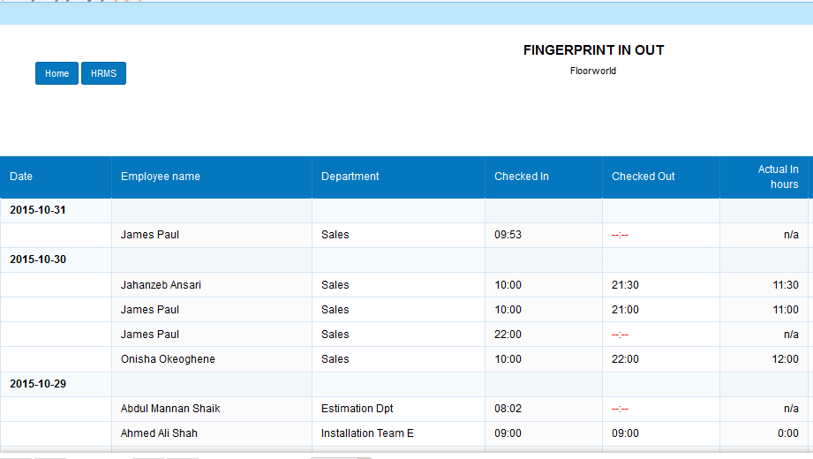
Biometric/fingerprint device integration
Actual hours when employees came to the office

Slide 28
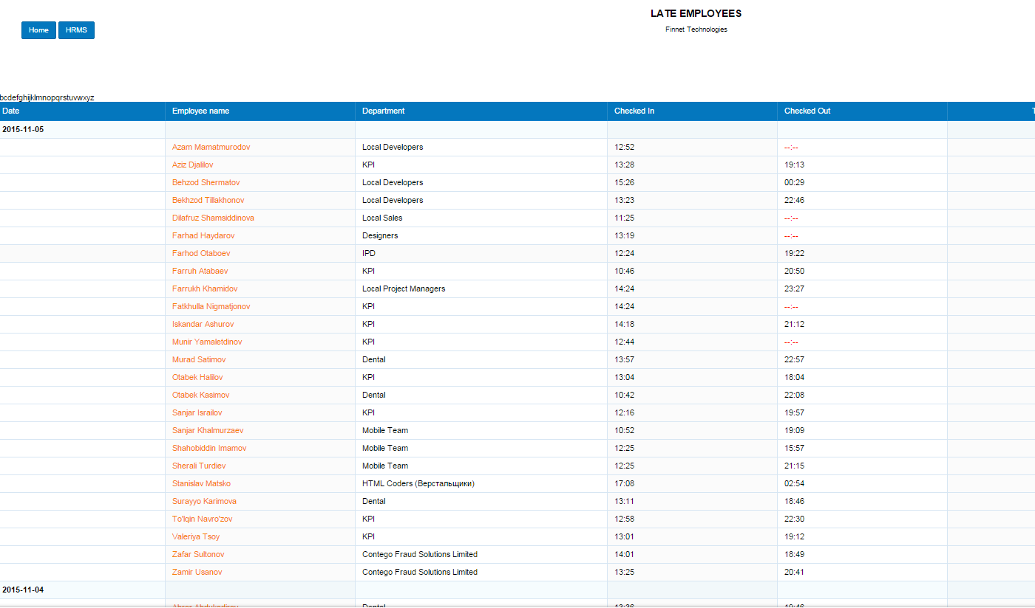
Attendance tracking
John wants to know top late employees of the week
Reporting -> HRMS -> Late Employees

Slide 29
Attendance Tracking –Settings

Slide 30
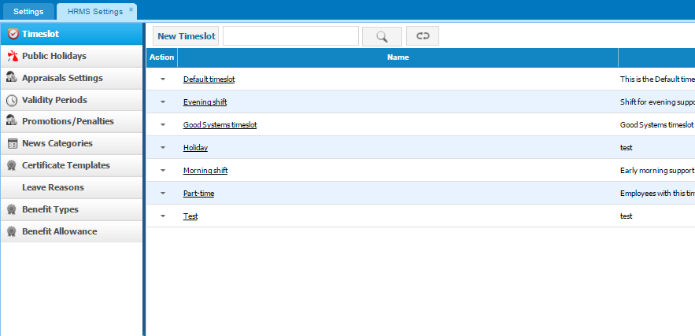
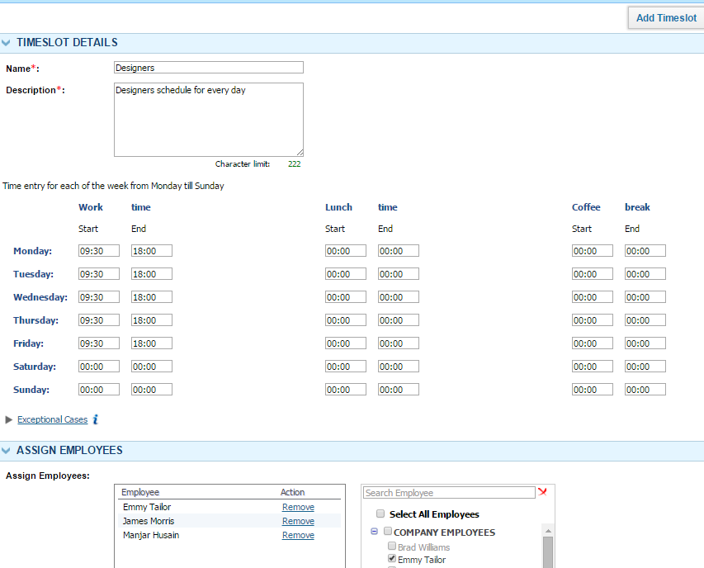
HR manager can set different schedules
Employees have different schedules, some of them are outsourced from freelance

Slide 31
Attendance Tracking –
Leave Requests

Slide 32
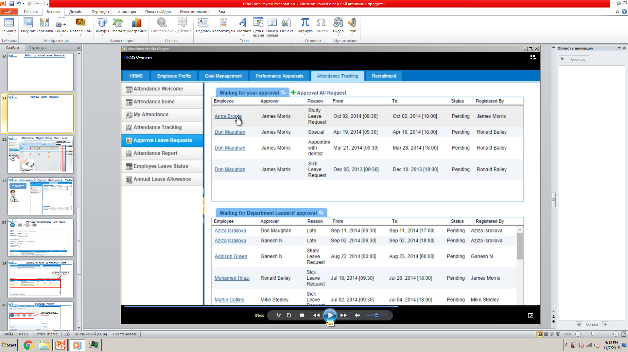
John views active leave requests
Let us see if she deserves leave request

Slide 33
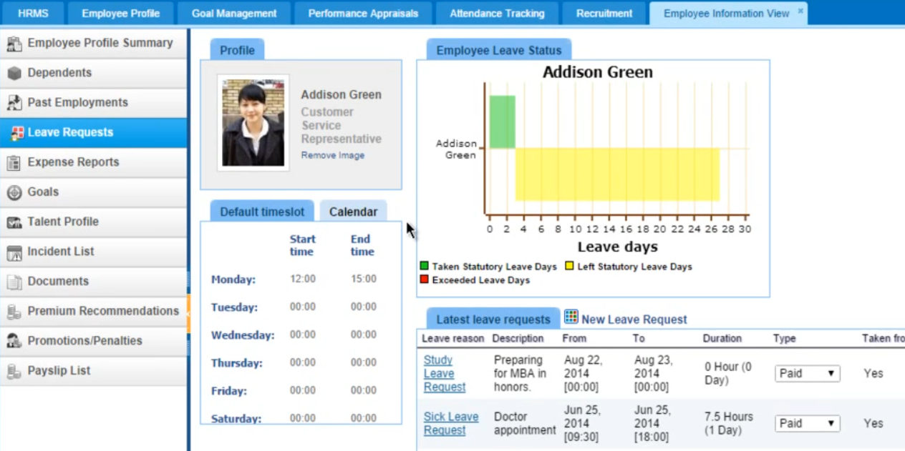
John can view leave status of employee before approval
All good

Slide 34
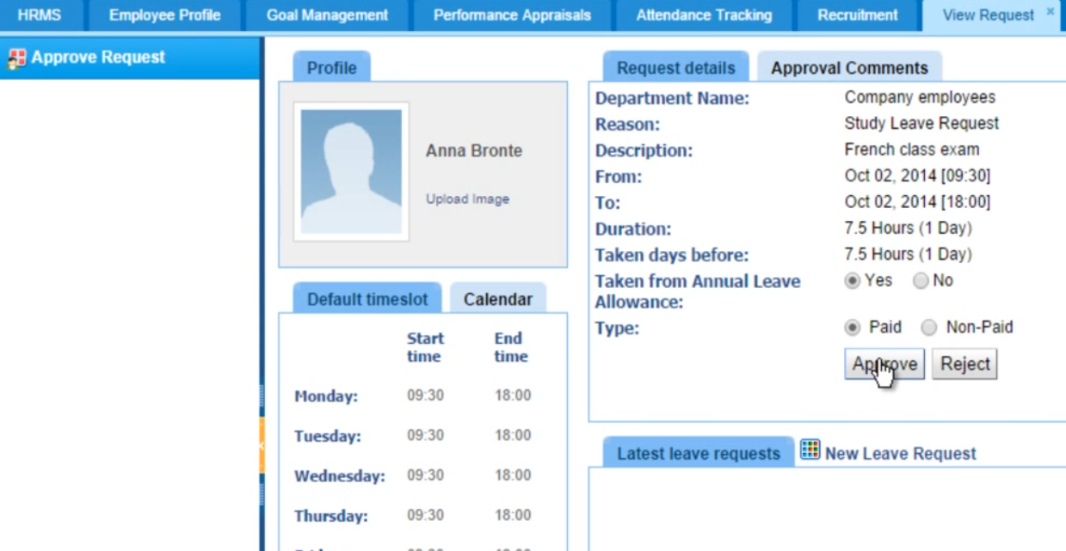
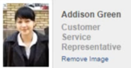
Approve leave requests
Approved, go

Slide 35
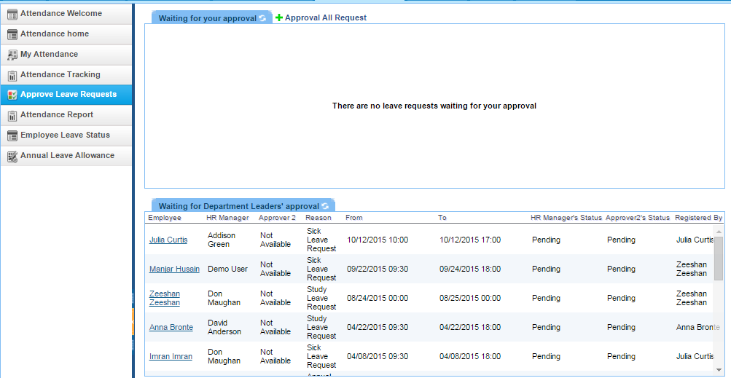
You can add 2 levels of approvals
We can enable 2 level approvals for your company

Slide 36
Payroll Software

Slide 37
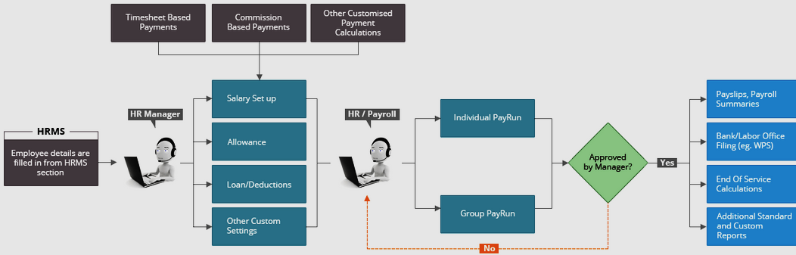
Our payroll is simple and yet functional
Payroll is fully tailored for UAE and Australia legislations
Contact us at support@kpi.com for payroll customizations at your own country

Slide 38
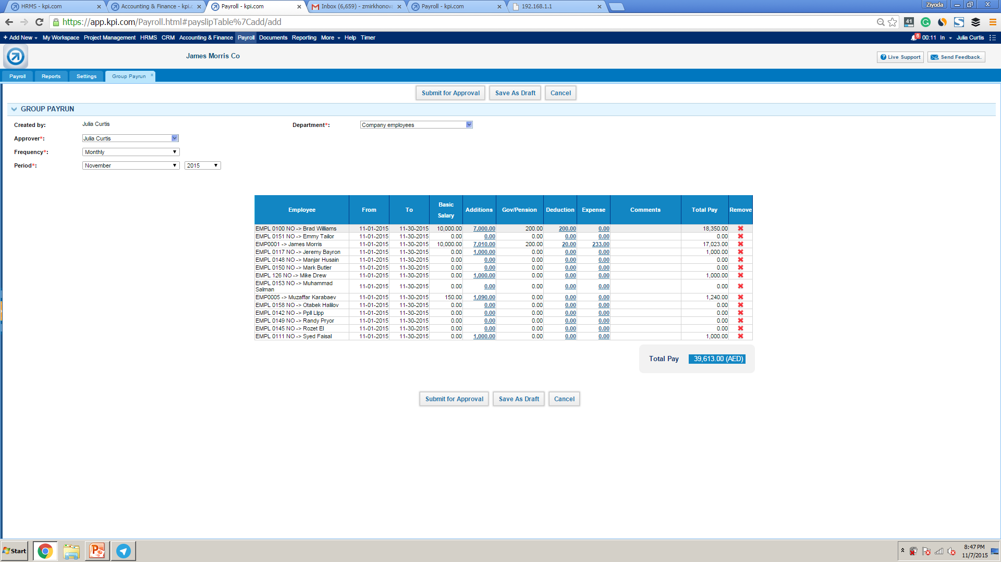
Issue salaries
Initiate a group payrun
I want to issue salary to all employees at once

Slide 39
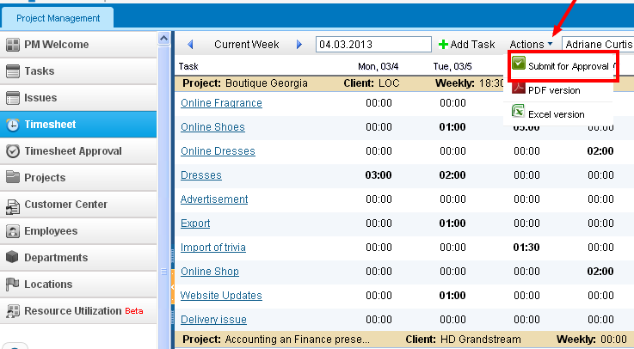
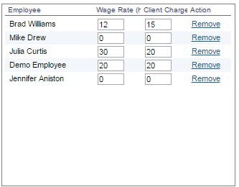
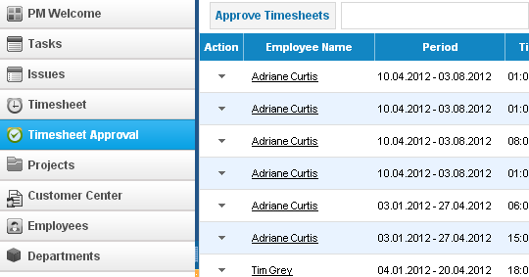
Timesheet/Payroll Integration
1. Make sure employees fill out timesheet
We want to pay employees on an hourly rate
2. Specify rates per project
4. Run payroll as regular
3. PMs Approve Timesheets

Slide 40
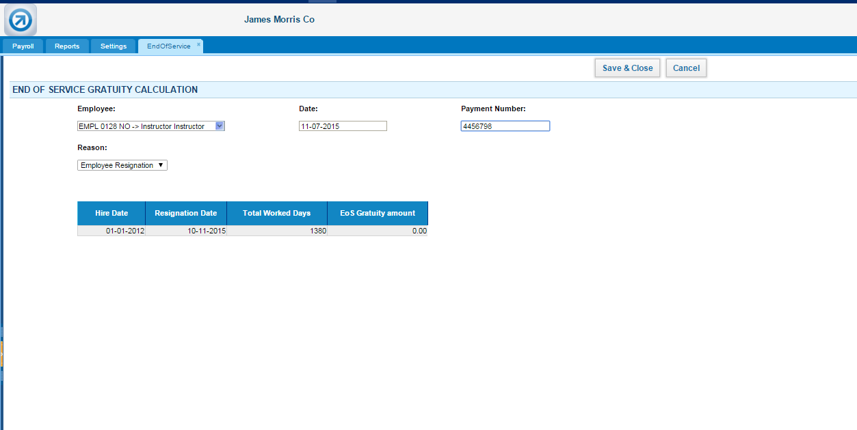
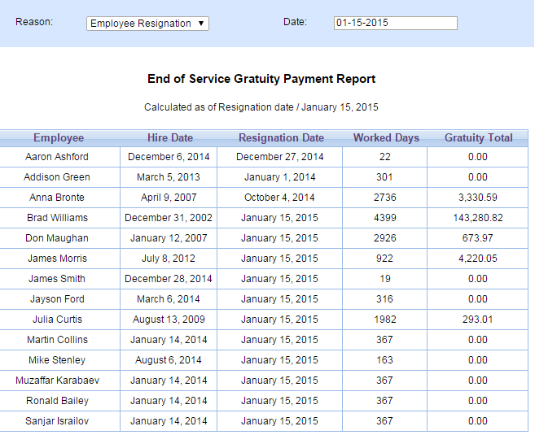
End of Service Gratuity
Calculate end of service gratuity for resigning employees if available

Slide 41
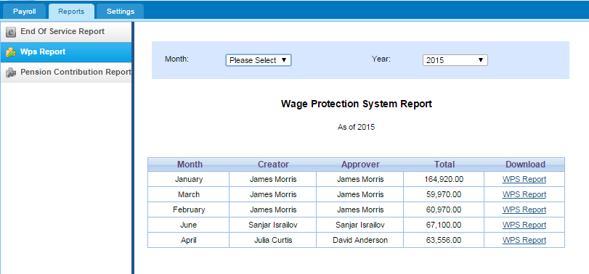
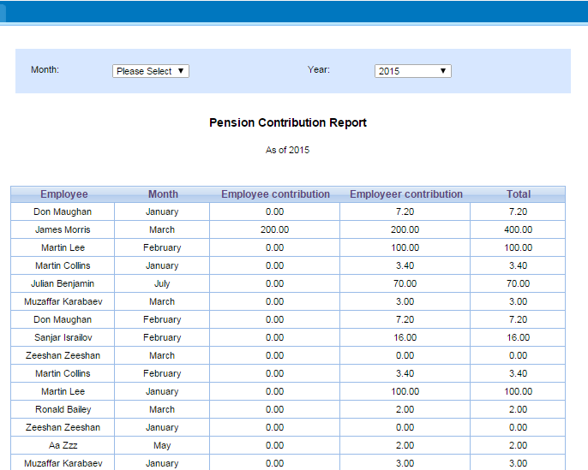
View WPS and Pension Contribution Reports

Slide 42
Recruitment

Slide 43
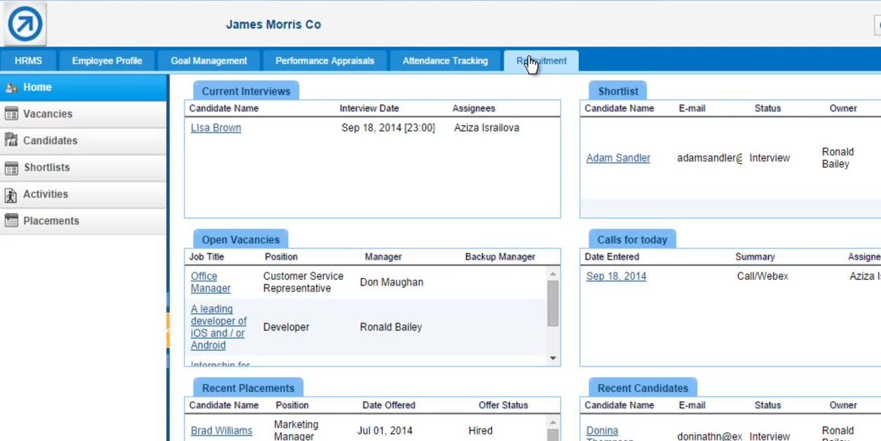
Recruitment
You can receive candidates from a web form
Publish vacancies to your website
https://www.youtube.com/watch?v=swYk62gTCwA

Slide 44

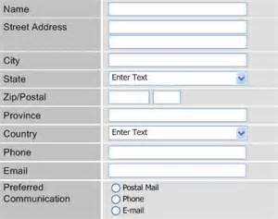

Recruitment Workflow
Publish Vacancies
Receive candidates
Schedule an interview
Prepare a shortlist
Candidate hired
Publish to job sites
Coming Soon!
Candidate added as employee
Web form in your website

Slide 45
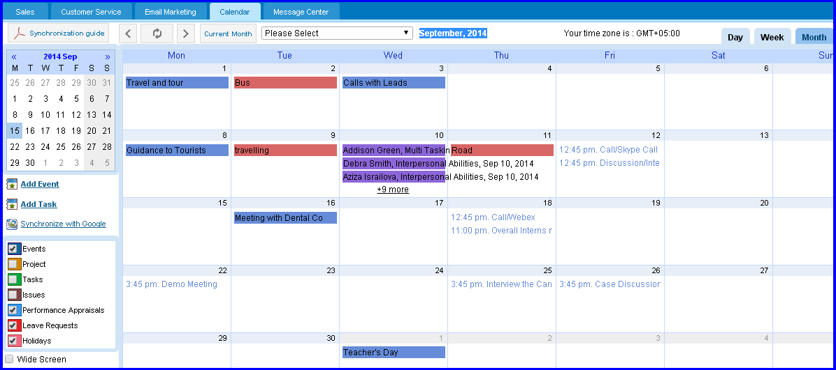
Calendar helps to plan daily interviews
The calendar is fully compatible with Google
It shows everything

Slide 46
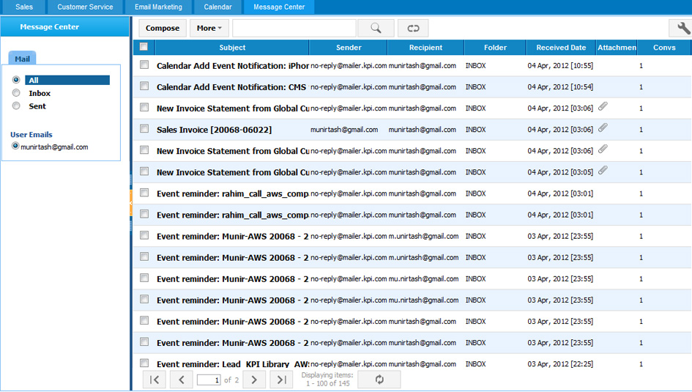
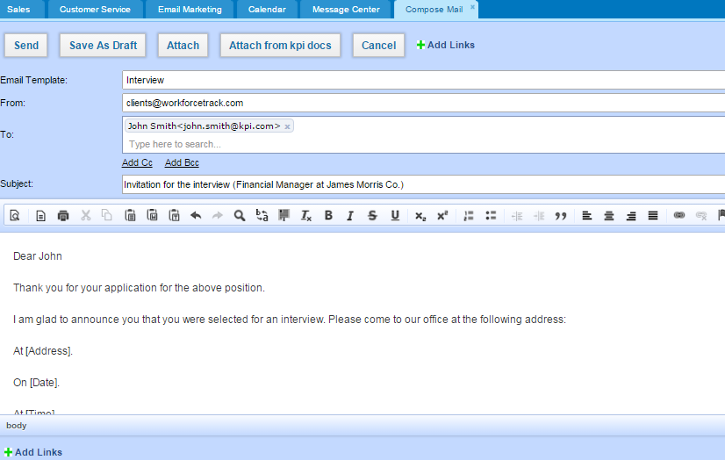
Email right in kpi.com
Email candidates directly at kpi.com
Recruitment@jamesmorris.com
Recruitment@jamesmorris.com

Slide 47
On-boarding

Slide 48

Introduction to On-boarding
On-boarding is a process in which new employees acquire the necessary knowledge, skills, and behaviors to become effective organizational members and insiders
Welcome
Review
Plan
Trial evaluation
Employee
On boarding
Socialize
Trial month
Documents
Training

Slide 49
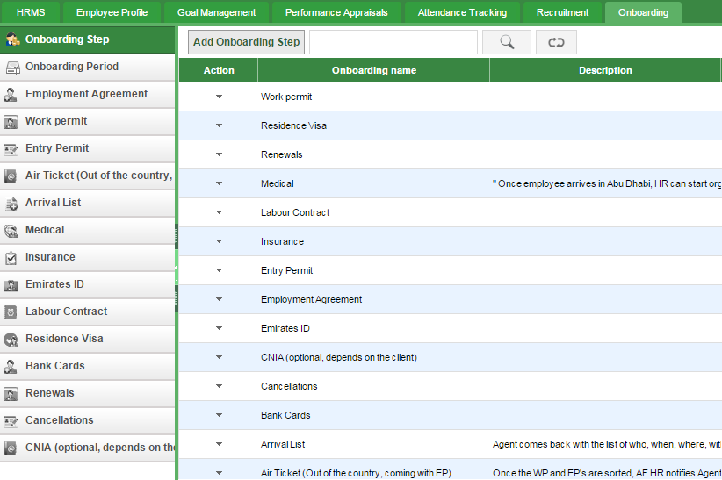
On-boarding
We can track passport, visa, government related forms, entry permits and set renewal reminders for HR managers

Slide 50
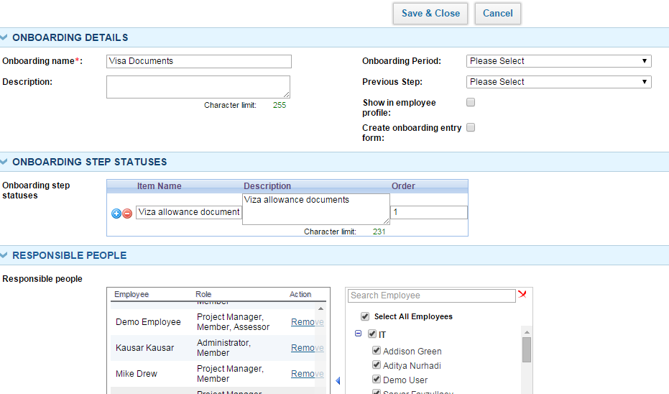
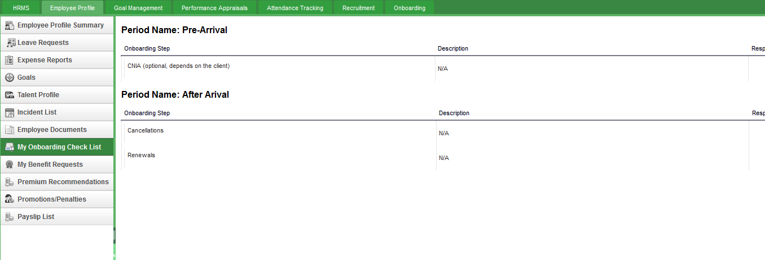
On-boarding
How on-boarding works in kpi.com:
HR Manager/Admin builds periods, steps with custom forms and custom fields with on-boarding steps
Employee sees their own on-boarding data in My On-boarding Checklist(if HR manager enabled for employees to them)

Slide 51
On-boarding Workflow
How on-boarding works in kpi.com:
Employees
HR Manager
Add On Boarding Period
View on boarding checklist
Add On Boarding Step
Fill out the form
Add Custom Fields
Upload documents
This step is completely optional

Slide 52
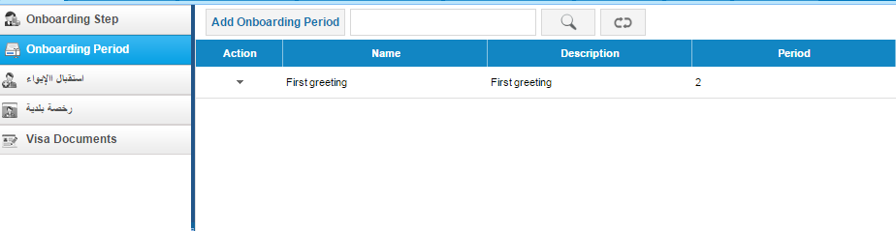
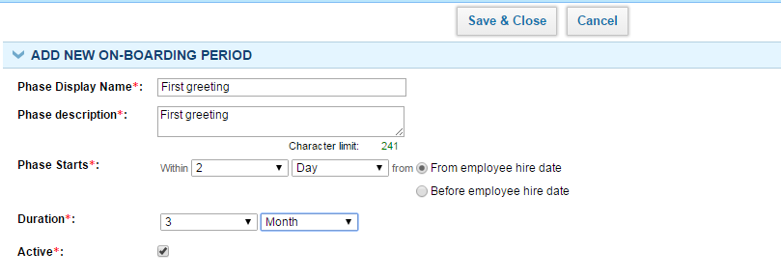
On-boarding period:
1. Add on-boarding period
An on-boarding period is a period when certain on boarding steps need to be completed

Slide 53
On-boarding steps:
2. Add on-boarding step
An on-boarding step is the step which employee should pass in when they are hired
When checked, it will be visible for employee
This will create a custom form

Slide 54
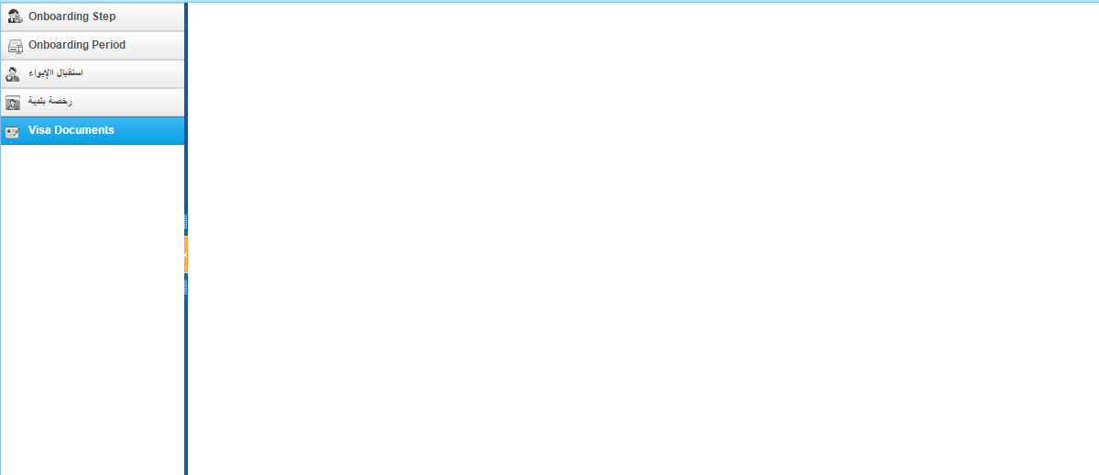
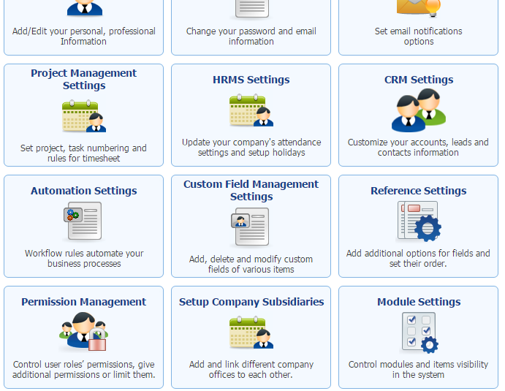
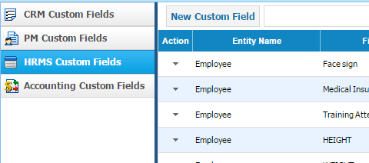
On-boarding steps:
3. Build an on boarding form in Settings
1. Go to Settings – Custom Field Settings
If you build a custom form, it will appear here
1. Go to Settings – Custom Field Settings

Slide 55
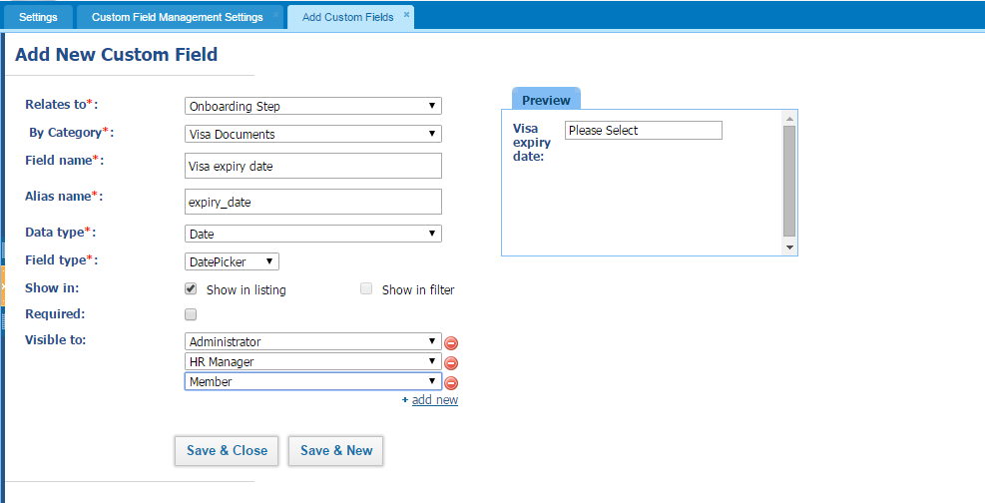
On-boarding custom fields
Add as many custom fields as needed:

Slide 56
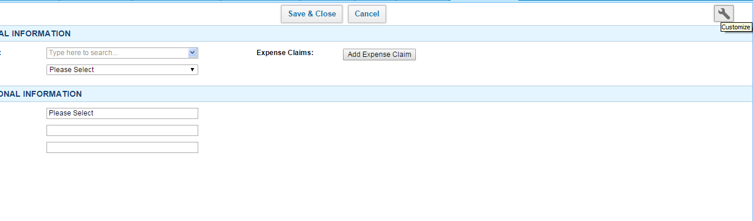

Make on boarding form user friendly
Drag and drop fields

Slide 57


How employees see on-boarding data

Slide 58
Performance Appraisals

Slide 59
Our Performance Review Template
Employee’s name
Competencies – Weight
Competency 1 – Score X
Competency 2 – Score Y
Goals – Weight
Goal 1 – Score X
Goal 2 – Score Y
Total Employee’s Score = XYZ
Total Goals x Weight + Competencies x Weight
Total of weights should equal 100%
Note: We can implement your own template upon request

Slide 60
Our Performance Review Workflow
This step can be totally omitted
Manager’s Initiative
Employee Self-Review
Manger Review and Rating
Manager’s Approval
Manager can be HR, Department leader, or a Project Manager

Slide 61

John Conducts Performance Review
I need to review my team members

Slide 62

He sets competencies and goals

Slide 63

Review or send to employee first
You can set your own goals in Goal Management Section

Slide 64

Manager Review
Rates can be customized

Slide 65

PA trends we want to follow in the future
At the end of the day, we want better results from employees as a company
We will be providing options for simple and more frequent feedback goal-measurement processes in the system
In other words, we will make it simple to measure performance and compare it over time

Slide 66
HRMS Reporting

Slide 67

Custom reporting tool helps to create your own reports
We want to stay flexible by creating our own reports
Step 1:Create your own report here

Slide 68

Custom reporting tool helps to create your own reports
2. Select the template
Contact us at support@kpi.com for more hrms templates

Slide 69

Custom reporting tool helps to create your own reports
Build your own report here

Slide 70

Custom reporting tool helps to create your own reports
You can build your own chart
Select columns
Select chart type

Slide 71
Add-ons and Settings

Slide 72
Need more?
You can customize kpi.com under your own requirements:
Invoice
Settings
Your own functionality/feature
Your own tabs/fields/entities
Your own rules
Colors
Logo
Level 3
Workflows, tabs, sharing
Hide/Add additional tabs
Workflow rules/reminders
Custom sharing/access controls
Level 2
Rules
Custom Fields,
2-level Workflows
Colors/Logo/Templates
Level 1
Workflow
Section 1
Feature 1
Feature 2
Core kpi.com

Slide 73

Settings
Set up each company and financial settings
Set up profile and how you should get an email
Custom Fields
Set up each module
Set up workflows
Set up permission levels

Slide 74

Workflow Automation Settings
Define workflows for certain rules in the system

Slide 75

Workflow Automation Settings
Following activities can be triggered when workflow rule is true
Example: send email customer every 2 weeks once the subscription is active

Slide 76


Reference Settings
You can change the default values in our lists

Slide 77
2-Level Workflows
Add Leave Request
Approve Leave Request
Approve Leave Request
2-Level approvals can be easily be enabled
Employee
Manager
Manager-2
Purchase Order Request
Approve Purchase Order
Approve Purchase Order
Employee
Manager
Manager-2
Contact us at support@kpi.com for enabling 2-level approvals for your company

Slide 78
Why kpi.com?

Slide 79






Benefits of kpi.com
By adopting kpi.com, you will be able to enjoy the following benefits:
Lower Operational Costs
Transparency of processes
Ease of Sharing
Improved Customer Service
Better Reporting
Increased Efficiency

Slide 80
Kpi.com is Safe and Secure
Physical security
It is hosted on Amazon cloud
Network security
HTTPS protocol is used to encrypt data
People and processes Employees have no access to customer data

Slide 81
Our backup policy
You can request one of these backups from the beginning of your subscription period
Daily Backups
Weekly Backups
DB Backups
All-time backups
Monthly Backups
You will get this when you decide to quit kpi.com

Slide 82
Our engagement model with clients
How will we work with you?
You will be assigned a relationship manager who will work with you from the beginning
Relationship manager will help you to setup the system and get running until the end of on-boarding period
On-boarding period is typically 3 months, but it can be extended
You will be able to call your own relationship manager any time in case of any issues
When you are fully on boarded, our generic support team will take care of you, but you will have an access to your own relationship manager too.

Slide 83


We Offer Lot’s of Training Materials for Free
Our guidebooks:
Our help center:
Our video trainings:
Project Management overview: http://www.youtube.com/watch?v=_hLNlEVsqho
CRM: http://www.youtube.com/watch?v=2qFEjSawfCU
HR: http://www.youtube.com/watch?v=swYk62gTCwA
Accounting Videos: http://www.youtube.com/playlist?list=PLa7P0Qa2jO2X9tYQ9aVPV4NJ3F4C9sScW

Slide 84


Our Support Team is There For You 24 Hours

Slide 85
















We love our customers and they love us too!
These Companies Trust Kpi.com in Running Their Business:
526+ Active Companies, 3000+ users from partners
12,000,000+ Projects
1,550,452+ Timesheet entries
4,458,263+ Invoice Documents

Slide 86





Signup For a Free Trial
It’s takes less than 60 seconds

