Slide 1

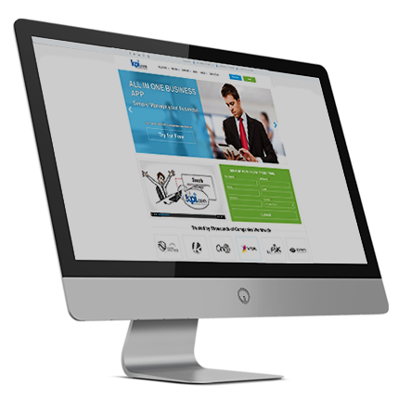
Cloud CRM Software
By: Muz Karabaev, Founder of kpi.com | muz@kpi.com

Slide 2

Introduction

Slide 3

Introduction – who we are
kpi.com – part of Finnet Limited, Software Company Started/Founded in 2005 by Muzaffar Karabaev in London, United Kingdom.
MobileCloud DMCC is a sister company in Dubai, and became GCC Sales and Support Headquarters for kpi.com-Finnet Limited from 2014.
120+ employees spread over three Regions:
Central Asia, GCC (UAE) & UK, Plus our Partner Network (KSA and Oman).
30+ partners/resellers working and providing support for kpi.com in more than 10 Countries. GCC is a major focus NOW

Slide 4
What is kpi.com/Business Management Software?
SME’s Business Processes
Cloud SaaS Software
Ease of Processes
Keep it simple
5 Modules
Single Platform
Built in Workflows
Affordable
With kpi.com you get:
Ease of adoptability
Five core modules in one application
Cloud and Central System
Focus on quality and working method
Multiple layers of support, including trainings and migration

Slide 5
Principles of kpi.com
The kpi.com is built around the following principles:
Cloud Business Management Software
Integrated
Customizable
Kpi.com Reporting Principles
The software should be able to provide the
Financial information quickly
Kpi.com Customer Service Principles
Customers should get full assistance from
support team until they are fully on-boarded.
Easy to Use
Affordable
Kpi.com Upgrading Principles
The cloud business software should provide
automatic regular upgrades for free. For all
customers.
Available on mobile

Slide 6
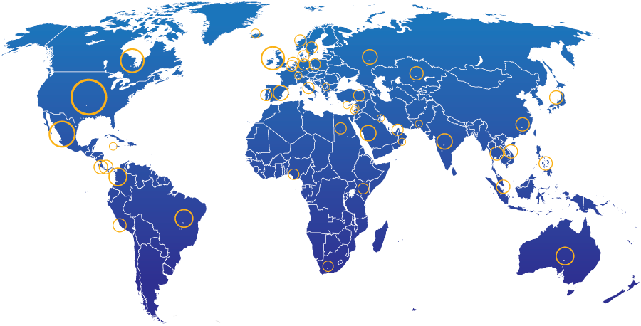
KPI.com: End Users Geographic Spread
28%
North America
21% Other parts of Europe
13%
UK
20%
Middle East
4%
South America
2%
Africa
5%
Australia
Rest of the world – 7%
3000+ Companies, 15000+ User Base and Growing

Slide 7
Kpi.com modules and processes

Slide 8






What is kpi.com software?
It incorporates all key business functions of your business
Payroll
Keep Track of Employees
HRMS
Manage cash/money
Accounting and Finance
Bookkeeping
CRM
Case management
Manage Customers
Inventory Management
Warehouse Management
Keep track of products
Project Management
Produce or Implement
Manufacturing
Sell
Storefront
Sales Force Automation

Slide 9
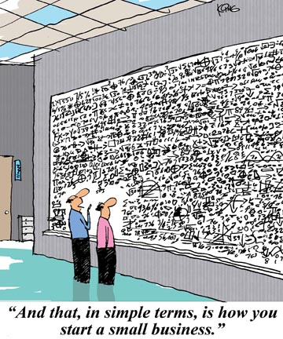

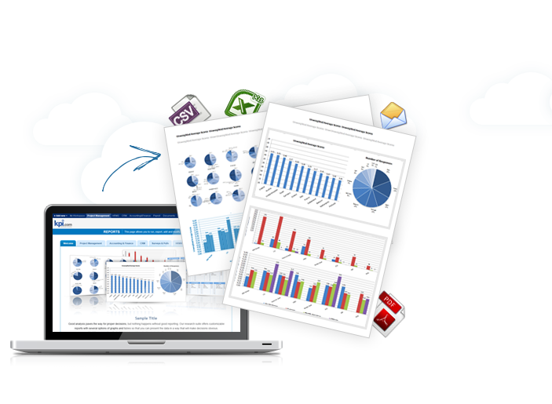
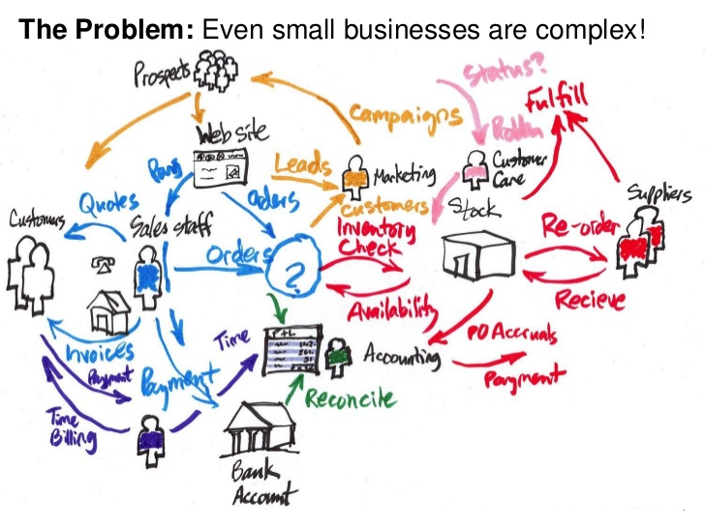
Even a small business is complicated
Kpi.com makes it easy to manage

Slide 10
CRM

Slide 11






CRM Features
CRM software has a number of benefits:
Sales Management
Web forms
Transparent Reports
Improved Customer Service
Mass Mailing and Message
Center
Available on Mobile

Slide 12
CRM Workflow
Marketing
Sales
Delivery
Support
Campaigns
Leads
Cases
Projects
Mass Mailing
Opportunities
Emails
Tasks
Web Forms
Sales Quotes
Solutions
Timesheet

Slide 13
CRM Workflow
Marketing
Sales
Delivery
Support
Campaigns
Leads
Cases
Projects
Mass Mailing
Opportunities
Emails
Tasks
Web Forms
Sales Quotes
Solutions
Timesheet
Most CRM solutions stop here

Slide 14
CRM Workflow
Marketing
Sales
Delivery
Support
Campaigns
Leads
Cases
Projects
Mass Mailing
Opportunities
Emails
Tasks
Web Forms
Sales Quotes
Solutions
Timesheet
With kpi.com, you get this step, you don’t need to buy another project management software
Most CRM solutions stop here

Slide 15
CRM Workflow
Marketing
Sales
Delivery
Support
Campaigns
Leads
Cases
Projects
Mass Mailing
Opportunities
Emails
Tasks
Web Forms
Sales Quotes
Solutions
Timesheet
Reporting
Accounting
With kpi.com, you get this step, you don’t need to buy another project management software
There is more in one software

Slide 16
CRM Default Access Levels
Roles | What they can see in PM?
Administrators | Everything within the CRM section
Sales Managers | Everything within the CRM section
Sales Rep | Only their own data
Accountants | All sales quotes, sales orders, sales invoice documents. All opportunities.
Directors | All sales reports

Slide 17
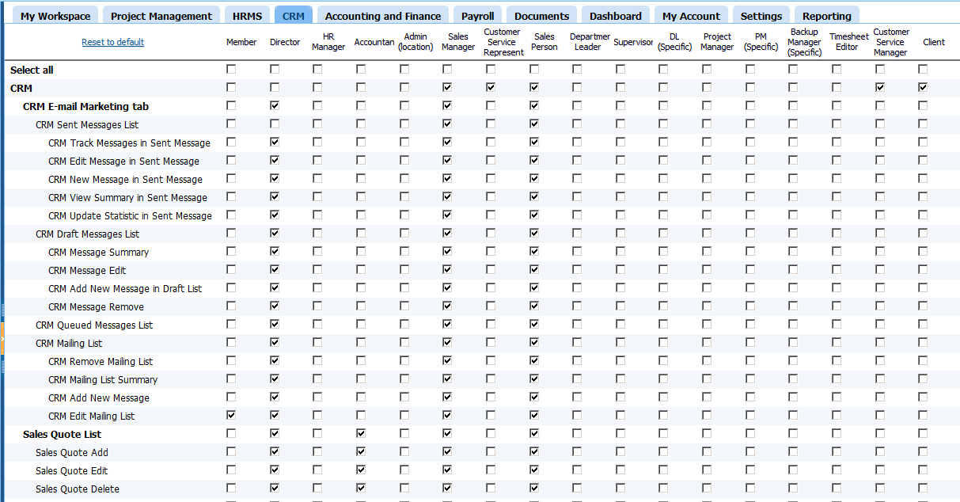
CRM Permission Management

Slide 18
Sales

Slide 19










CRM-Sales Workflow
Lead
Qualification
Opportunity
Won
Project
Reports and
Dashboards
Lead Capture
Opportunity
Sales Order
Lost
No Leaky funnel + Complete Visibility
= Integrated sales, project management and accounting process

Slide 20

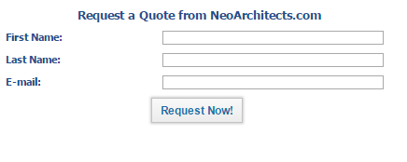
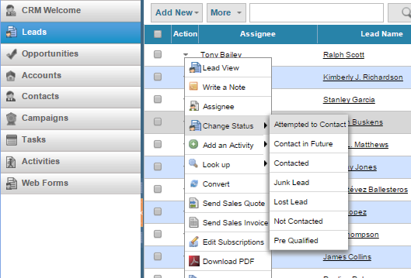
Sales: Just Work With Leads, No Data Entry Required
Easily embed a web form to your main website
And start working with leads in kpi.com

Slide 21
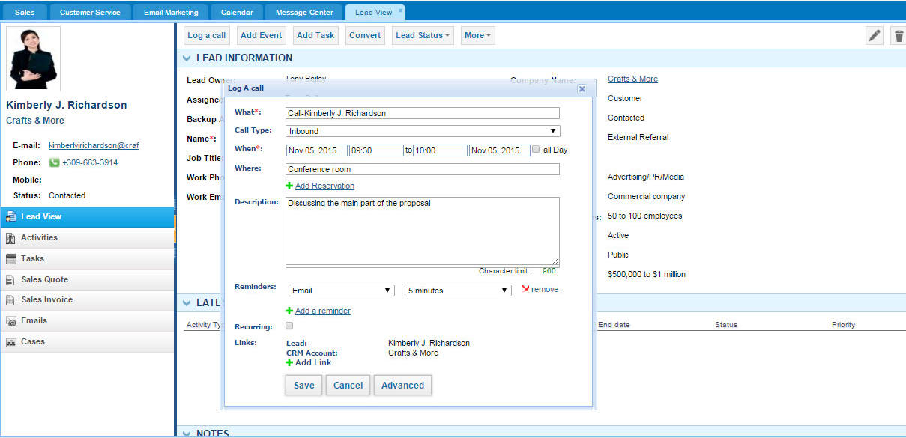
Working with leads
All activities automatically appear in calendar

Slide 22
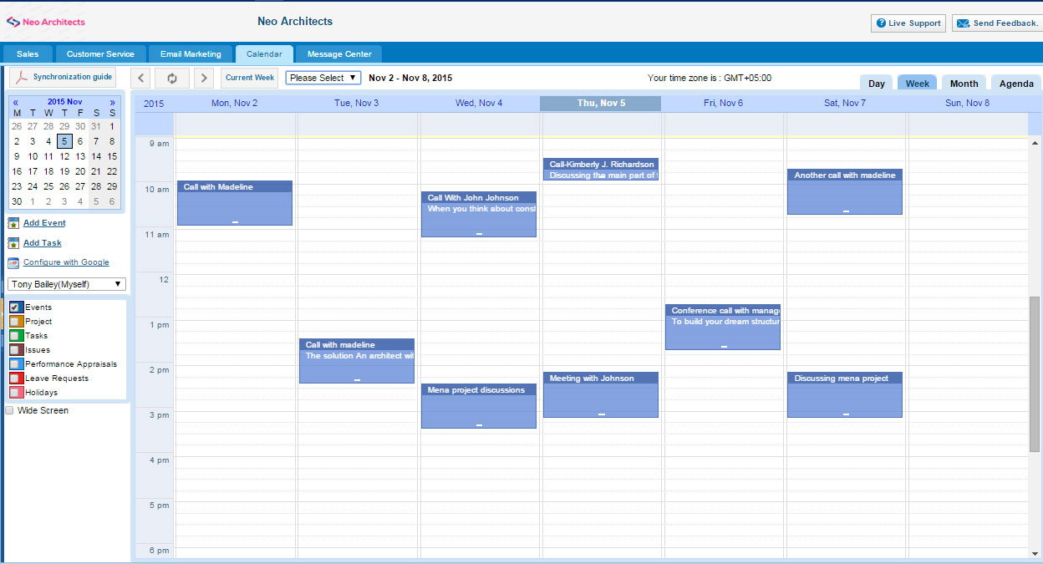
View planned tasks in calendar
Sync with Google
Calendar shows projects, tasks, and leave requests

Slide 23
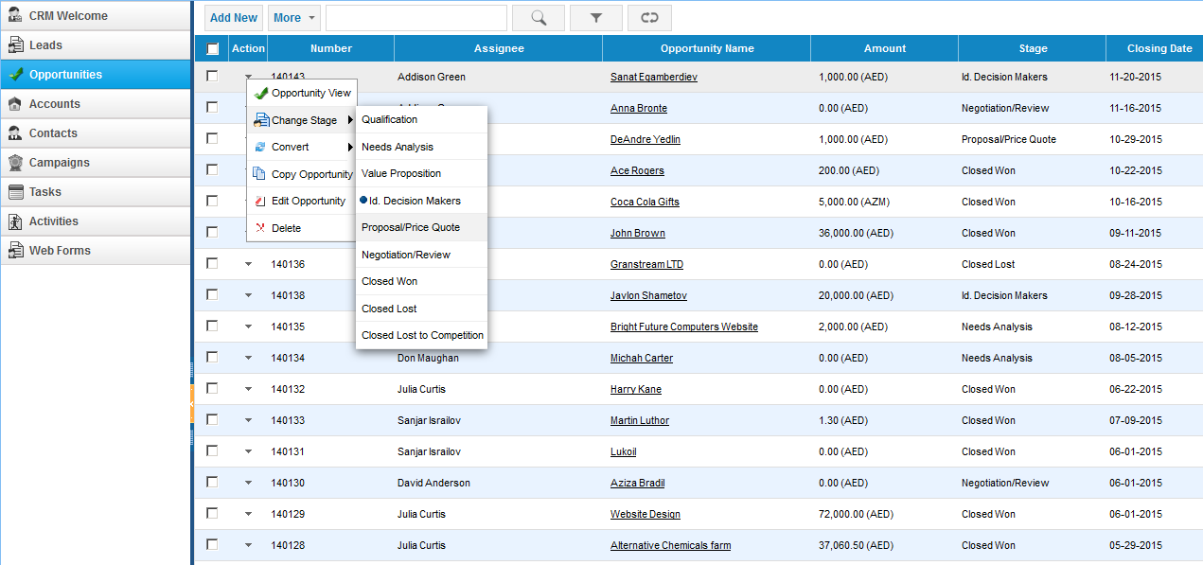
CRM Opportunities
View how your team is performing
You can create your own sequence in Settings – Reference settings

Slide 24
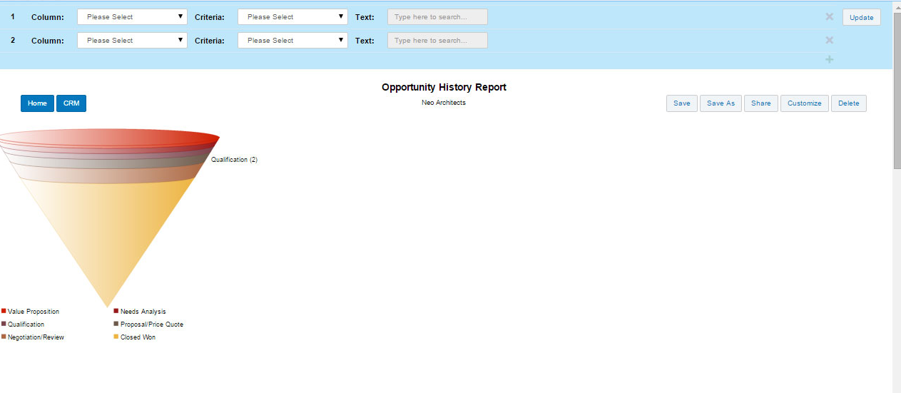
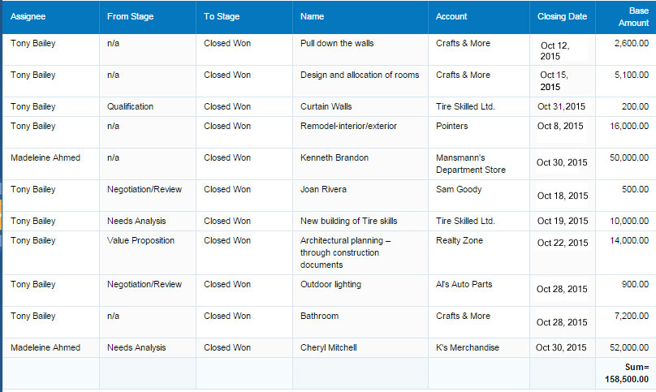
Find out how you are performing monthly
It indicates that there are not enough sales at the top of the pipeline
Total sales this month

Slide 25
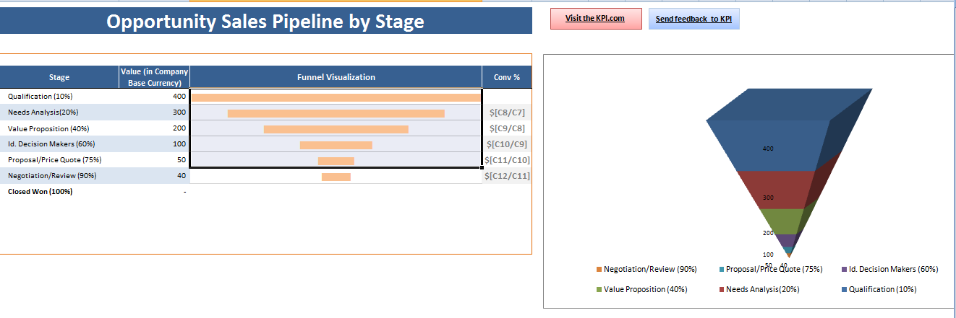
Export your report to excel and view there

Slide 26
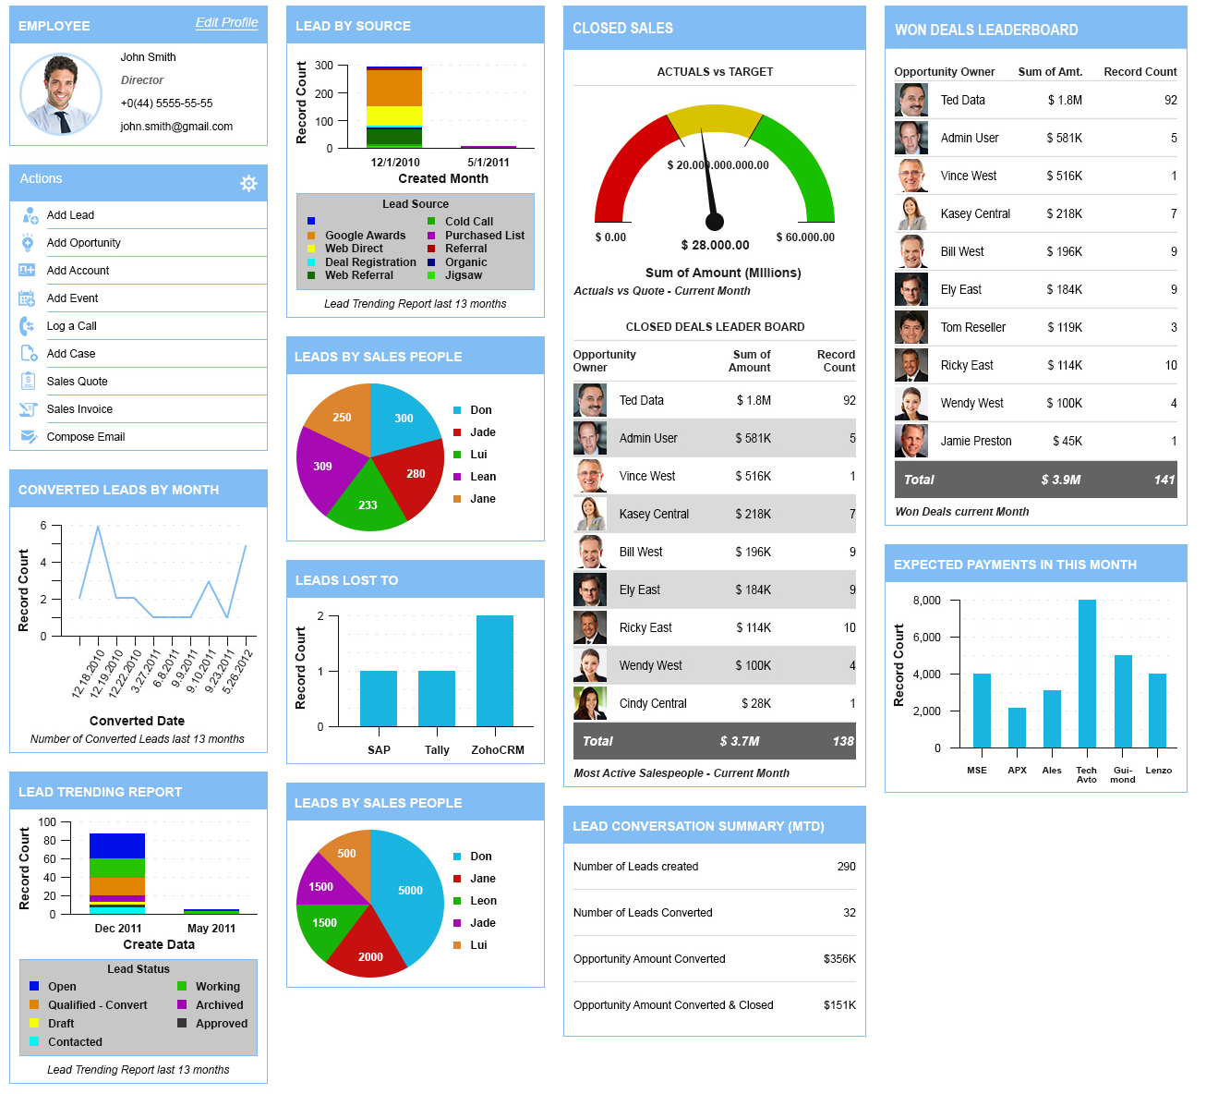

Sales Manager’s Dashboard
Coming Soon!
We want to see some important highlights in dashboard

Slide 27
Mass Mailing

Slide 28
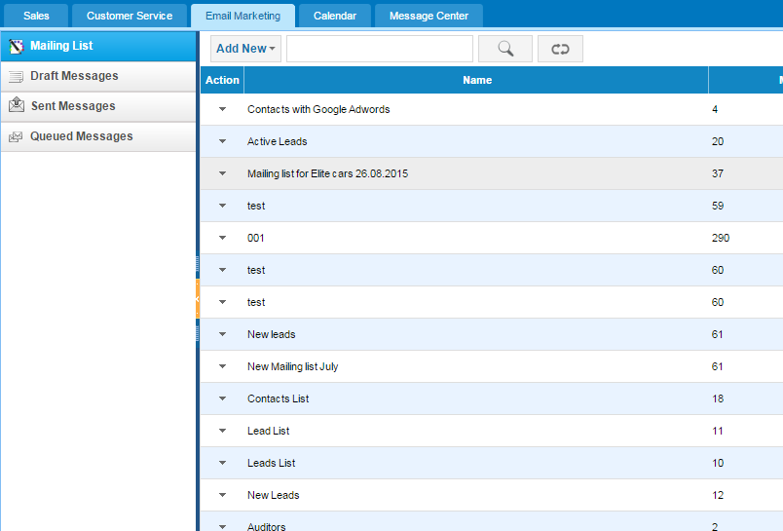
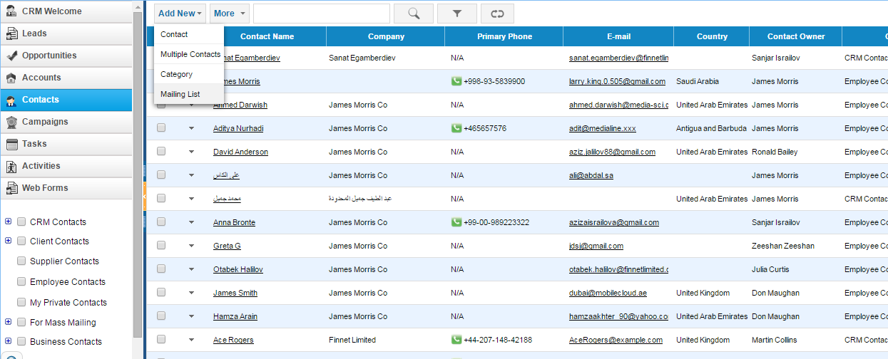
Create a mailing list
You can send emails to your customers and leads in Email marketing – mailing list
We want to send emails to our leads
1. Create mailing list first: Go to contacts – Add new - Mailing list

Slide 29
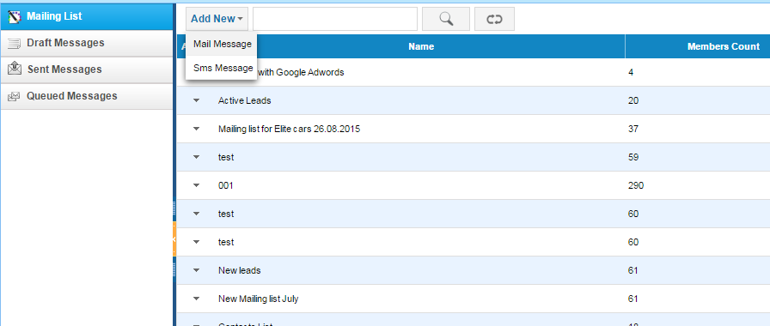
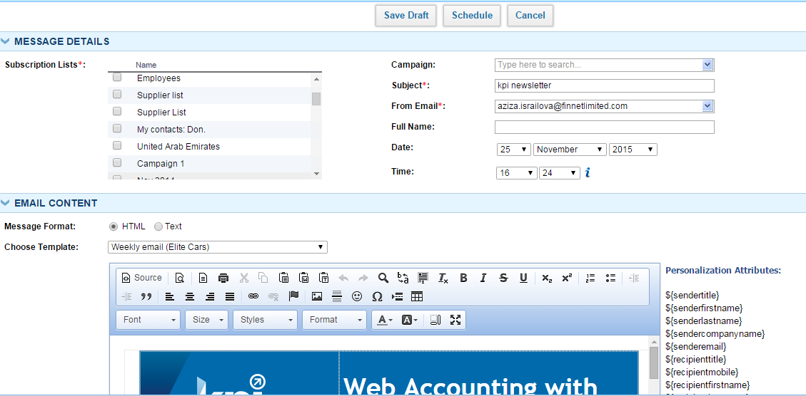
Send mass mail to your leads and clients
You can send mail message or sms message to your contacts
Configure sms settings before using it

Slide 30
Case Management

Slide 31
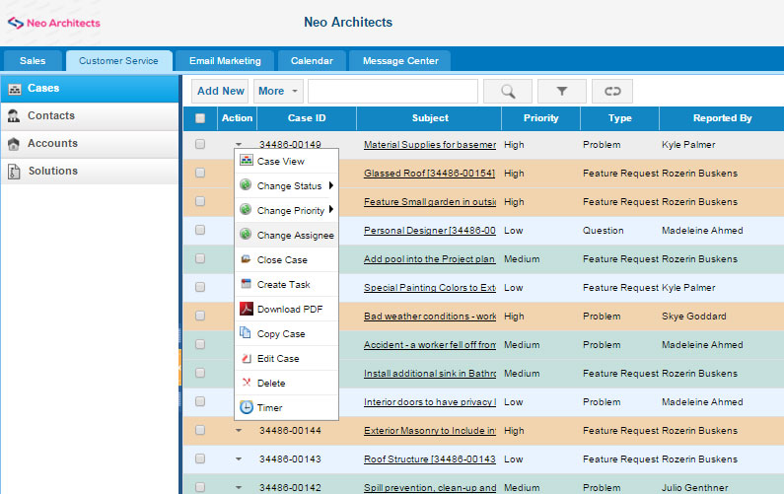
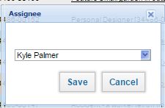
Manage issues and requests in case management
You can configure color coding important tickets when you need
Assign cases(tickets) right there

Slide 32
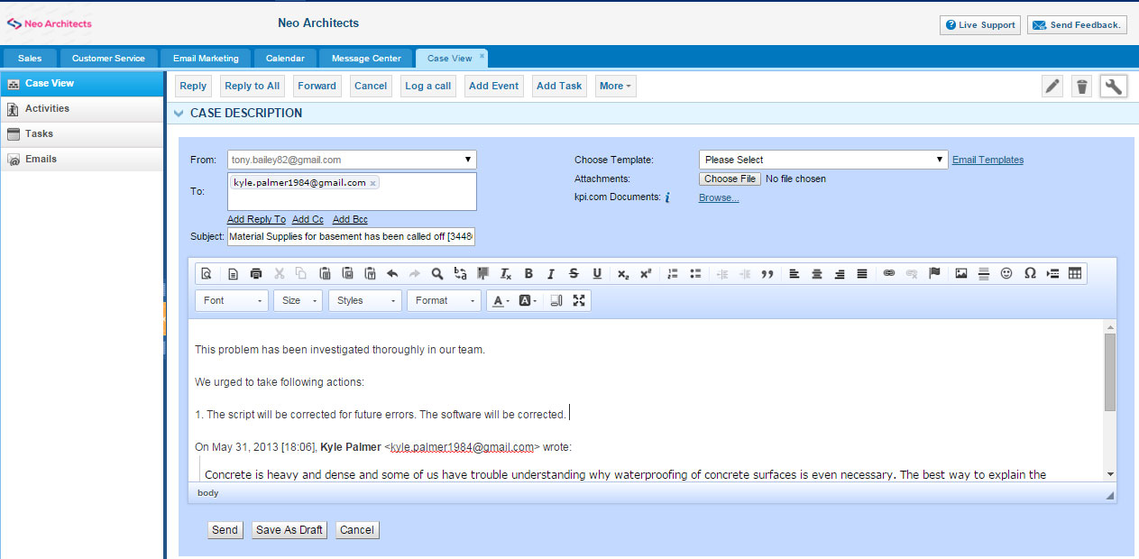
Email customers right from kpi.com
Reply right here

Slide 33
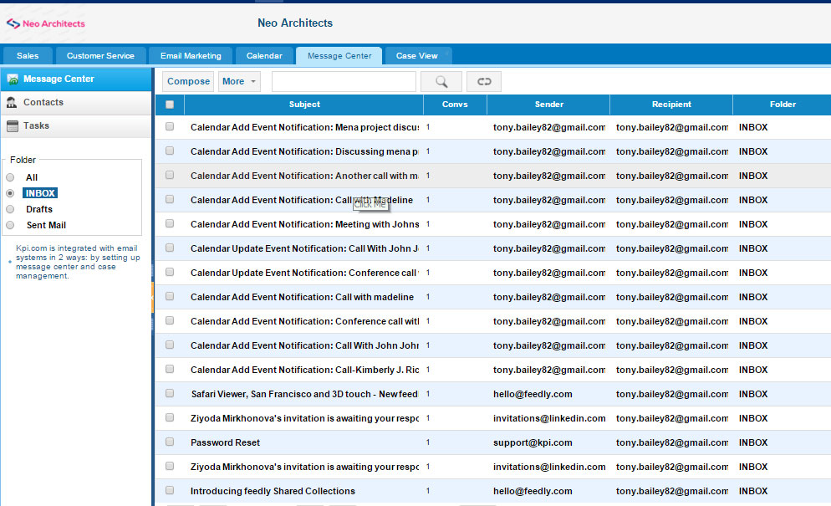
Need to email more? There is a message center
You can connect it to your Google apps account

Slide 34
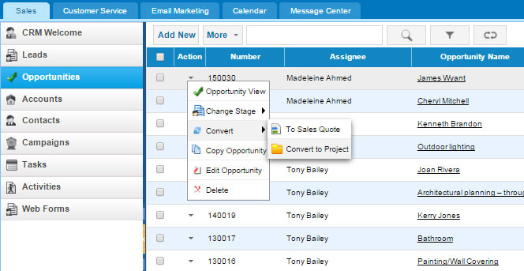
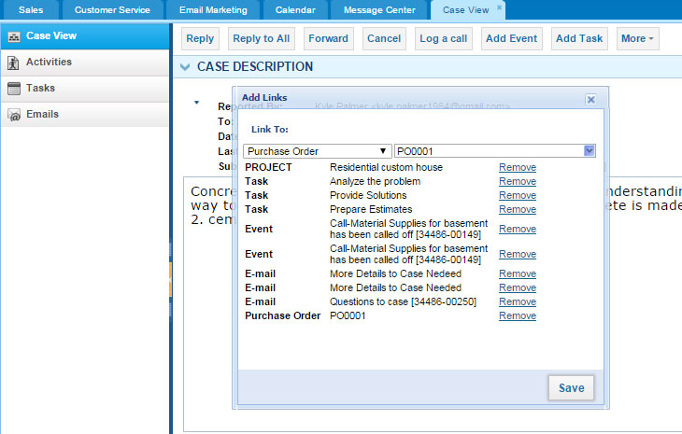
Everything is connected
You can convert opportunities to project, and manage it from project management section
OR
Manage any issues appearing in company from one place. You can relate cases (tickets) to anything. You can track even purchasing issues from suppliers
No need to integrate
different apps with each other

Slide 35
Reporting

Slide 36


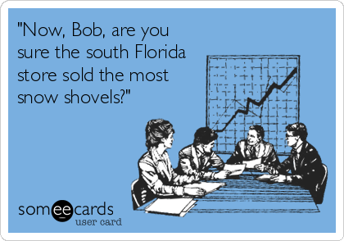


Introduction to reporting tool
You can analyze the company performance with reporting tool.
Custom Reports
Excel Templates
Charts and Dashboards
Advanced Formulas
Watch on You-tube:
https://youtu.be/u7tx4rwkalM

Slide 37
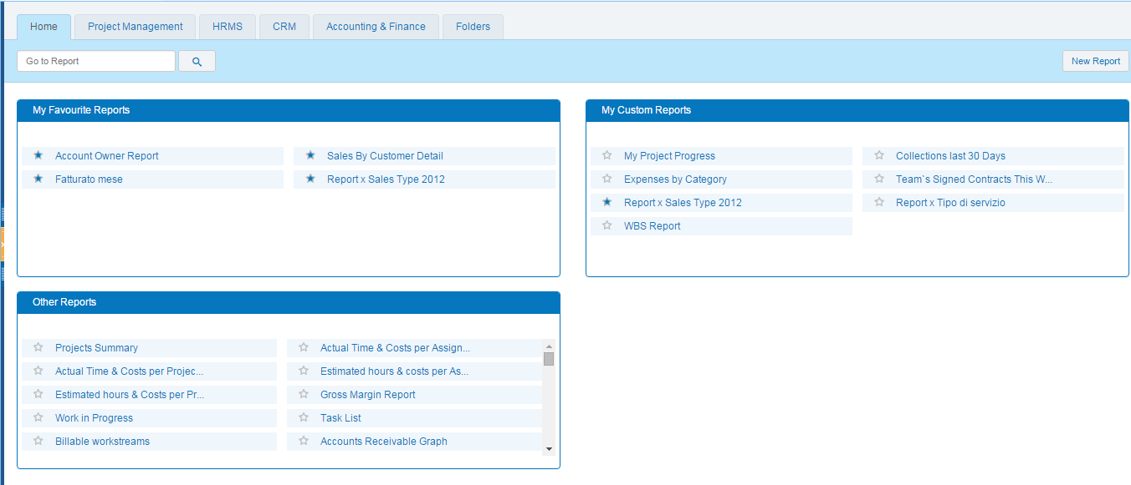
Reporting Home
Setup your favorite reports for easy access
Create your own report
Default reports

Slide 38
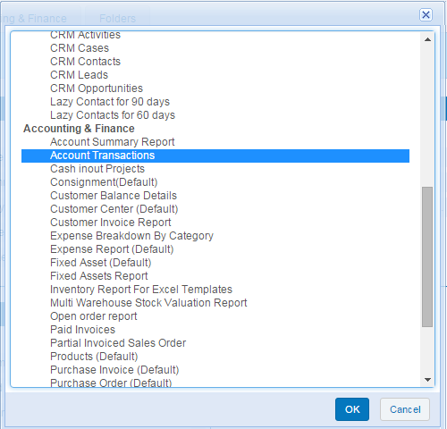
Create your own report
1. Choose Report Template
2. Customize Report

Slide 39
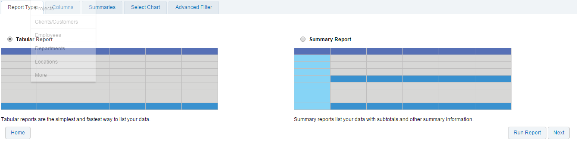
Create your own report
Choose report style: tabular/summary

Slide 40
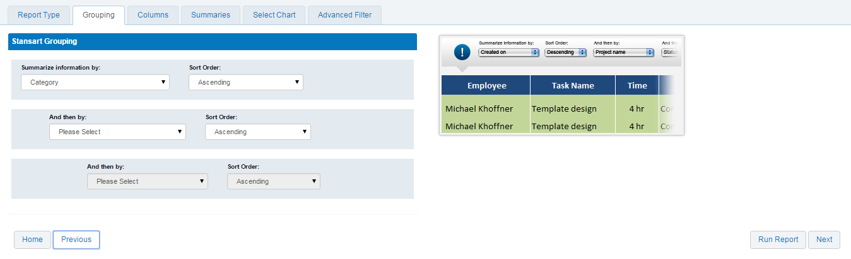
Create your own report
Choose grouping type:

Slide 41
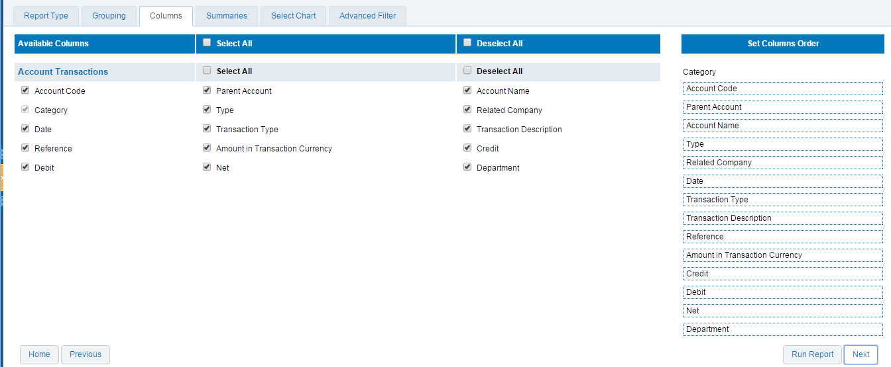
Create your own report
Choose columns:

Slide 42
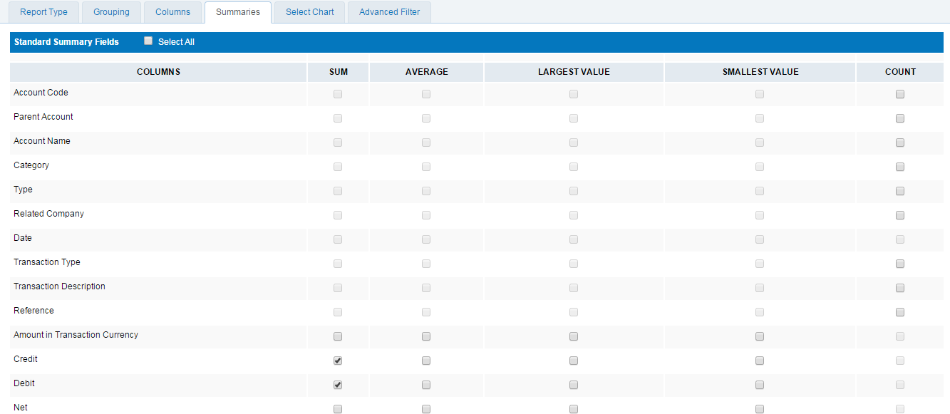
Create your own report
Select summaries:

Slide 43
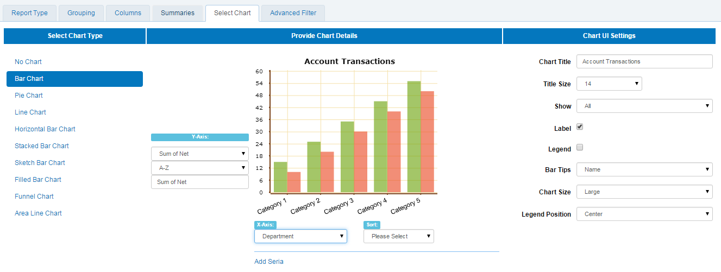
Create your own report
Select the chart type:

Slide 44
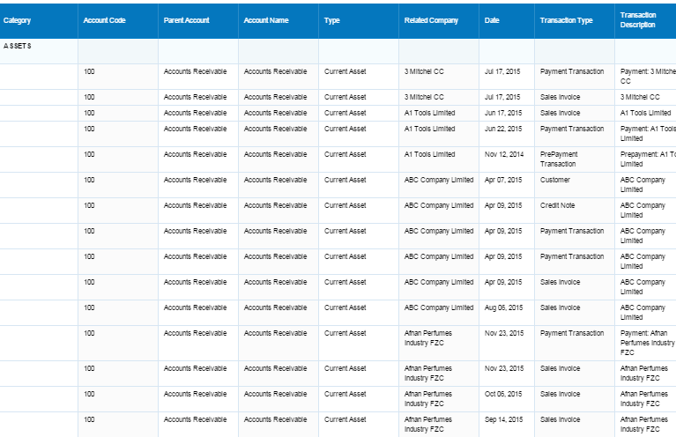
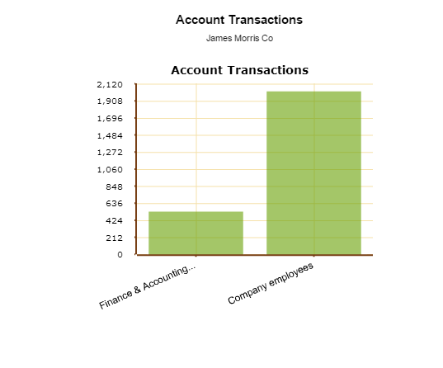
Create your own report
Report is created:

Slide 45
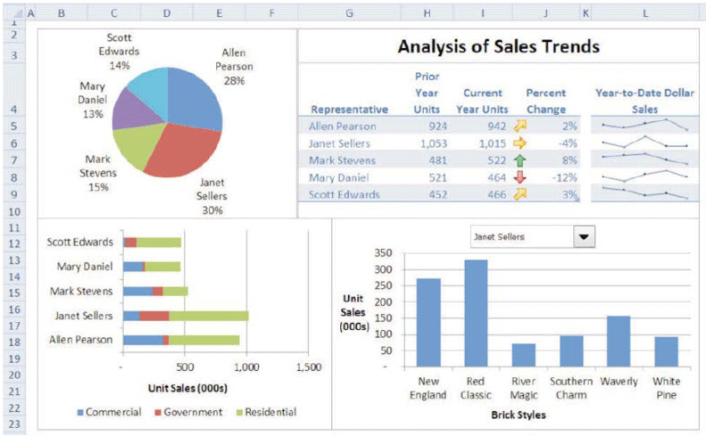
Excel Templates
After customizing Report, NCO were able to design complex reports in a simple way, by themselves. The ability to export in Excel format let them modify the pieces of information of their reports according to sales situations, as well as improve the visual appearance

Slide 46
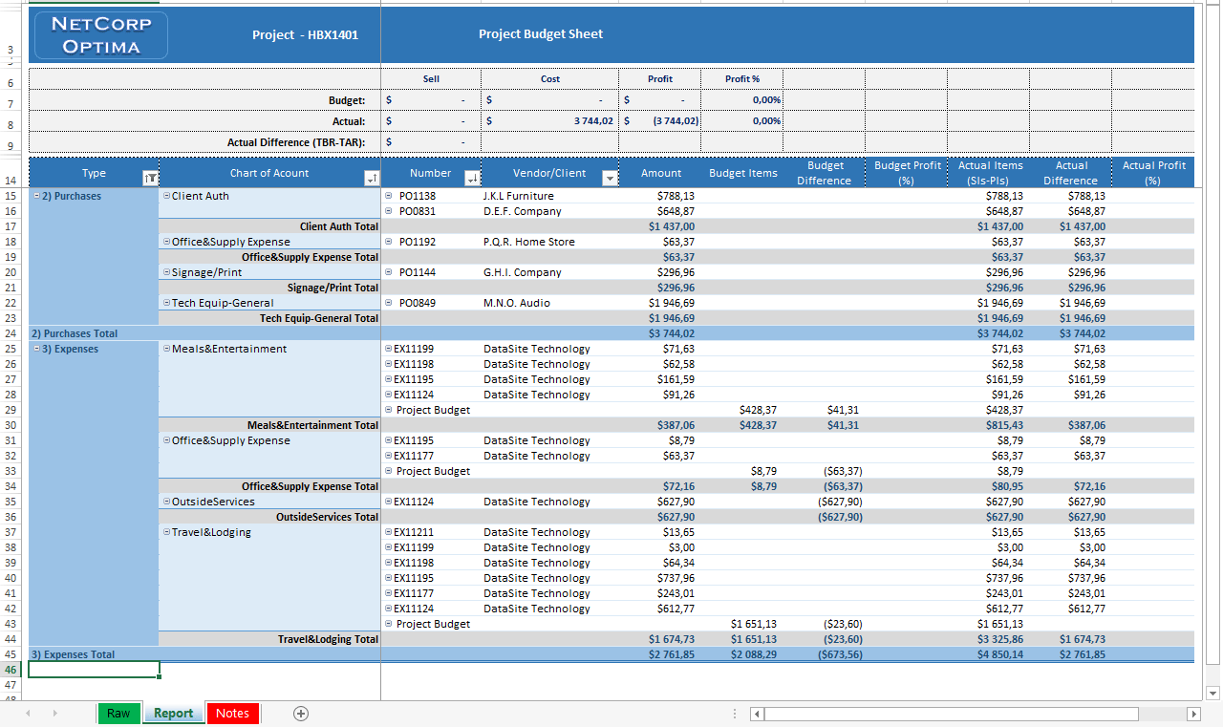
Excel Templates
One of our clients – NetCorp Optima (NCO) project managers of which wanted, while leading a project, to get answers to questions such as: What is the current status of the project?, How is the project going?, What are the important issues we should worry about?

Slide 47
Add-Ons

Slide 48
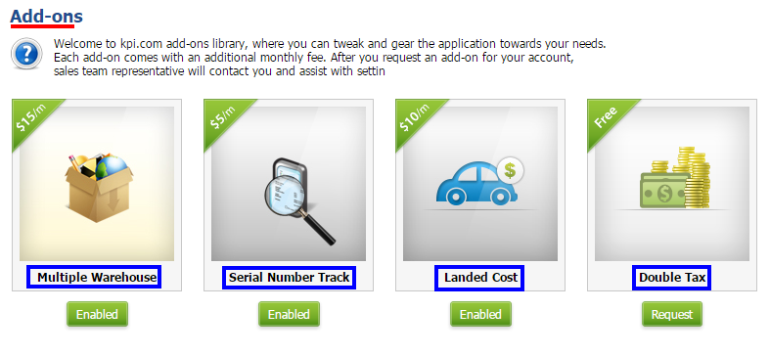
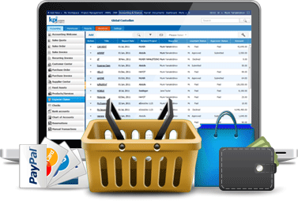
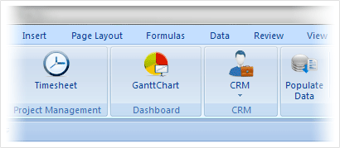
Kpi.com Plugins
There are a number of add-ons which you can enable:
Storefront
Excel Plugin

Slide 49
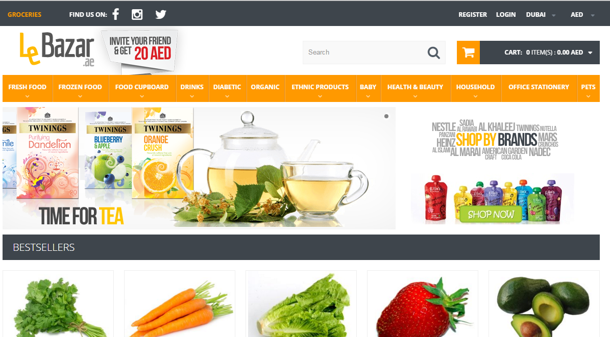
Storefront Management Plug-in
LeBazar.ae – Our customer who built storefront in kpi.com
Manage products inside
Kpi.com

Slide 50
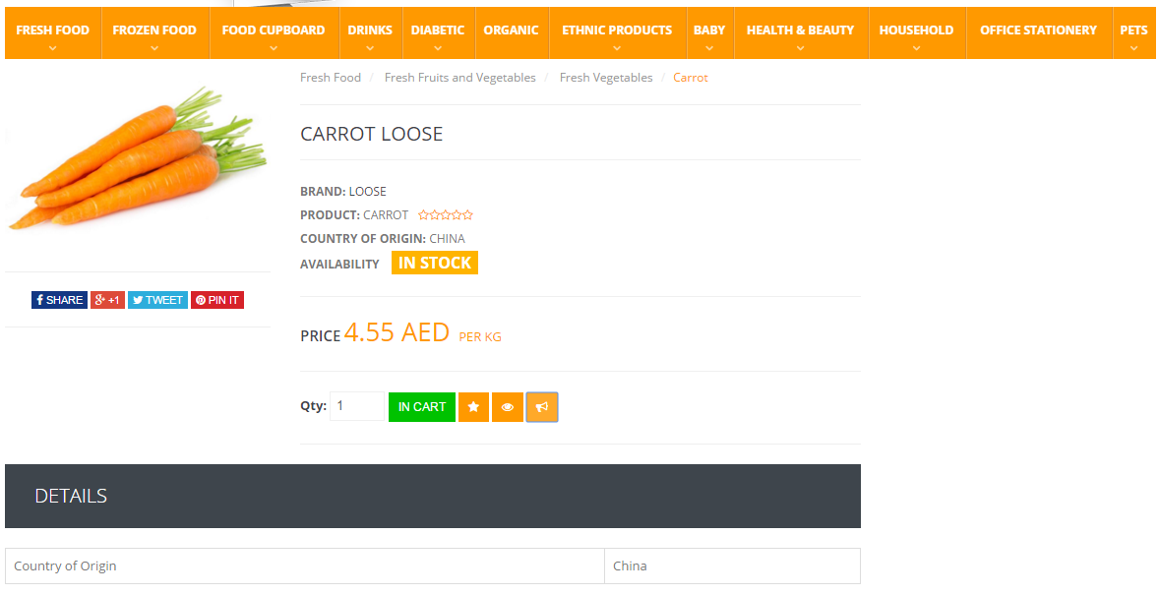
Storefront Management Plug-in
LeBazar.ae – Our customer who built storefront in kpi.com
Manage products inside
Kpi.com
All storefront purchases are
processed from accounting (sales orders)

Slide 51
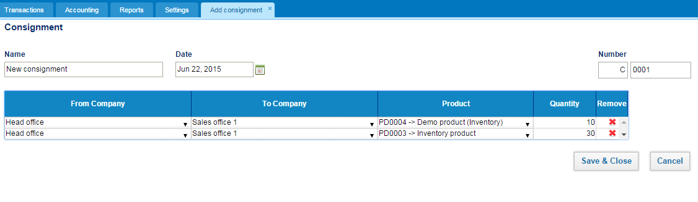
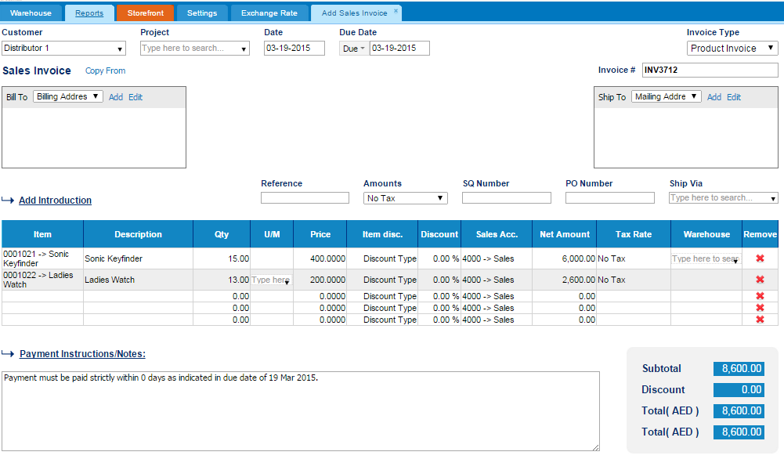
Consignment add-on
You can send items to your clients or subsidiaries for consignment
Your clients/customers will appear here
When your subsidiaries the sales of consignment items trigger bookkeeping transactions automatically

Slide 52
Need more?
You can customize kpi.com under your own requirements:
Invoice
Settings
Your own functionality/feature
Your own tabs/fields/entities
Your own rules
Colors
Logo
Level 3
Workflows, tabs, sharing
Hide/Add additional tabs
Workflow rules/reminders
Custom sharing/access controls
Level 2
Rules
Custom Fields,
2-level Workflows
Colors/Logo/Templates
Level 1
Workflow
Section 1
Feature 1
Feature 2
Core kpi.com

Slide 53
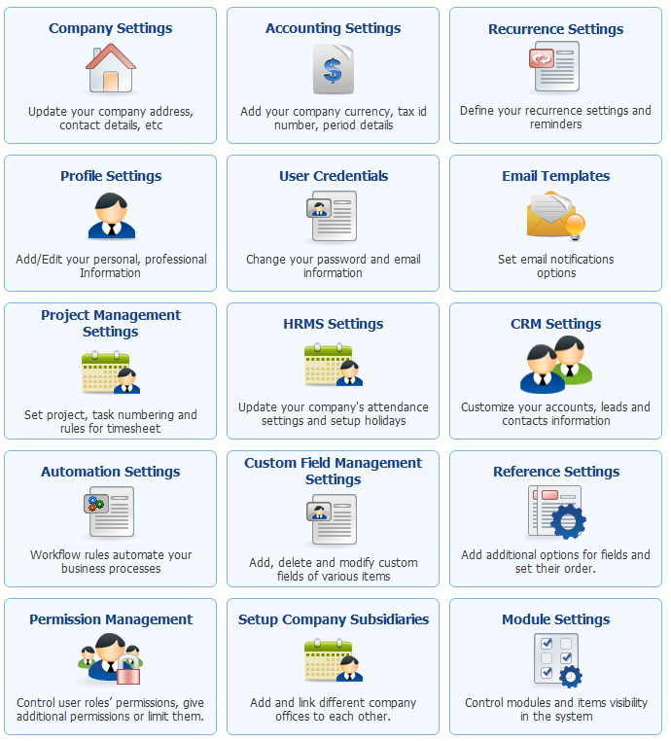
Settings
Set up each company and financial settings
Set up profile and how you should get an email
Custom Fields
Set up each module
Set up workflows
Set up permission levels

Slide 54
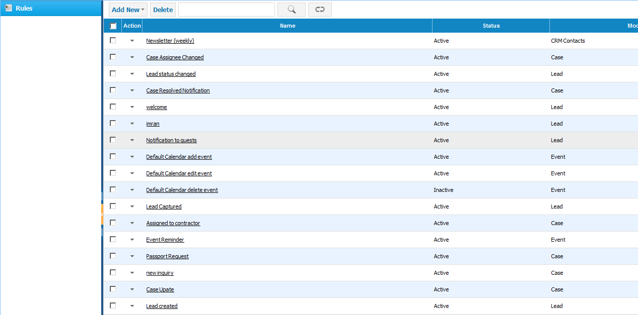
Workflow Automation Settings
Define workflows for certain rules in the system

Slide 55
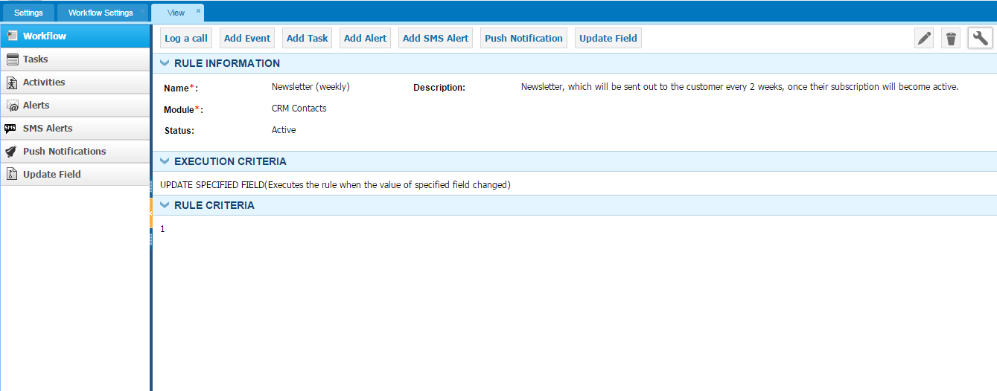
Workflow Automation Settings
Following activities can be triggered when workflow rule is true
Example: send email customer every 2 weeks once the subscription is active

Slide 56
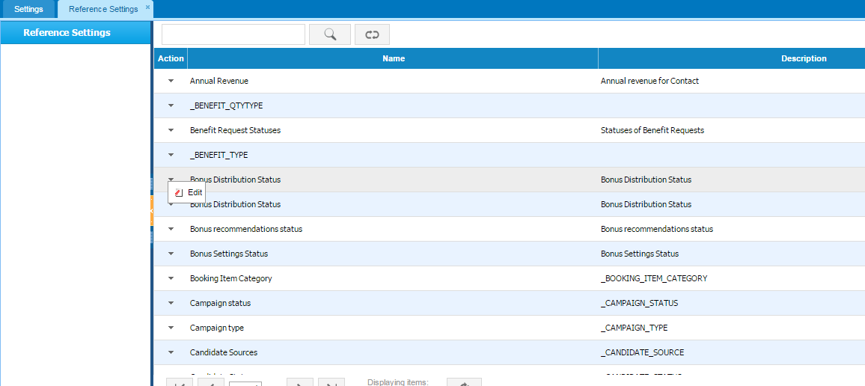
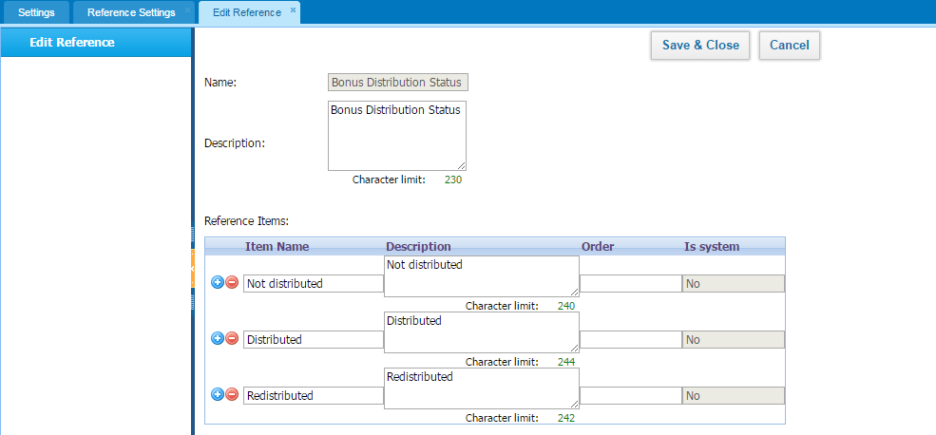
Reference Settings
You can change the default values in our lists

Slide 57
2-Level Workflows
Add Leave Request
Approve Leave Request
Approve Leave Request
2-Level approvals can be easily be enabled
Employee
Manager
Manager-2
Purchase Order Request
Approve Purchase Order
Approve Purchase Order
Employee
Manager
Manager-2
Contact us at support@kpi.com for enabling 2-level approvals for your company

Slide 58
Why kpi.com?

Slide 59



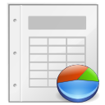

Benefits of kpi.com
By adopting kpi.com, you will be able to enjoy the following benefits:
Lower Operational Costs
Transparency of processes
Ease of Sharing
Improved Customer Service
Better Reporting
Increased Efficiency

Slide 60
Kpi.com is Safe and Secure
Physical security
It is hosted on Amazon cloud
Network security
HTTPS protocol is used to encrypt data
People and processes Employees have no access to customer data

Slide 61
Our backup policy
You can request one of these backups from the beginning of your subscription period
Daily Backups
Weekly Backups
DB Backups
All-time backups
Monthly Backups
You will get this when you decide to quit kpi.com

Slide 62
Our engagement model with clients
How will we work with you?
You will be assigned a relationship manager who will work with you from the beginning
Relationship manager will help you to setup the system and get running until the end of on-boarding period
On-boarding period is typically 3 months, but it can be extended
You will be able to call your own relationship manager any time in case of any issues
When you are fully on boarded, our generic support team will take care of you, but you will have an access to your own relationship manager too.

Slide 63


We Offer Lot’s of Training Materials for Free
Our guidebooks:
Our help center:
Our video trainings:
Project Management overview: http://www.youtube.com/watch?v=_hLNlEVsqho
CRM: http://www.youtube.com/watch?v=2qFEjSawfCU
HR: http://www.youtube.com/watch?v=swYk62gTCwA
Accounting Videos: http://www.youtube.com/playlist?list=PLa7P0Qa2jO2X9tYQ9aVPV4NJ3F4C9sScW

Slide 64


Our Support Team is There For You 24 Hours

Slide 65
















We love our customers and they love us too!
These Companies Trust Kpi.com in Running Their Business:
526+ Active Companies, 3000+ users from partners
12,000,000+ Projects
1,550,452+ Timesheet entries
4,458,263+ Invoice Documents

Slide 66





Signup For a Free Trial
It’s takes less than 60 seconds

