Slide 1

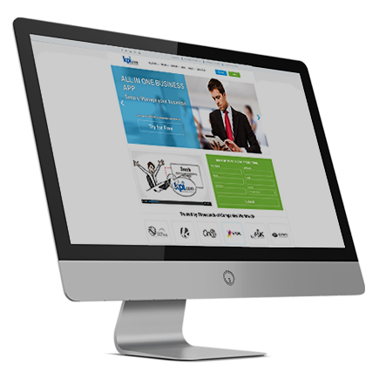
Cloud Accounting and Finance
By: Muz Karabaev, Founder of kpi.com | muz@kpi.com

Slide 2

Introduction

Slide 3

Introduction – who we are
kpi.com – part of Finnet Limited, Software Company Started/Founded in 2005 by Muzaffar Karabaev in London, United Kingdom.
MobileCloud DMCC is a sister company in Dubai, and became GCC Sales and Support Headquarters for kpi.com-Finnet Limited from 2014.
120+ employees spread over three Regions:
Central Asia, GCC (UAE) & UK, Plus our Partner Network (KSA and Oman).
30+ partners/resellers working and providing support for kpi.com in more than 10 Countries. GCC is a major focus NOW

Slide 4
What is kpi.com/Business Management Software?
SME’s Business Processes
Cloud SaaS Software
Ease of Processes
Keep it simple
5 Modules
Single Platform
Built in Workflows
Affordable
With kpi.com you get:
Ease of adoptability
Five core modules in one application
Cloud and Central System
Focus on quality and working method
Multiple layers of support, including trainings and migration

Slide 5
Principles of kpi.com
The kpi.com is built around the following principles:
Cloud Business Management Software
Integrated
Customizable
Kpi.com Reporting Principles
The software should be able to provide the
Financial information quickly
Kpi.com Customer Service Principles
Customers should get full assistance from
support team until they are fully on-boarded.
Easy to Use
Affordable
Kpi.com Upgrading Principles
The cloud business software should provide
automatic regular upgrades for free. For all
customers.
Available on mobile

Slide 6
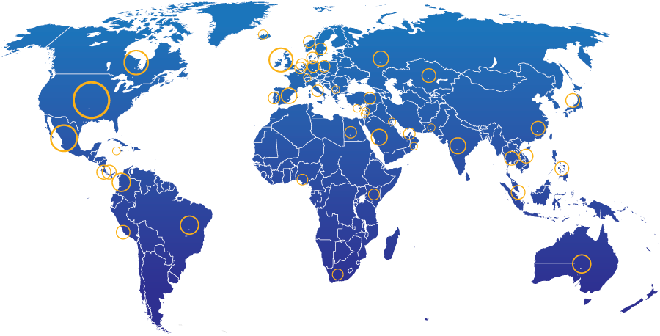
KPI.com: End Users Geographic Spread
28%
North America
21% Other parts of Europe
13%
UK
20%
Middle East
4%
South America
2%
Africa
5%
Australia
Rest of the world – 7%
3000+ Companies, 15000+ User Base and Growing

Slide 7
Kpi.com modules and processes

Slide 8






What is kpi.com software?
It incorporates all key business functions of your business
Payroll
Keep Track of Employees
HRMS
Manage cash/money
Accounting and Finance
Bookkeeping
CRM
Case management
Manage Customers
Inventory Management
Warehouse Management
Keep track of products
Project Management
Produce or Implement
Manufacturing
Sell
Storefront
Sales Force Automation

Slide 9
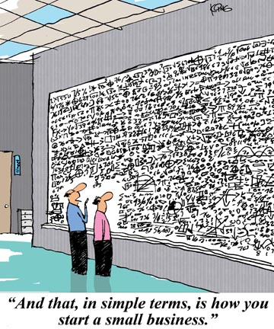

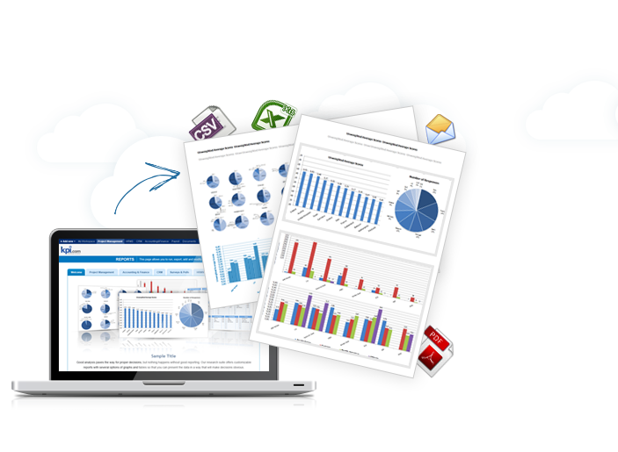
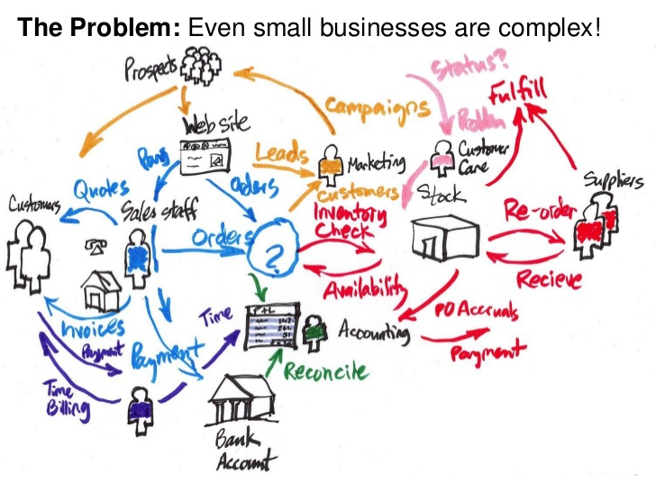
Even a small business is complicated
Kpi.com makes it easy to manage

Slide 10
Accounting and Inventory

Slide 11




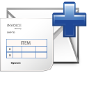



Accounting and Inventory Workflow
The following workflow can be utilized by retailers:
Purchase Order
Receive Goods
Make Payment
Warehousing
Match Payment
w/ Invoice
Request
Purchase Invoice
Approval
Sales Order
Ship Items
Convert to Invoice
Receive Payment
Get from Storefront
Pick
Pack
Ship
Sales Receipt
Statement charges
Handle Returns
Create
Approve
View Reports
Balance Sheet
P&L Statements Sales Reports

Slide 12
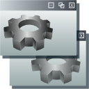
Accounting and Inventory Workflow
Manufacturing industries can utilize the following workflow:
Purchase Order
Receive Goods
Make Payment
Warehousing
Match Payment
w/ Invoice
Request
Purchase Invoice
Approval
Sales Order
Build Assembly
Ship Items
Convert to Invoice
Get from Storefront
Inventory
Product
Warehouse
Pick
Pack
Ship
Handle Returns
Create
Approve
View Reports
Receive Payment
Balance Sheet
P&L Statements Sales Reports
Sales Receipt
Statement charges

Slide 13


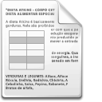


Accounting and Project Workflow
Professional Services Industry:
Timesheet
Timesheet Approval
Project Management
Planned vs. Actual
Task Timer
Task duration
Entries
Create Sales Quote
Timesheet Invoice
Receive Payment
Accounting
Request for Quote
Totals by tasks
Sales Receipt
Statement charges
Totals by employees
Client Approval
Add Project
CRM Won Opportunity
View Reports
Budget and Estimates
Balance Sheet
P&L Statements Sales Reports
Project Details

Slide 14
Invoicing

Slide 15
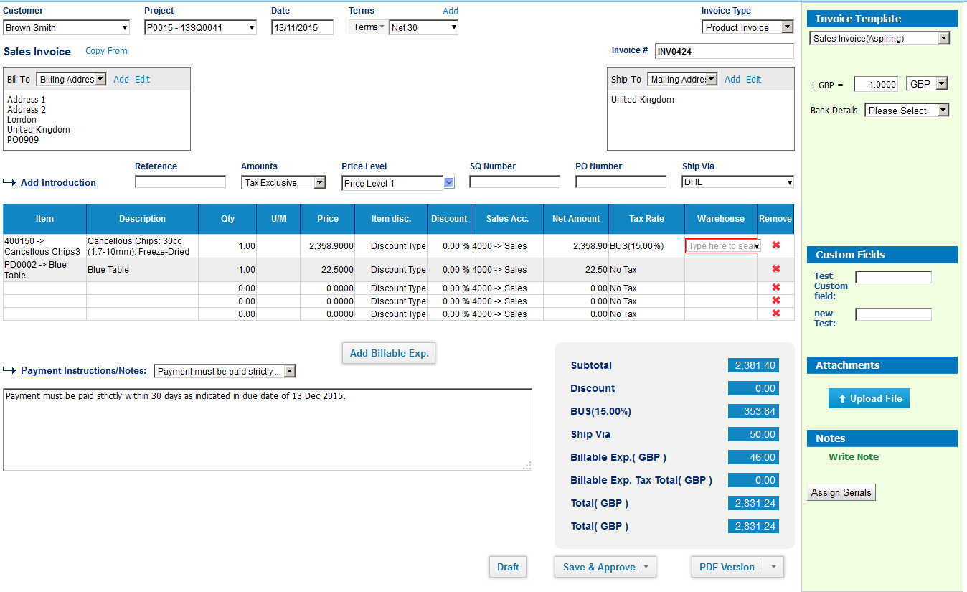
Invoicing
Invoicing features:
Multiple currencies
Custom templates
You can create your own templates
Custom fields
Billable expenses
Product/service types
Recurring invoice
Credit notes

Slide 16
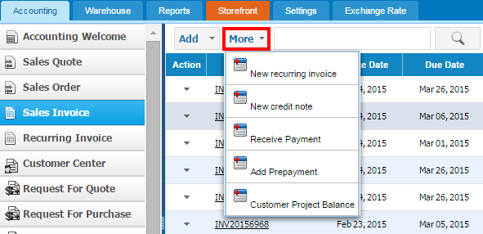

Different types of invoicing
We want to create recurring invoice and credit notes

Slide 17
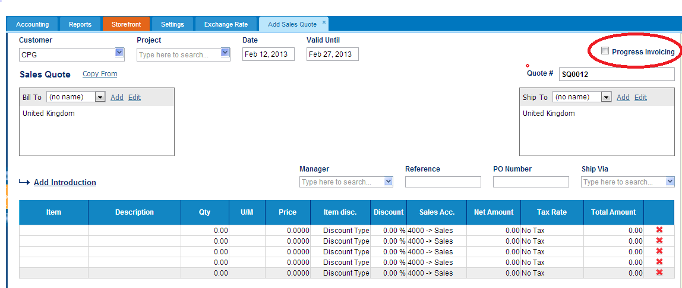
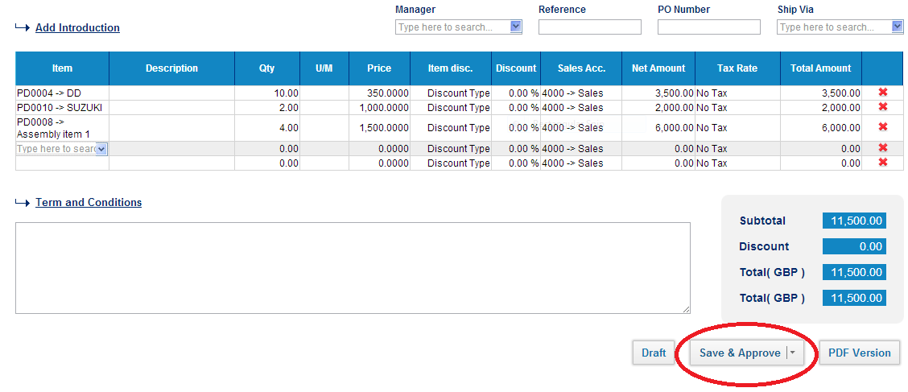
Sales Quotes with Progress Invoicing
We want to charge our customers partially

Slide 18
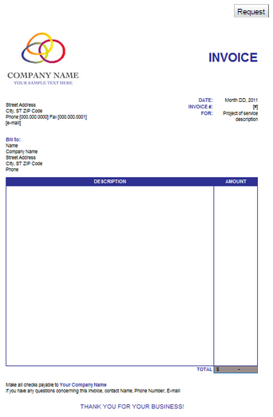
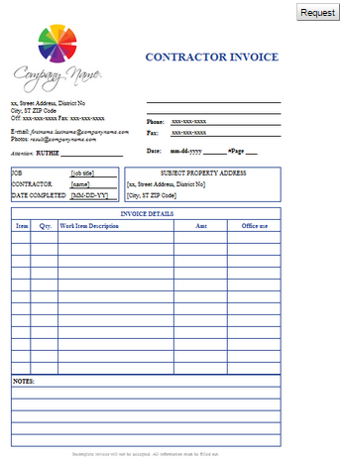
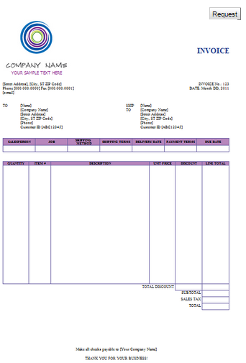
Import your own invoice templates
Invoice documents can be sent as PDF in your own template
Contact us at support@kpi.com for importing your own invoice templates

Slide 19
Purchase Order and Invoice

Slide 20
PO Workflow in kpi.com
Add Purchase Order
Manager Approval
Send PO to Supplier
Receive Goods
Convert to Invoice
Add Purchase Request
Coming Soon
Pay Bills
These steps can be combined and automated

Slide 21
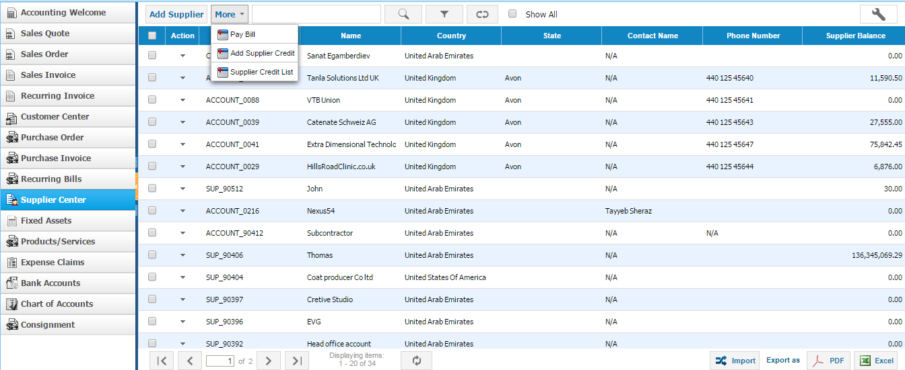
Suppliers center
You can manage your suppliers right here
We need to manage relationships with our suppliers
Manage your suppliers right here
View how much you own the suppliers

Slide 22
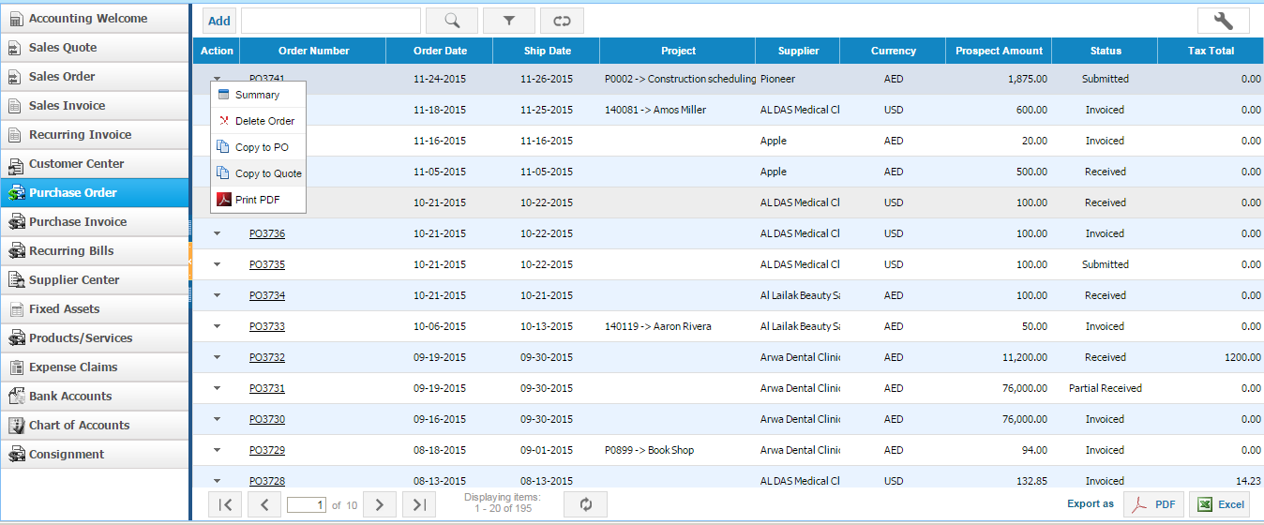
Purchase Orders
Purchase order listing shows active purchase orders
You can copy PO details to a Sales Quote
Manage your suppliers right here

Slide 23
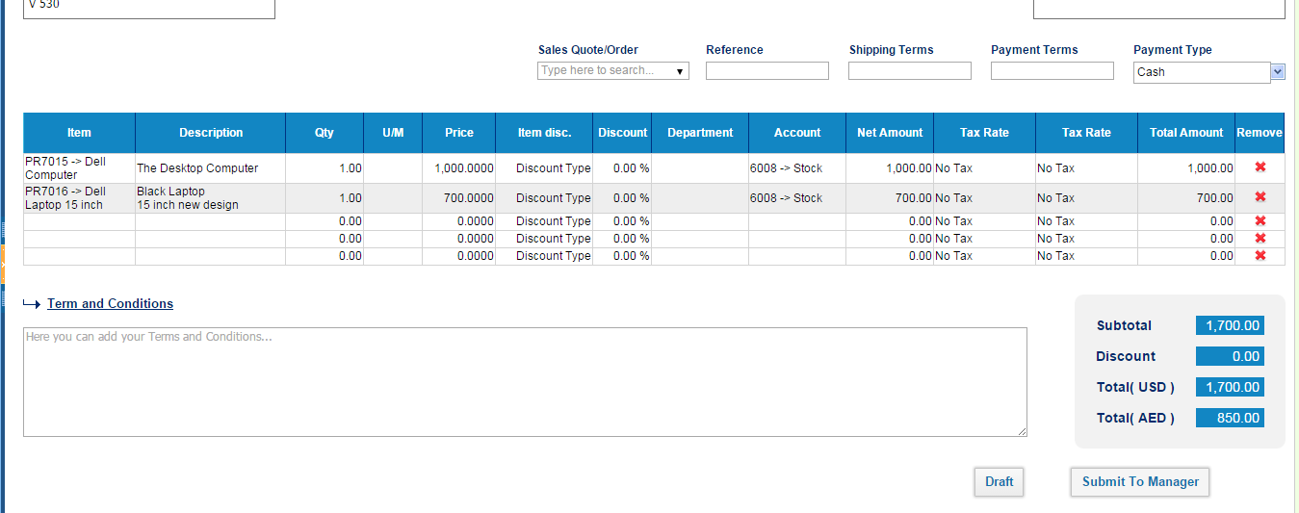
Add New Purchase Order

Slide 24
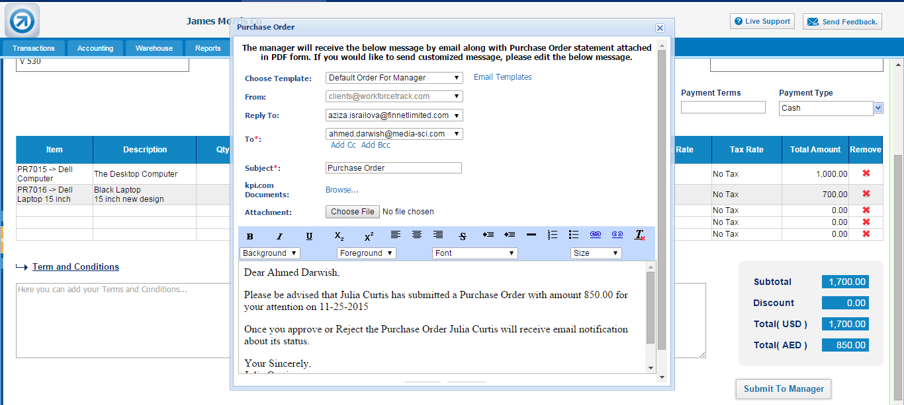
Add New Purchase Order
We email purchase orders to our suppliers

Slide 25
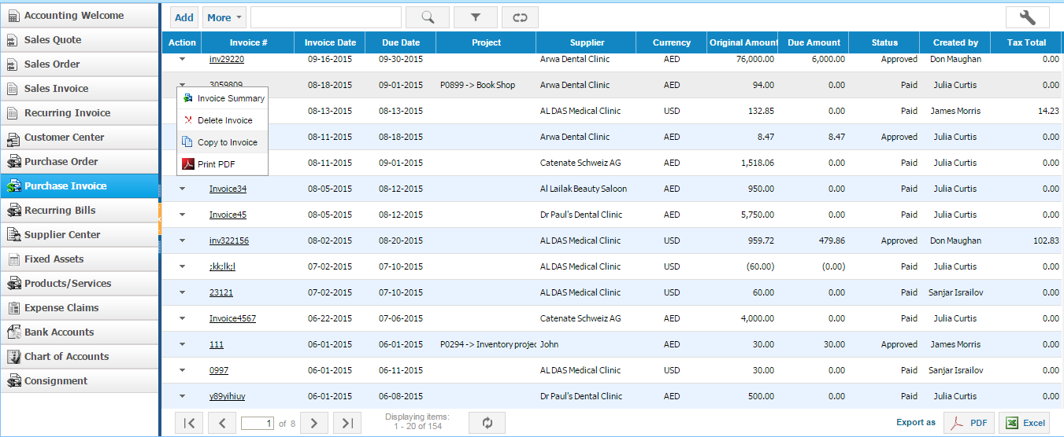
Purchase Invoice Listing
Purchase invoice listing shows active purchase invoices
Manage your suppliers right here

Slide 26
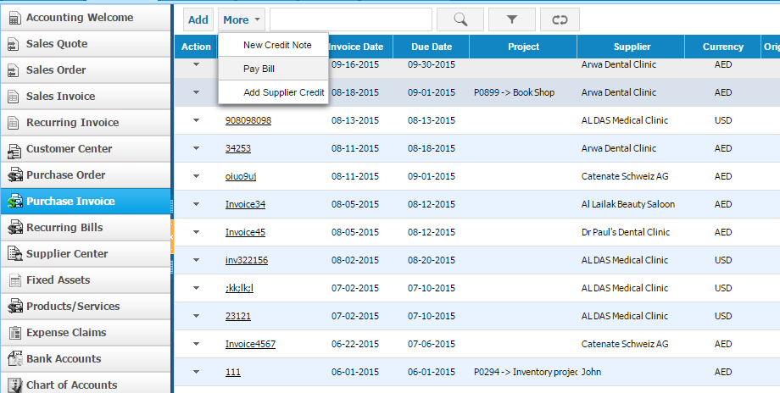
Purchase Invoice Listing
Pay your purchase bill

Slide 27
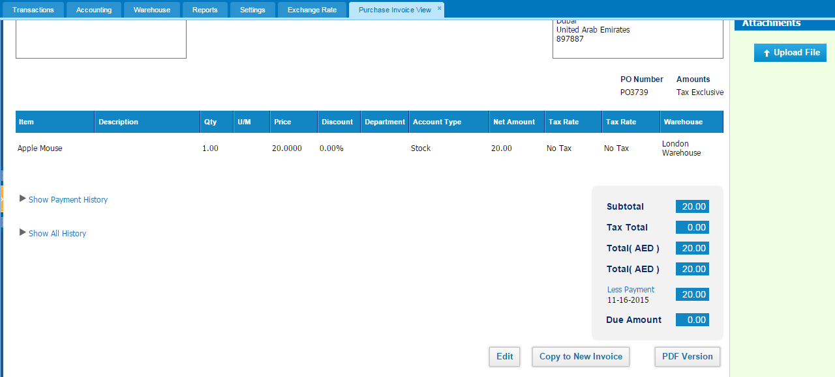
View Purchase Invoice

Slide 28
Sales Quote and Sales Orders

Slide 29
Sales Quote and Sales Order Workflow in kpi.com
Convert to Invoice
Add Sales Quote
Manager Approval
Send Sales Quote to Client
Client Approval
Convert to Sales Order
Request for Quote
These steps can be combined and automated
via Workflow Settings

Slide 30
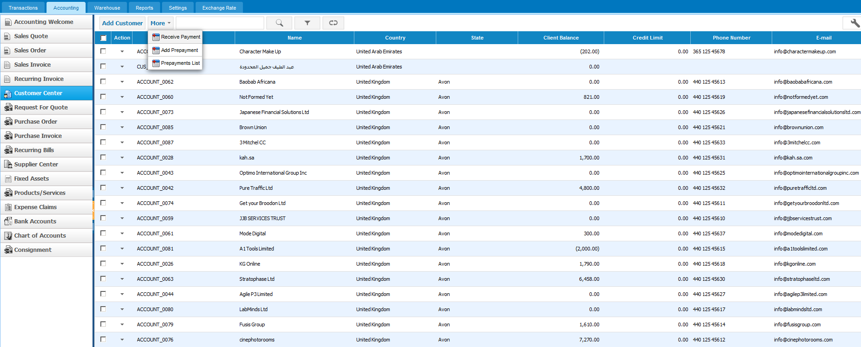
Customer center
You can manage your customers and view their balance
View how much you your customers owe you

Slide 31
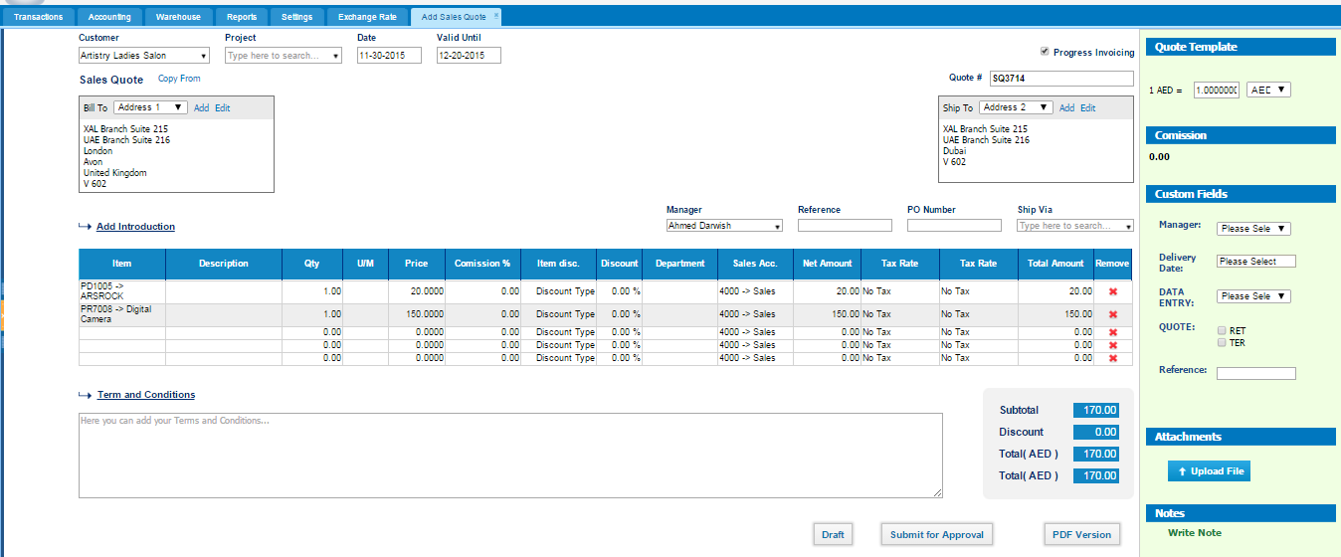
Sales Quotes
Add sales quote and submit for approval
Enabling progress invoicing allows partial step by step payments
View how much you your customers owe you

Slide 32
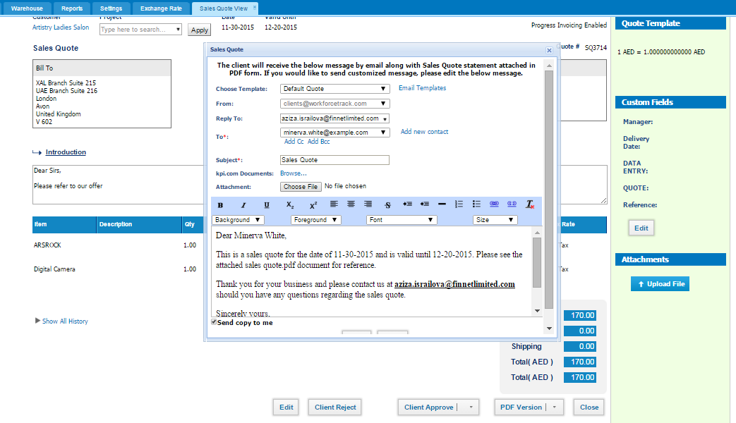
Approve and Send Sales Quote to Client
Send sales quote for client approval directly in the system

Slide 33
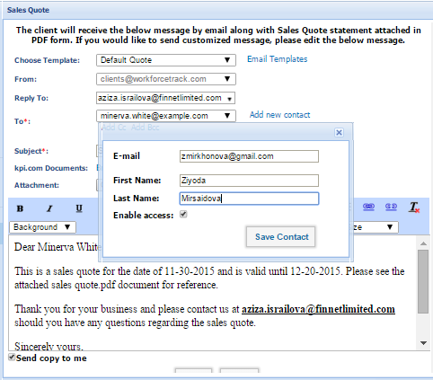
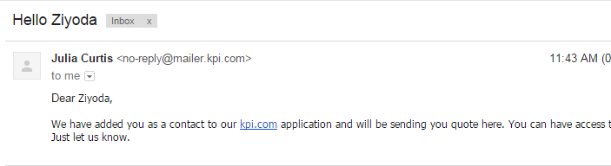
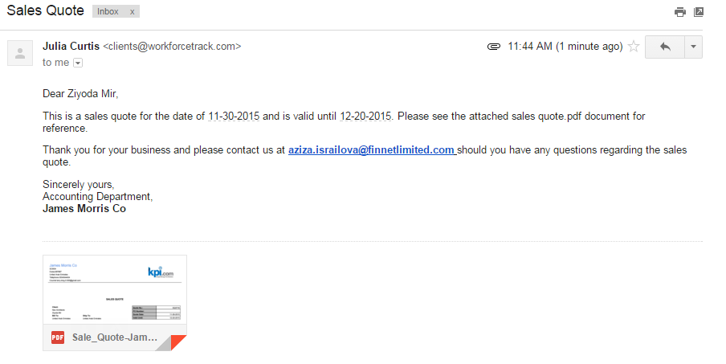
Client Approval
Clients can login to kpi.com and approve a sales quote:
1
Enable access to clients
2
Client receives email notification

Slide 34
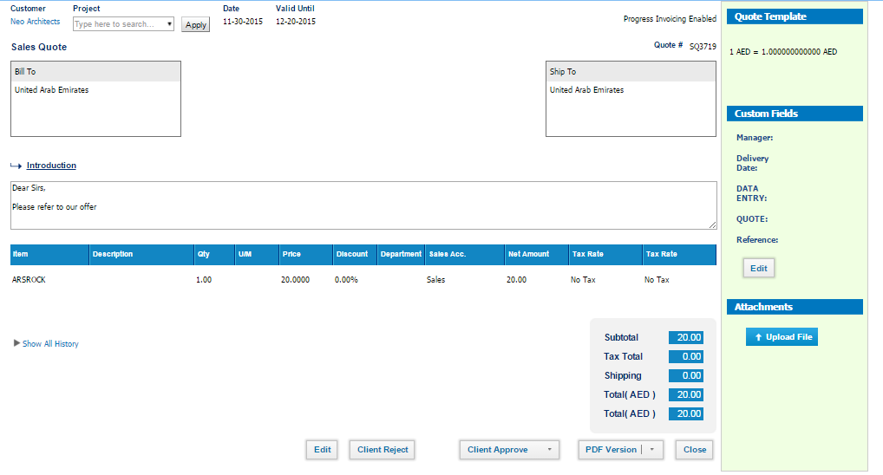
Client Login
Client logins and approves the sales quote or rejects it
2
Client login and approval

Slide 35
Sales Orders

Slide 36
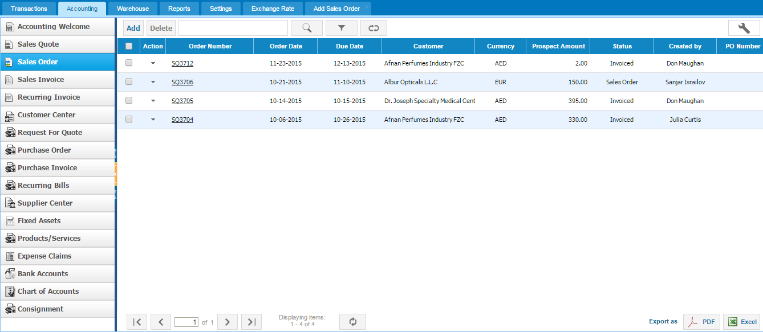

Sales Orders
Sales orders are used for Storefront and Inventory Management

Slide 37
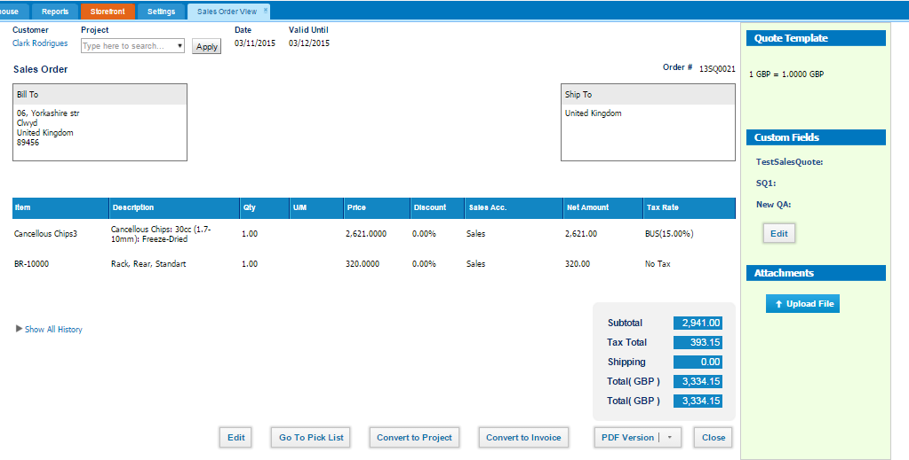
Sales Order View
Pick Pack and Ship for Inventory

Slide 38
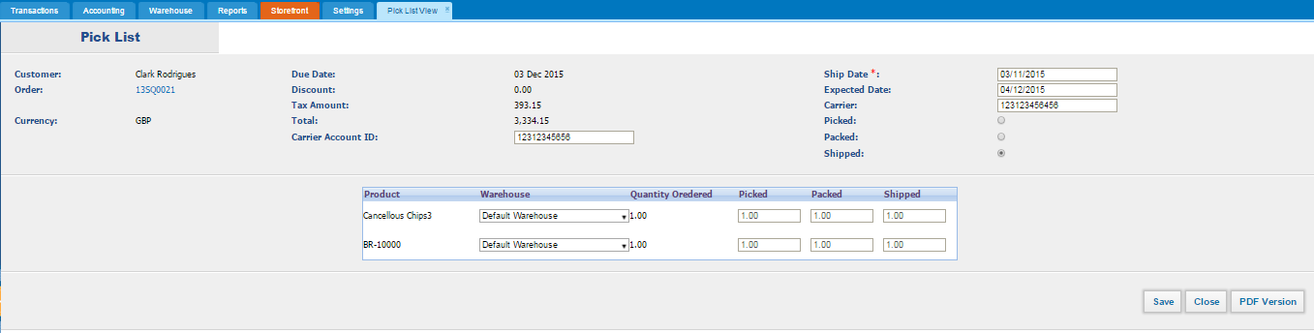
Pick List View
Pick Pack and Ship Items in Sales Quote

Slide 39
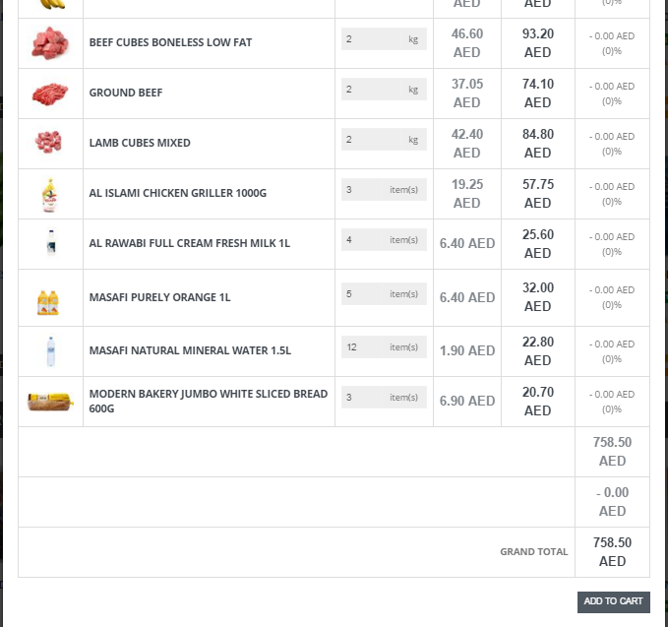
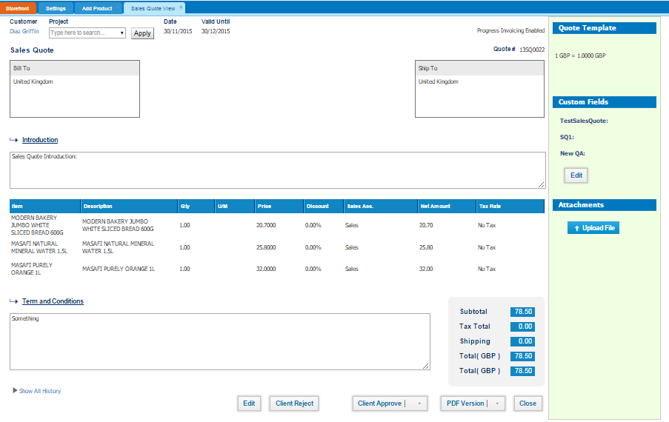
Storefront – Sales Orders
Shopping cart items automatically appear as sales order

Slide 40
Fixed Asset Management

Slide 41
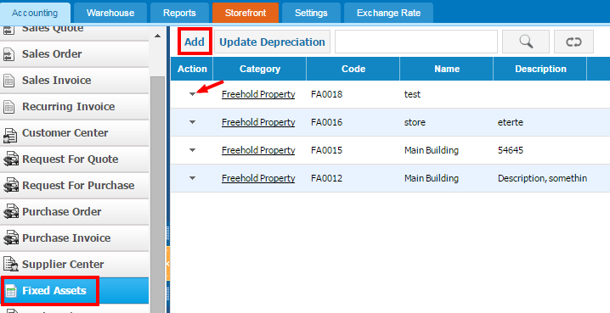
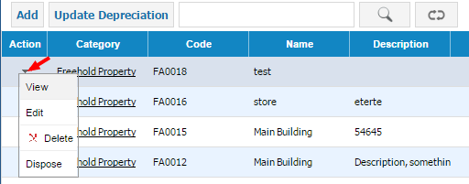
Fixed Assets
You can manage your fixed assets and apply straight line method of depreciation

Slide 42
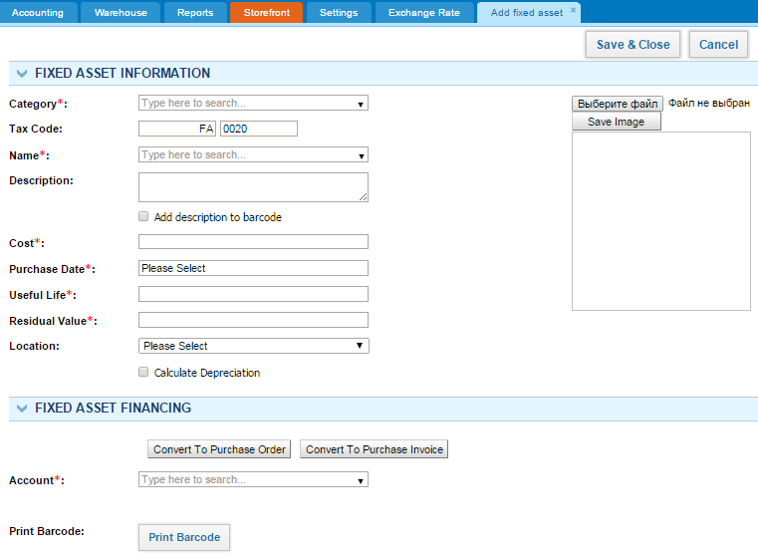
Add Fixed Asset
Through this link you can add this fixed asset to purchase order or invoice form.

Slide 43
Inventory Management

Slide 44






Why kpi.com Inventory Management?
Our Inventory Management Software Has a Number of Benefits:
Faster Shipping
Lower Amount of Returns
Transparent Tracking
Improved Customer Service
Automatic Bookkeeping
Availability on Mobile

Slide 45
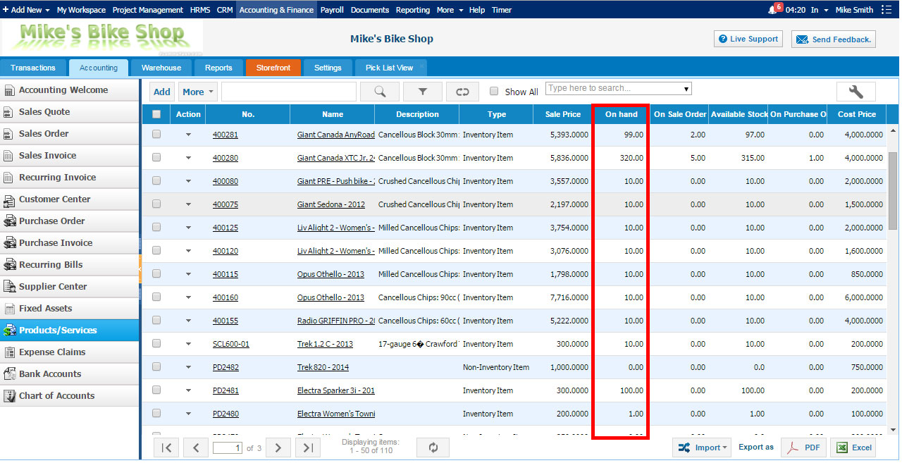
Let’s start with the basics
Know how much stock is available in real time

Slide 46
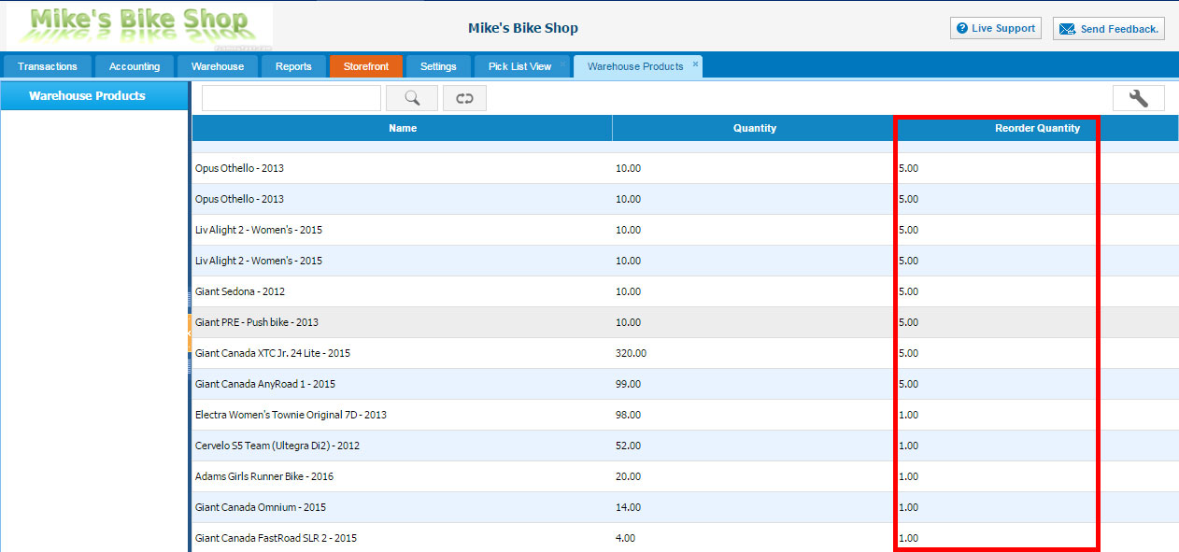
Don’t be afraid of shortage
If you setup reorder quantities, the system will automatically order the product when you are running short of item
You will not be left without any stock

Slide 47
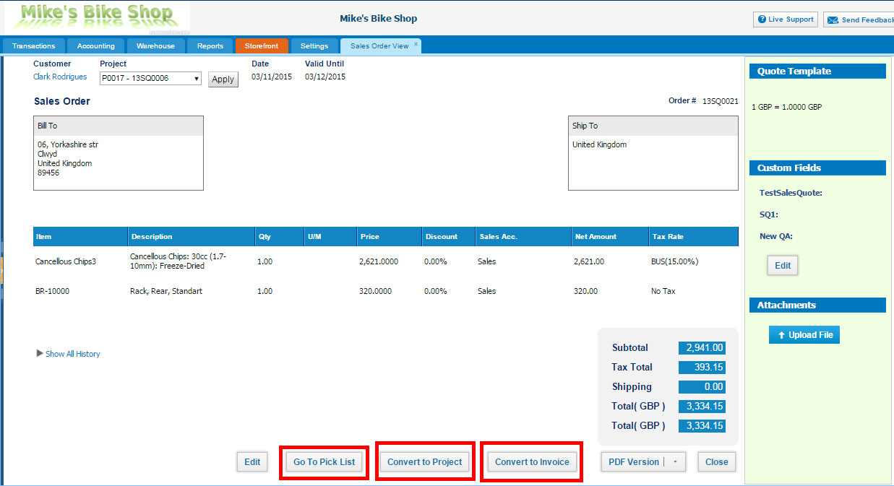
Easily Manage Sales Orders
You can create projects from sales orders
Go to pick list in order to mark items as shipped
One click does it all for you

Slide 48
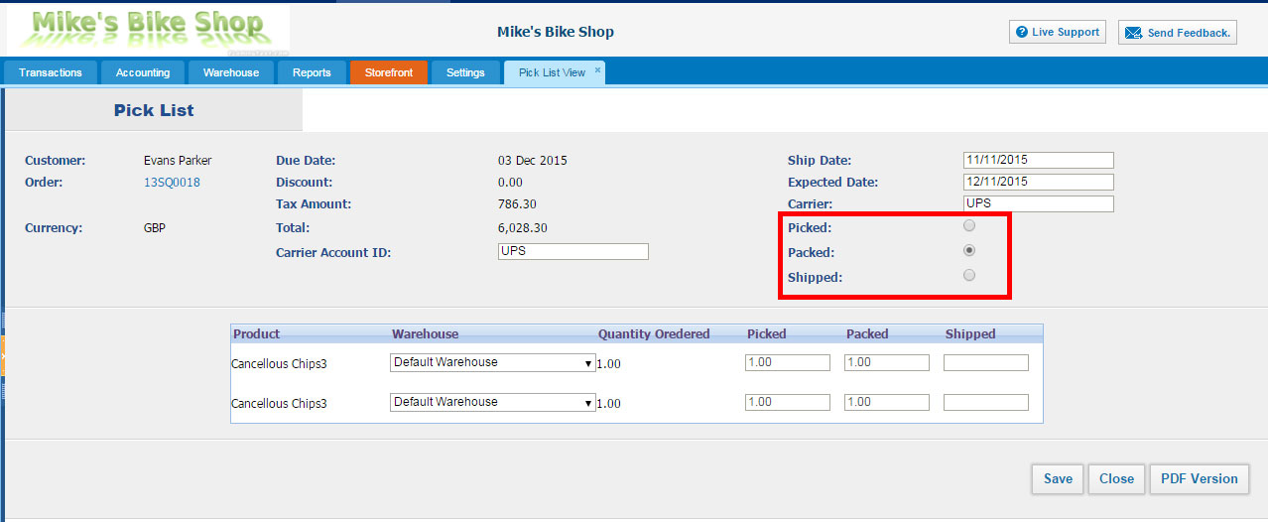
Streamline Your Operations
Pick, pack and ship inventory items

Slide 49
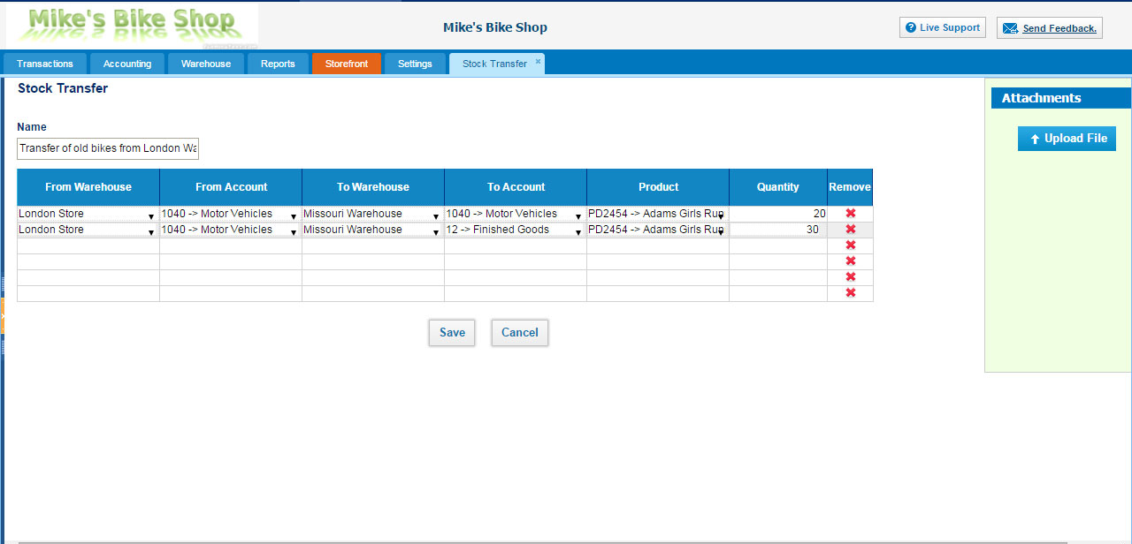
Transfer Stock Between the Warehouses

Slide 50
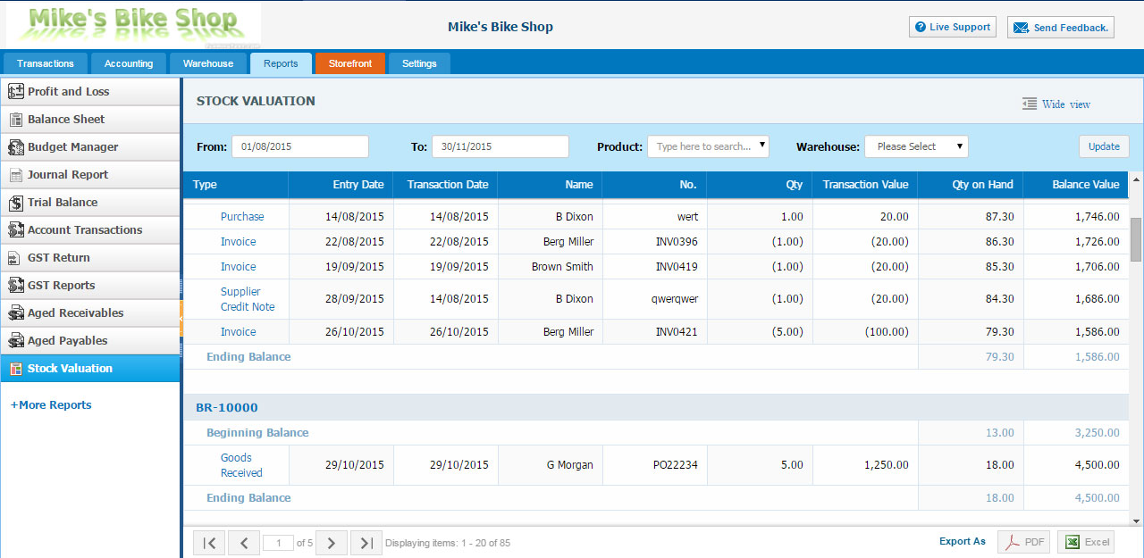
Make Better Decisions
View the current value of products

Slide 51
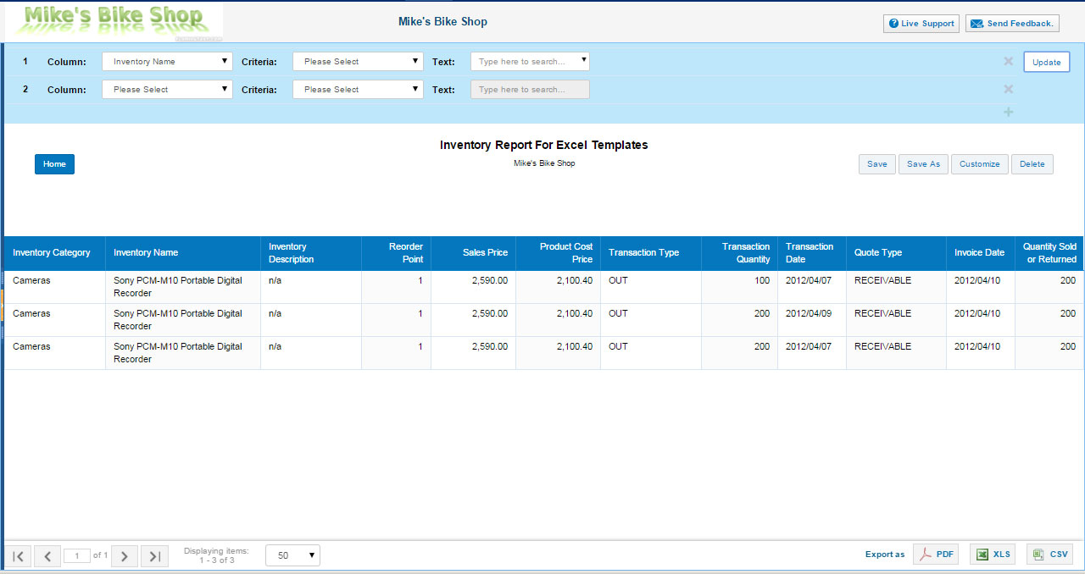
Stay Flexible As You Grow
Create custom reports and add them to your favorites

Slide 52
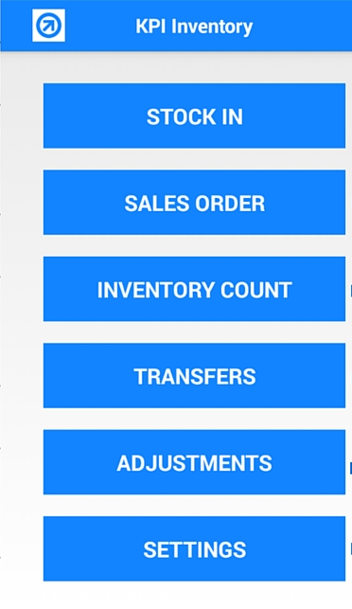
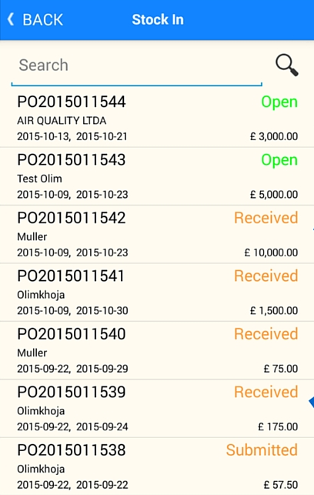
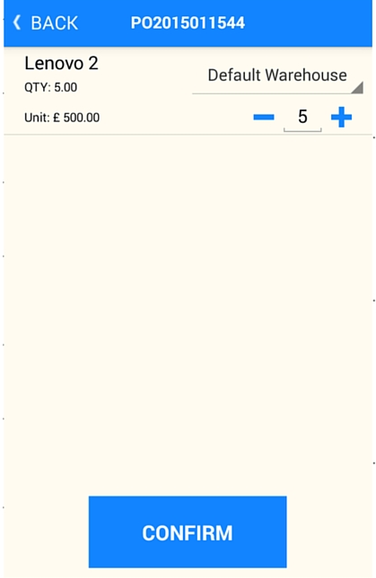
You can manage your inventory in a mobile app

Slide 53
Bookkeeping and Reports

Slide 54
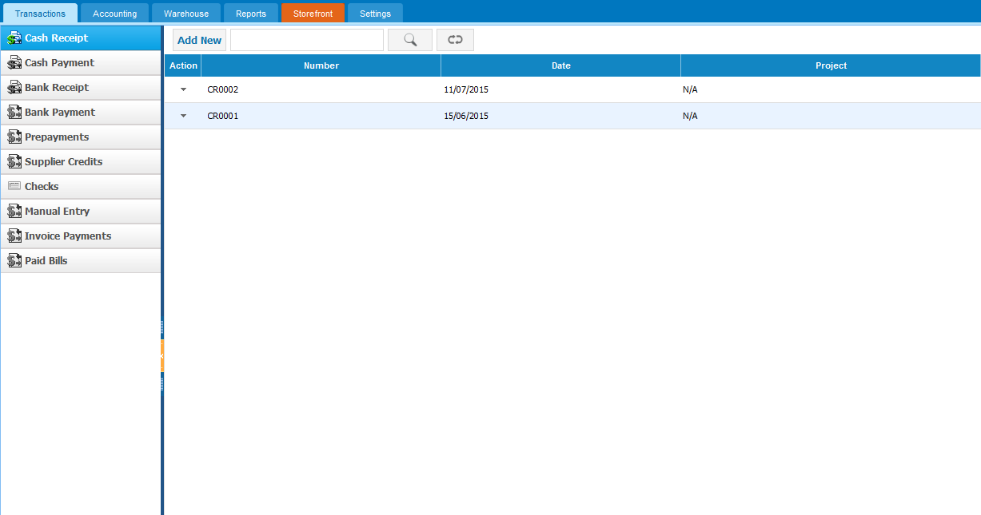
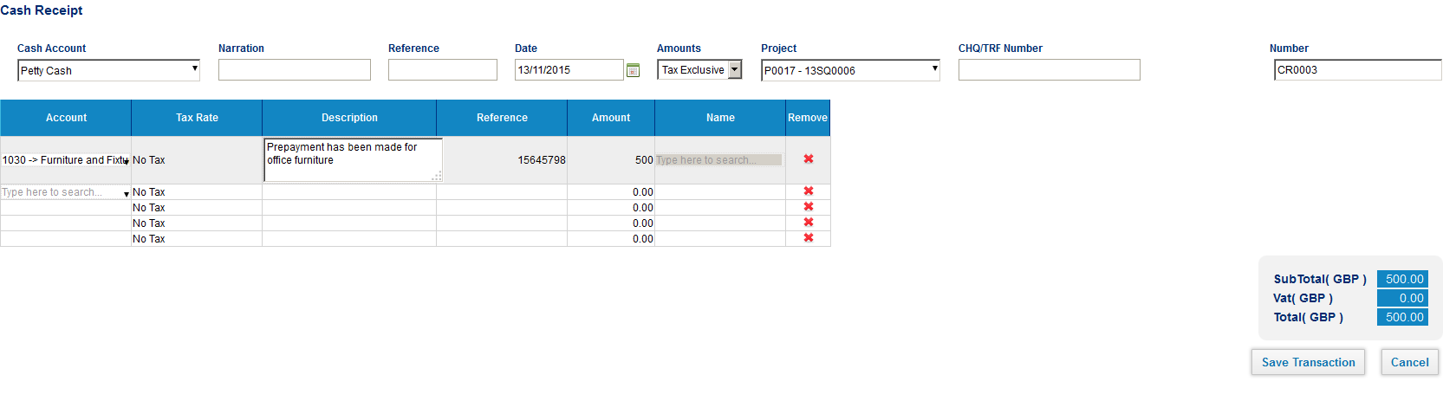
Accounting and Bookkeeping
You can create other accounting transactions

Slide 55
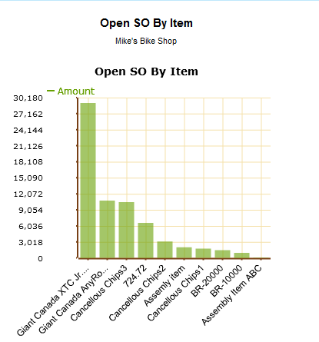


Sales charts
You can analyze your top customers and products

Slide 56


View Accounting Reports
You can provide access to your accountants or advisors to analyze the figures

Slide 57
Reporting

Slide 58





Introduction to reporting tool
You can analyze the company performance with reporting tool.
Custom Reports
Excel Templates
Charts and Dashboards
Advanced Formulas
Watch on You-tube:
https://youtu.be/u7tx4rwkalM

Slide 59

Reporting Home
Setup your favorite reports for easy access
Create your own report
Default reports

Slide 60

Create your own report
1. Choose Report Template
2. Customize Report

Slide 61

Create your own report
Choose report style: tabular/summary

Slide 62

Create your own report
Choose grouping type:

Slide 63

Create your own report
Choose columns:

Slide 64

Create your own report
Select summaries:

Slide 65

Create your own report
Select the chart type:

Slide 66


Create your own report
Report is created:

Slide 67

Excel Templates
After customizing Report, NCO were able to design complex reports in a simple way, by themselves. The ability to export in Excel format let them modify the pieces of information of their reports according to sales situations, as well as improve the visual appearance

Slide 68

Excel Templates
One of our clients – NetCorp Optima (NCO) project managers of which wanted, while leading a project, to get answers to questions such as: What is the current status of the project?, How is the project going?, What are the important issues we should worry about?

Slide 69
Add-Ons

Slide 70



Kpi.com Plugins
There are a number of add-ons which you can enable:
Storefront
Excel Plugin

Slide 71

Storefront Management Plug-in
LeBazar.ae – Our customer who built storefront in kpi.com
Manage products inside
Kpi.com

Slide 72

Storefront Management Plug-in
LeBazar.ae – Our customer who built storefront in kpi.com
Manage products inside
Kpi.com
All storefront purchases are
processed from accounting (sales orders)

Slide 73


Consignment add-on
You can send items to your clients or subsidiaries for consignment
Your clients/customers will appear here
When your subsidiaries the sales of consignment items trigger bookkeeping transactions automatically

Slide 74
Need more?
You can customize kpi.com under your own requirements:
Invoice
Settings
Your own functionality/feature
Your own tabs/fields/entities
Your own rules
Colors
Logo
Level 3
Workflows, tabs, sharing
Hide/Add additional tabs
Workflow rules/reminders
Custom sharing/access controls
Level 2
Rules
Custom Fields,
2-level Workflows
Colors/Logo/Templates
Level 1
Workflow
Section 1
Feature 1
Feature 2
Core kpi.com

Slide 75

Settings
Set up each company and financial settings
Set up profile and how you should get an email
Custom Fields
Set up each module
Set up workflows
Set up permission levels

Slide 76

Workflow Automation Settings
Define workflows for certain rules in the system

Slide 77

Workflow Automation Settings
Following activities can be triggered when workflow rule is true
Example: send email customer every 2 weeks once the subscription is active

Slide 78


Reference Settings
You can change the default values in our lists

Slide 79
2-Level Workflows
Add Leave Request
Approve Leave Request
Approve Leave Request
2-Level approvals can be easily be enabled
Employee
Manager
Manager-2
Purchase Order Request
Approve Purchase Order
Approve Purchase Order
Employee
Manager
Manager-2
Contact us at support@kpi.com for enabling 2-level approvals for your company

Slide 80
Why kpi.com?

Slide 81




Benefits of kpi.com
By adopting kpi.com, you will be able to enjoy the following benefits:
Lower Operational Costs
Transparency of processes
Ease of Sharing
Improved Customer Service
Better Reporting
Increased Efficiency

Slide 82
Kpi.com is Safe and Secure
Physical security
It is hosted on Amazon cloud
Network security
HTTPS protocol is used to encrypt data
People and processes Employees have no access to customer data

Slide 83
Our backup policy
You can request one of these backups from the beginning of your subscription period
Daily Backups
Weekly Backups
DB Backups
All-time backups
Monthly Backups
You will get this when you decide to quit kpi.com

Slide 84
Our engagement model with clients
How will we work with you?
You will be assigned a relationship manager who will work with you from the beginning
Relationship manager will help you to setup the system and get running until the end of on-boarding period
On-boarding period is typically 3 months, but it can be extended
You will be able to call your own relationship manager any time in case of any issues
When you are fully on boarded, our generic support team will take care of you, but you will have an access to your own relationship manager too.

Slide 85


We Offer Lot’s of Training Materials for Free
Our guidebooks:
Our help center:
Our video trainings:
Project Management overview: http://www.youtube.com/watch?v=_hLNlEVsqho
CRM: http://www.youtube.com/watch?v=2qFEjSawfCU
HR: http://www.youtube.com/watch?v=swYk62gTCwA
Accounting Videos: http://www.youtube.com/playlist?list=PLa7P0Qa2jO2X9tYQ9aVPV4NJ3F4C9sScW

Slide 86


Our Support Team is There For You 24 Hours

Slide 87














We love our customers and they love us too!
These Companies Trust Kpi.com in Running Their Business:
526+ Active Companies, 3000+ users from partners
12,000,000+ Projects
1,550,452+ Timesheet entries
4,458,263+ Invoice Documents

Slide 88





Signup For a Free Trial
It’s takes less than 60 seconds

